Slide 1

A skilling initiative for the industry, reassuring the consumer and benefitting the jeweler.

Slide 2

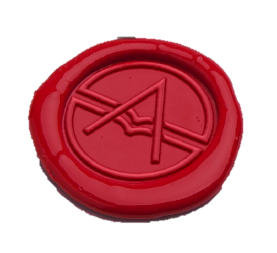
A joint venture between World Gold Council and MMTC-PAMP
A not for profit company, industry driven body, with the principal objective of:
Providing training and certification in field of assaying,
Standardization and promoting best practices for gold and precious metals Industry.
Provide learning opportunities -acquiring new techniques and upgrading analytical skills

Slide 3
The institute will be supported by an industry-nominated Steering Committee.
Government Partners ( OBSERVERS)
Assay Technology Syllabus Partners
Bureau of Indian Standards (BIS)
National Accreditation Board for Testing and Calibration Laboratories (NABL)
Indian Institute of Technology, Bombay (IIT, Bombay)
College of Engineering, Pune (COEP)
Others leaders in industry
Industry Partners
Indian Bullion and Jewellery Association
Gems and Jewellery Export Promotion Council
Bullion Federation of India
Gems & Jewellery Council
Indian Association of Hallmarking Centres
Association of Gold Refiners and Mints

Slide 4
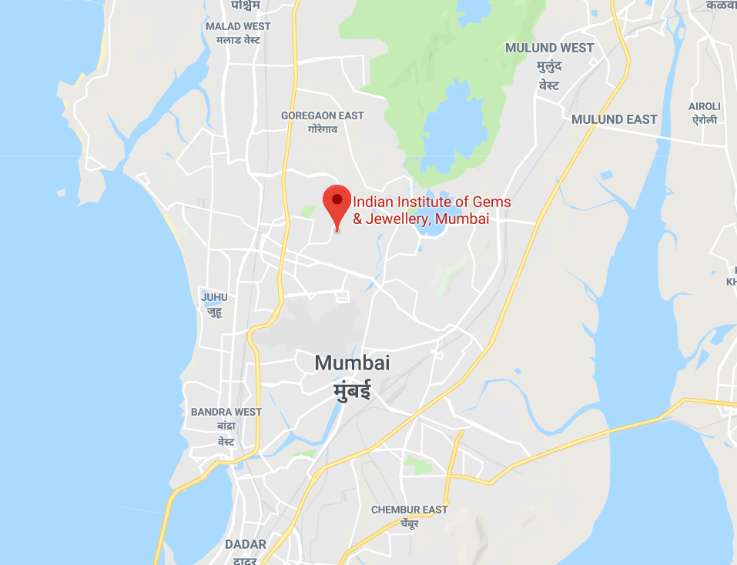
Location
PMATI MUMBAI
Indian Institute of Gems and Jewellery
Bagmal Laxmichand Parikh Campus,
Plot No. 111/2,13th Road,
M.I.D.C., Andheri (E),
Mumbai - 400 093, India.

Slide 5


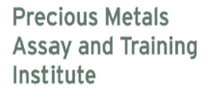
Programs Offered
  Basic (Module 1) Certificate Course – 30 days
  Module 2 Certificate Course – 60 days
  Advanced (Module 3) Certificate Course – 90 days

Slide 6
Basic (Module 1) Certification Course Details
1st Week
Introduction-Metallurgy & Minerals
Laboratory Working Methods & Practices
Touch Acid Testing-Basic Introduction
Analytical Weighing Balance
30
Foundation
CERTIFICATION
COURSE
2nd Week
XRF – Basic Theory & operations
Sampling-Theory & Practice
✓ Fusion application in assaying
Health & Safety Consideration
Waste management
DAYS
Basic
Theoretical Classes : 12 Days
Practical Classes : 12 Days
✓ Analysis of Gold by Fire Assay
Method
Impact of elemental composition
Preparation and calculations
Best practices
Expertise
3rd Week
WHO CAN APPLY
✓ Prospective Students
Part Time Students
Business & Industry
International Students
Source of Error
Homogeneity
Hall Marking Regulations-Introduction
Theoretical Assessment
Practical Assessment
4th Week
Assessment

Slide 7
Basic (Module 1) Course content :
 |  | Allocated Marks |  | Allocated Time Days
 | Module Content | Theory | Practice | Theory | Practice
1 | Introduction to Basic Chemistry of Metal & Alloys with special reference to Precious Metals and safety Introduction, Laboratory Working Methods & Practices ,Metallurgy & Minerals ,Health & Safety, Touch Acid Testing-Basic Introduction, Analytical Weighing Balance | 50 | 75 | 2 | 2
2 | XRF ,Precious metal Sampling XRF – Basic Theory & operations, Sampling Theory & Practice, Fusion application in assaying, Health & Safety Consideration, Waste management . | 50 | 75 | 3 | 3
3 | Gold Analysis by Fire Assay Analysis of Gold by Fire Assay, Method,Machine Handling ,Sources of Error , Impact of elemental composition, Preparation and calculations, Best practices. | 50 | 100 | 4 | 4
4 | Hall Mark Regulations & Assessment Source of Error, Homogeneity, Hall Marking Regulations-Introduction, Assessment | 50 | 50 | 3 | 3
 | TOTAL | 200 | 300 | 12 days | 12 Days
Note : At the end of the course there will be a full assessment to ensure students are competent to be certified as a Qualified Assayer

Slide 8
Module 2 Certification Course Details
1st Sem
✓ Laboratory Working Methods & Practices
✓ Basic Concepts of Chemistry
Sampling Theory & Practice
Minerals & Metallurgy
✓ MSDS ,Health & Safety Consideration
60
Foundation
CERTIFICATION
COURSE
2nd Sem
✓ X Ray Fluorescence - Theory
✓ Machine Handling -Operations
Determining Composition by XRF
Calibration Technique
Sources of Error
DAYS
Basic
Theoretical Classes : 22 Days
Practical Classes : 25 Days
Fusion application in assaying
Analysis of Gold by Fire Assay
Impact of elemental composition
Preparation and calculations
✓ Best practices ,homogeneity
Expertise
3rd Sem
WHO CAN APPLY
✓ Prospective Students
Part Time Students
Business & Industry
International Students
Silver Assaying
Methods for Potentiometric & Gravimetric
Accreditation & Certification
Theoretical Assessment
Practical Assessment
4th Sem
Assessment

Slide 9
Module 2 Course content
 |  | Allocated Marks |  | Allocated Time Days
 | Module Content | Theory | Practice | Theory | Practice
1 | Introduction to Basic Chemistry of Metal & Alloys with special reference to Precious Metals and safety Laboratory Working Methods & Practices ,Basic Concepts of Chemistry ,Accuracy & Precision ,Metallurgy & Minerals , MSDS, Sampling Theory & Practice, Health & Safety | 50 | 50 | 3 | 4
2 | X-Ray Fluorescence for Precious metal Assaying XRF – Basic Theory & operations, Sampling Theory & Practice, Determining Composition by XRF, Calibration Technique ,Sources of Error | 50 | 50 | 6 | 6
3 | Gold Analysis by Fire Assay Analysis of Gold by Fire Assay, Method, Machine Handling ,Sources of Error , Impact of elemental composition, Preparation and calculations, Best practices | 100 | 150 | 8 | 10
4 | Silver Assaying ,Accreditation, certification Silver Assaying, Methods for Potentiometric & Gravimetric analysis ,Accreditation, Quality Control & Assurance ,Certification, Communication skills | 50 | 50 | 5 | 5
 | TOTAL | 250 | 300 | 22 days | 25 Days
Note : At the end of the course there will be a full assessment to ensure students are competent to be certified as a Qualified Assayer

Slide 10
Advanced (Module 3) Certification Course Details
1st Sem
✓ Laboratory Working Methods & Practices
✓ Basic Chemistry ,Accuracy & Precision
✓ Sampling Theory & Practice
✓ Touch acid method
90
CERTIFICATION
COURSE
2nd Sem
✓ X Ray Fluorescence - Theory
Machine Handling –Operations
Determining Composition by XRF
Silver Assaying
Gravimetric & Potentiometric set up
DAYS
Theoretical Classes : 35 Days
Practical Classes : 39 Days
Analysis of gold & Silver : Fire Assay
Gravi-metric & Volumetric Analysis
Sampling Preparation ,Homogeneity
Parting Analysis Calculation
Sources of Error
3rd Sem
WHO CAN APPLY
✓ Prospective Students
Part Time Students
Business & Industry
International Students
Introduction to Spectroscopic technics
Introduction to ICP, Spark and others
Communication and presenting skills
Accreditation &QC,QA & Certification
Theoretical & Practical Assessment
4th Sem

Slide 11
Advanced (Module 3) Course content
 |  | Allocated Marks |  | Allocated Time Days
 | Module Content | Theory | Practice | Theory | Practice
1 | Introduction to Basic Chemistry with reference to Precious Metals and safety Laboratory Working Methods & Practices ,Basic Concepts of Chemistry ,Accuracy & Precision ,Metallurgy & Minerals , touch acid method, MSDS, Sampling theory | 50 | 50 | 5 | 6
2 | Precious metal assaying, XRF Fusion application, Weighing Balance. X Ray Fluorescence ,Machine Handling , Determining Composition by XRF Calibration ,Sources of Error ,silver assaying , | 100 | 150 | 5 | 8
3 | Fire Assay Gravimetric-Volumetric analysis, Potentiometric titration-principles, titration methods & data management, Factors affecting accuracy & precision, Parting Analysis Calculations. | 100 | 150 | 13 | 15
4 | Spectroscopy & Accreditation/certification, Quality Control & assurance, Statistics Basic principles involved in atomic and emission spectroscopy ,Error Calculations Instrument Calibration ,Accreditation, Quality Control & Assurance , Certification , Theoretical Assessment Practical Assessment | 50 | 50 | 10 | 10
 | TOTAL | 300 | 400 | 33 days | 39 Days

Slide 12
A skilling initiative for the industry, reassuring the consumer and benefitting the jeweler.

