Slide 1

August 2018
Cameron Alexander, Director Metals Demand Asia, GFMS
Notes:
We don’t have a lot of time but I wanted to quickly run through a few key slides.
Firstly to quickly review where we have been and where think we might be heading.

Slide 2
WORLD SILVER SUPPLY AND DEMAND
Tonnes |  | 2013 | 2014 | 2015 |  | 2016 | 2017 | Market share | % ∆ - 2016 | % ∆ - 2013
Mine Production |  | 25,607 | 26,993 | 27,841 |  | 27,638 | 26,502 |  | -4% | 3%
Total Supply |  | 30,712 | 32,659 | 32,472 |  | 31,396 | 30,843 |  | -2% | 0%
Jewellery & Silverware |  | 6,862 | 7,041 | 7,050 |  | 6,376 | 6,503 | 26% | 4% | -4%
Coins & Bars |  | 7,500 | 7,281 | 9,086 |  | 6,462 | 4,699 | 15% | -27% | -37%
Industrial Fabrication |  | 18,804 | 18,548 | 18,141 |  | 17,942 | 18,632 | 59% | 4% | -1%
Physical Demand |  | 35,010 | 34,773 | 36,244 |  | 32,408 | 31,652 |  | -2% | -10%
Physical Surplus/ Deficit |  | -4,298 (12%) | -2,114 (6%) | -3,772 (10%) |  | -1,012 (3%) | -810 (3%)
Annual Average Silver Price US$/oz |  | 23.79 | 19.08 | 15.68 |  | 17.14 | 17.05 |  | -1% | -28%
Notes:
Looking here at the Main Supply and demand table overview:
Silver mine supply fell for second consecutive year and by 4% following 13 consecutive years of increases prior. Scrap was flat so total supply down 2% to just under 31,000 tonnes
Demand for jewellery and silverware was very positive, up 4% together accounting for just over a quarter of total fabrication demand. Indian jewellery fabrication was 7% stronger while silverware was 19% higher.
Meanwhile, Industrial fabrication, accounting for almost 60% of total demand, was also up 4% y/y, with electronics and photovoltaics in particular strong last year.
The 2% drop in total fabrication last year was driven by investment demand which accounts for about 15% of total demand. Particularly from coins and bar sales in the US which fell sharply.
We saw a Physical deficit of 26 Moz or 810 tonnes (3% of total demand) which one could argue is more or less a balanced market considering the abundance of above ground stocks .

Slide 3
WORLD SILVER IDENTIFIABLE INVESTMENT VOLUME AND VALUE
Identifiable Investment is the sum of bars, coins and ETPs.
Notes:
So here we are total Net identifiable investment, which includes bars & coins + delta ETFs. A drop of 40% in volume terms.
Investment was Down last year on lower physical investment, while ETF, although positive, was also lower than 2016.
Net identifiable investment reached $2.6 Bn in value last year, down 60% from a peak in 2012 of $6.7 Bn.
And partly explains the lower price for silver – there is not a great appetite for the metal by investors.

Slide 4
SOLAR DEMAND – SILVER POWDER PRODUCTION
Notes:
As mentioned Industrial demand is rising and we expect to see further gains this year.
Most notably for the solar (or PV) industry which jumped by 19% last year to 2930 tonnes and accounts for about 17% of total industrial demand.
China was the main contributor to the rise accounting for more than half of new solar panel installations in 2017
While Global capacity increased 24% y/y to 94 GigaWatts.
The Chart here shows silver powder fabrication which is first transformation from silver grain to powder. After that its powder to paste and then panel. The majority of powder fabrication is produced in Japan but sold to China.
We are expecting 15% annual growth in this sector this year with growth in India and other emerging markets offsetting slower growth in China – the government has recently announced a reduction in rebate which is likely to dampen demand and has required downwards adjustment to our forecast

Slide 5
WORLD PHYSICAL SILVER DEMAND (Tonnes)
Notes:
So despite the stronger jewellery, silverware, and industrial demand - Total physical demand was down 2% y/y in 2017.
But if we exclude investment (the yellow bit of the chart) Industrial fabrication + jewellery and silverware was actually up 4%.
It points to a Dichotomy in the market: weak physical investment demand but strong physical industrial demand last year . A trend which has continued into 2018.

Slide 6
SILVER MINE PRODUCTION BY REGION AND ANNUAL CHANGE
Global mine production declined by 4.1% in 2017 to a total of 852 Moz (26,502 t), the second consecutive fall. At the regional level, losses in the Americas were partly offset by gains in India and Kazakhstan.
Notes:
And briefly touching on mine production.
Starting with middle chart and clearly we can see the 13 years consecutive increases until 2016 before two annual declines 2016 and 2017.
On the Left chart, regional breakdown of silver production. The America’s dominate here at around 60% of total.
And finally, the third chart to the right, a rolling 3 year average growth rate of mine production. As you can see, in 2017 it finally became negative with two out of three years in decline.
Another loss is forecast for this year.

Slide 7
SILVER OUTPUT BY SOURCE METAL
Primary Silver Mine Supply % of World Production
primary silver supply as % of total
2011
2014
2017
29
30
28
World Silver Production by Source – primary, Lead/Zinc, Copper, Gold
Notes:
Important to recognise that the bulk of silver mine production stems not from primary production (where silver is mined selectively) but as a by product of gold or base metal so price movements in these sectors will play a major role in supply for silver
On this slide we have Primary silver output overview.
Top left: primary silver production % of total silver prod over the years. In 2017 it down to 28% of total production.
Gold up, Lead/Zinc too in terms of market share.
And on the Right chart: silver production from gold miners has risen the most in %-wise over the last decade.

Slide 8
ABOVE GROUND STOCKS
Thomson Reuters, GFMS / Silver Institute
Notes:
Another major hurdle for silver to overcome – at least from a fundamental point of view is the significant level of Above ground stocks. Metal sitting in Vaults!
Above ground stocks continued to rise in 2017, albeit less pronounced then the growth we registered in 2016.
The biggest rise was registered in Europe ( up 20%), followed by North America (10%)
Holdings in Asia declined 4%. Asia accounts for almost half of above ground custodian stocks as you can see from the chart on the right.
Stocks last year stood at over 86,500 tonnes. These inventories could cover 33 months worth of physical demand – a 22 year high.

Slide 9
GLOBAL ETP HOLDINGS, MARKET SHARE END-2017
Notes:
ETF/ETPs have seen a rapid increase over the years. You could argue a lot of the rise in supply over that period was absorbed by the uptake of ETP’s.
Mine supply rose 295 Moz over 2000-2017 period while ETP uptake rose by 670 Moz.
ETP uptake is stagnating at the moment which is also reflected in the weak sentiment of physical demand. Year to date we have seen outflows of Almost 263 tonnes with total holdings down just 1% this year
Hands remain quite sticky – unlike the gold market which is far more liquid but as I said earlier investors are currently looking elsewhere.

Slide 10
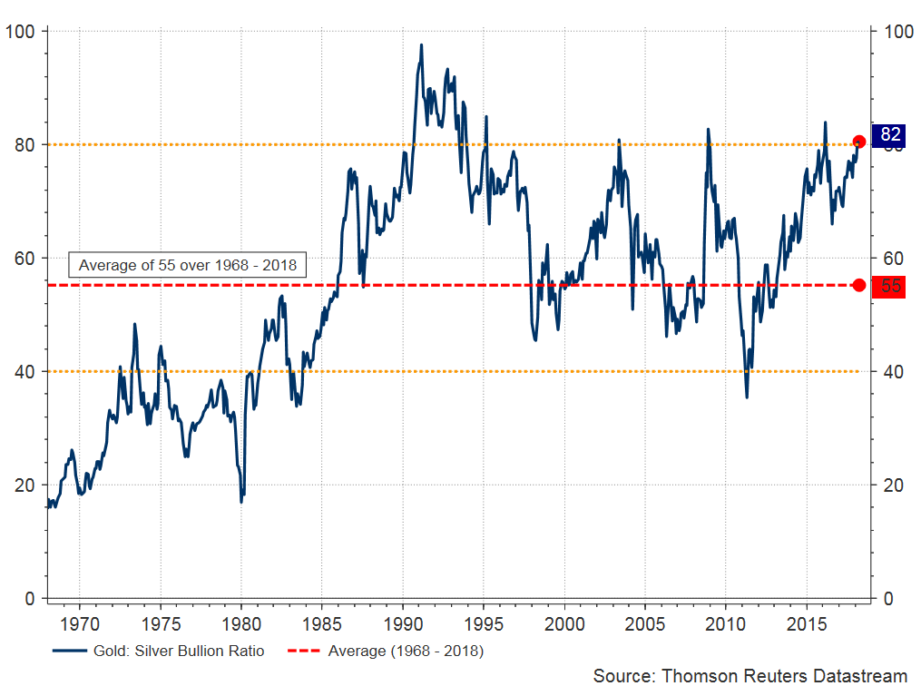
LONG TERM GOLD/SILVER RATIO
Notes:
According to the gold:silver ratio Silver is still underperforming. Silver is cheap compared to gold or gold expensive compared to silver.
Every time we have hit around 80-ish the ratio reverts back towards the mean of 55 over a 50 year period.
So based on those figures there is still potential for silver to accelerate compared to gold.
We are expecting higher silver prices in the second half of the year and the ratio to ease back to the 75-77 level.
Currently sitting around the 79 level.

Slide 11
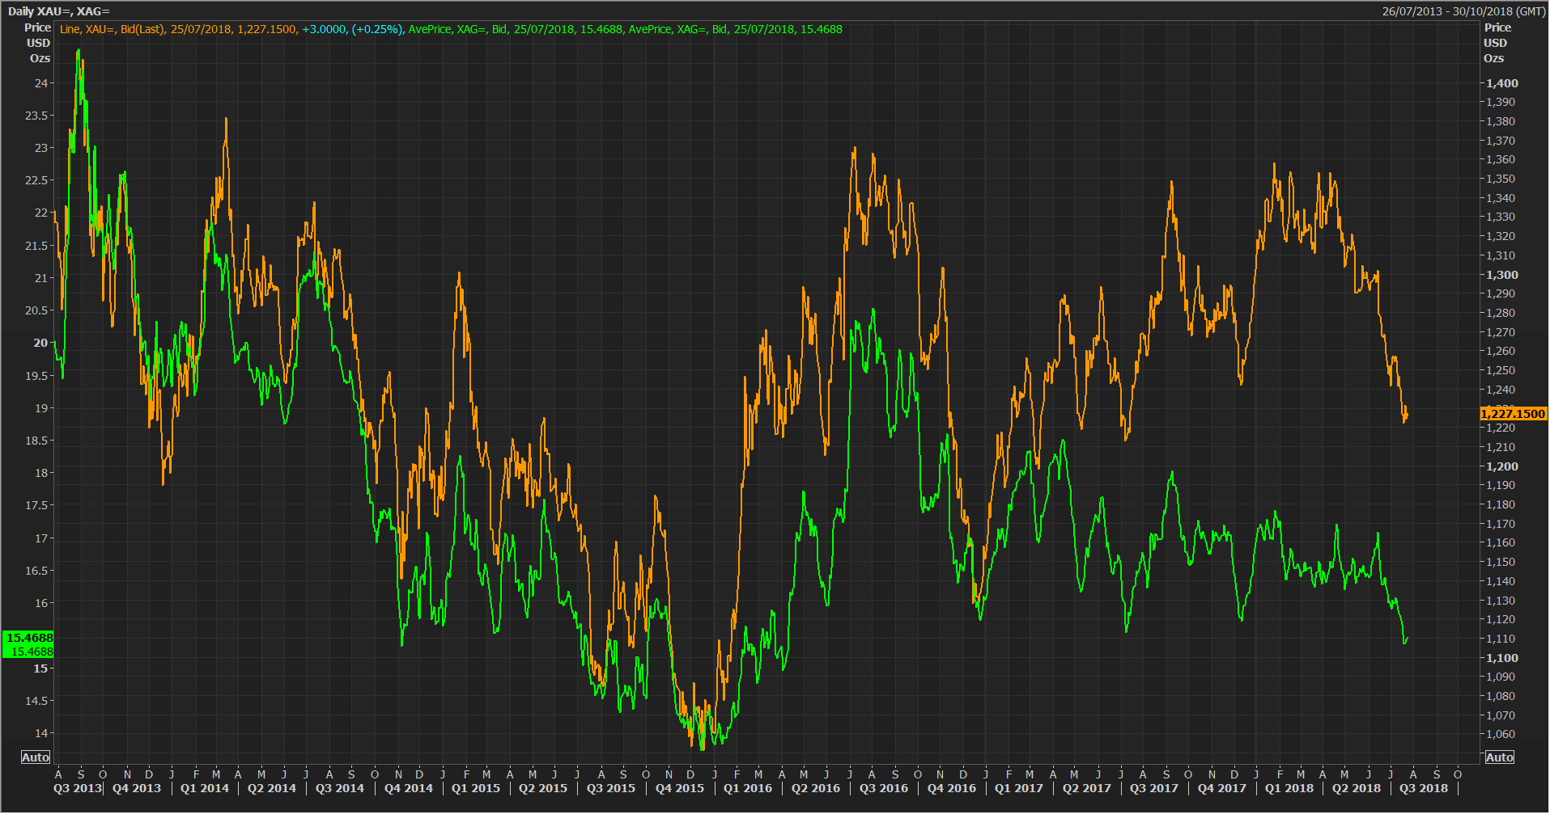
LONG TERM GOLD & SILVER PRICE
Notes:
In all reality silver fundamentals do not shape the price. They are at best provide a support to the price.
Of more influence is the movements with the gold price, and at times, the base metals complex. Silver can oscelate between being viewed as a precious or industrial metal.
Silver has a very strong correlation with gold and you can see the tight trading pattern between the two metals over the longer term.
The base metals performance recently has been a factor. Base metals have been a casualty of the trump trade war and silver (viewed in this instance an industrial metal) dragging prices lower in recent months.

Slide 12
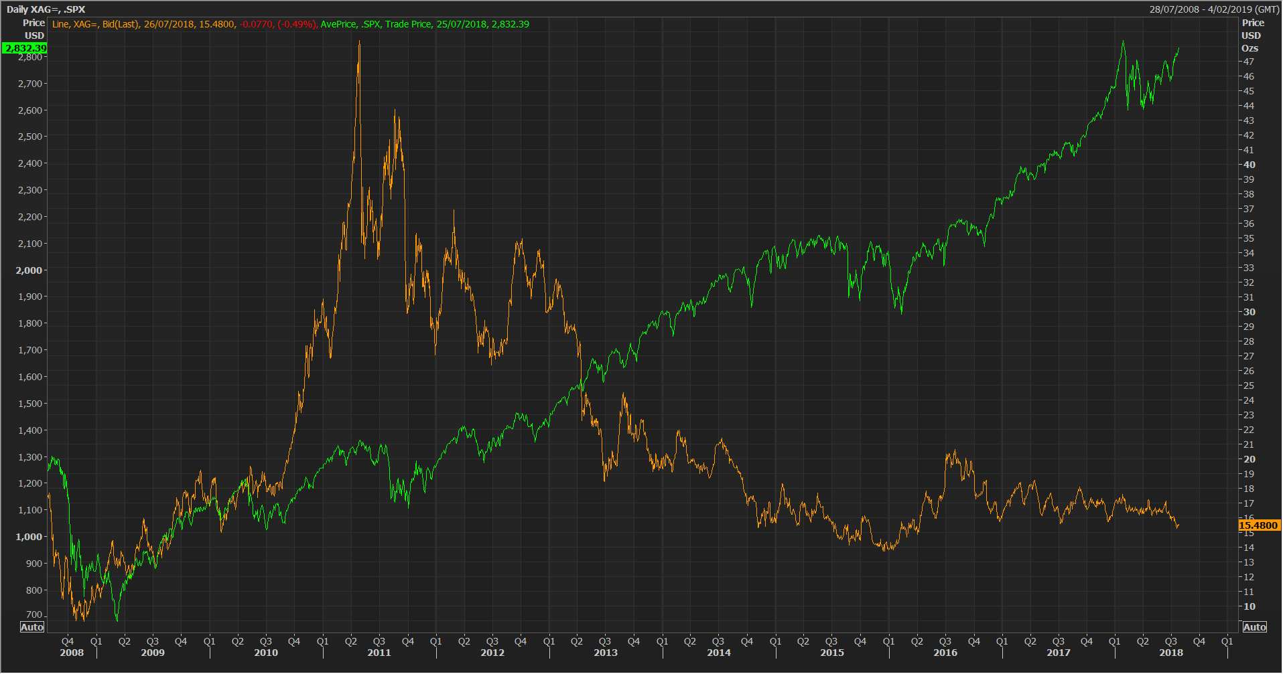
LONG TERM SILVER v S & P 500 INDEX
Notes:
So what will be the drivers for silver?
We have heard Marcus detail what he believes will influence the gold price and I tend to agree with a lot of what he suggests will be factors moving forward
The main question to consider is how long can the strength in the US dollar continue. Consumer spending in the US looks vulnerable – lack of wages growth.
A weaker emerging market and Eurozone propelled the US dollar higher last year so will the acceleration of a trade war have a further impact on this markets? This could potentially lead to a stronger dollar.
Can the equities market continue to trend higher? Is the market bloated and ready for a correction?
And doubt that the FED will be able to deliver on planned timetable for rate rises.
The average silver price year to date stands at around $16.50./oz.
The current trade disputes between the United States and much of the world is dragging down industrial demand and impacting base metals prices, and silver in this instance has been a casualty of this. A slowdown in China remains a downside risk and and U.S. sentiment (in regards to silver) remains lackluster based on coin sales for example, and stocks of silver are abundant.
A correction in equity markets could see silver benefit as would greater geo political volatility. Absence of any economic shocks will make it difficult case for silver to rally too much. None the less we feel silver is slightly undervalued and prices will creep up out to 2020 with prices that year averaging $18.90/oz.

Slide 13
SILVER PRICE FORECASTS
Silver
 | Q1 18 | Q2 18 | Q3 18 | Q4 18 | AVG 2018 | AVG 2019 | AVG 2020
High | 17.56 | 17.23 | 17.60 | 17.75 | 17.75 | 20.30 | 21.80
Average | 16.75 | 16.53 | 16.20 | 16.20 | 16.42 | 18.00 | 18.90
Low | 16.18 | 16.03 | 15.25 | 15.20 | 15.20 | 16.10 | 17.20
Thomson Reuters, GFMS / Silver Institute
Notes:
And finally a quick break down of our current price forecast out to 2020.

