Slide 1
Gold Markets in next five years: Opportunities and Challenges
John Reade
Chief Market Strategist
August 2018

Slide 2
Opportunities

Slide 3
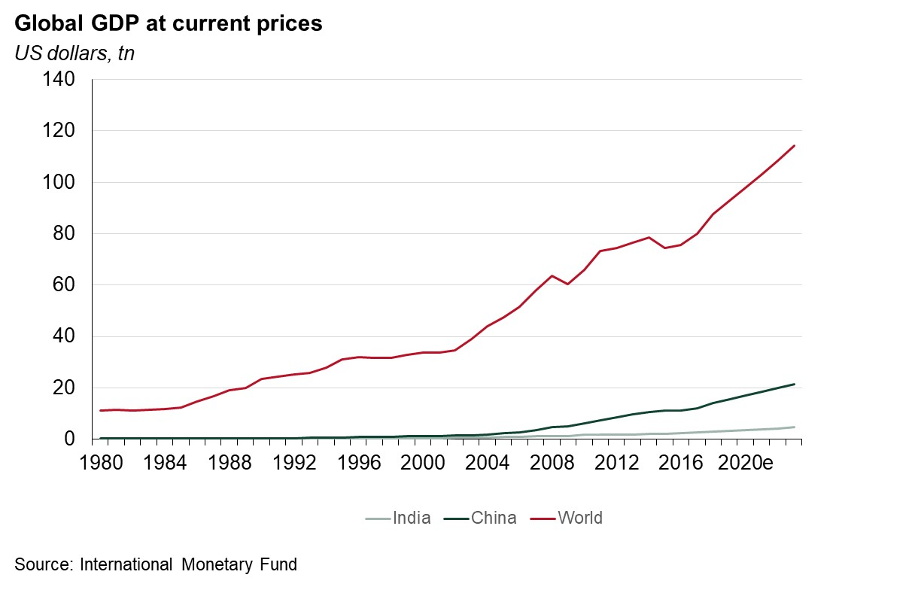
The world will get richer

Slide 4
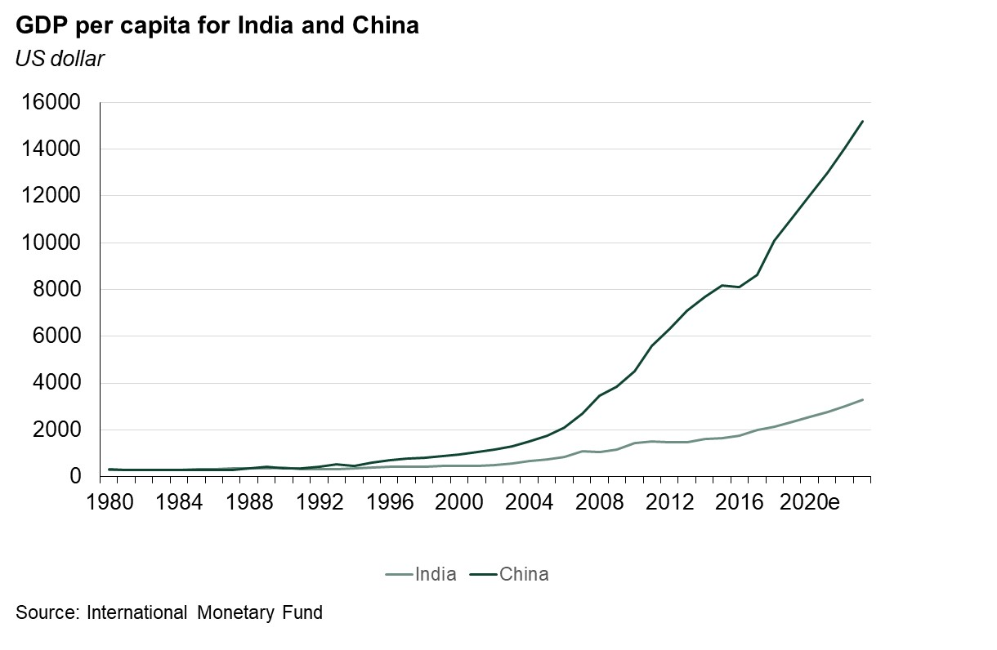
Income in China and India will rise

Slide 5
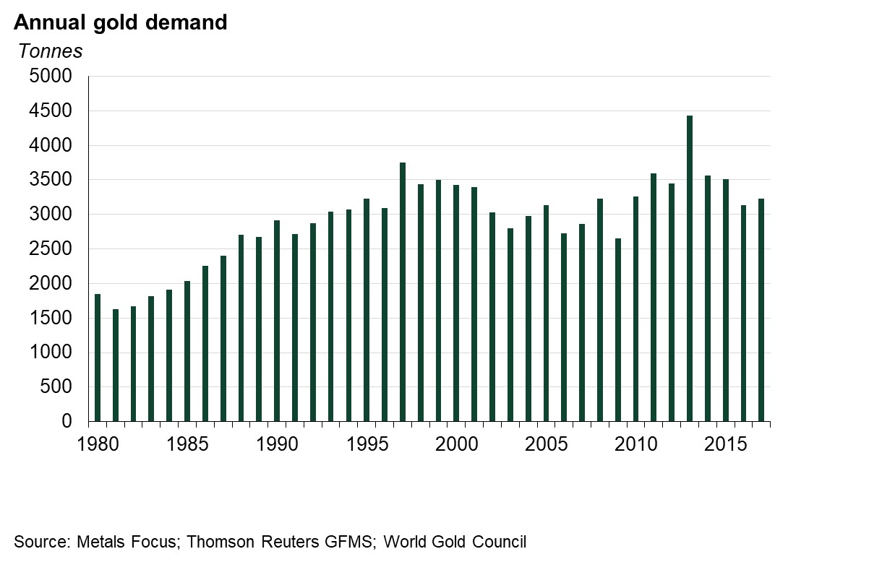
Gold demand has increased over time

Slide 6
Income growth drives consumer gold demand
Economies will grow, especially in emerging markets
GDP per capita will continue to rise
Middle Class proportion will rise
Increased wealth and increased middle class will drive gold demand

Slide 7
New opportunities for new consumers

Slide 8
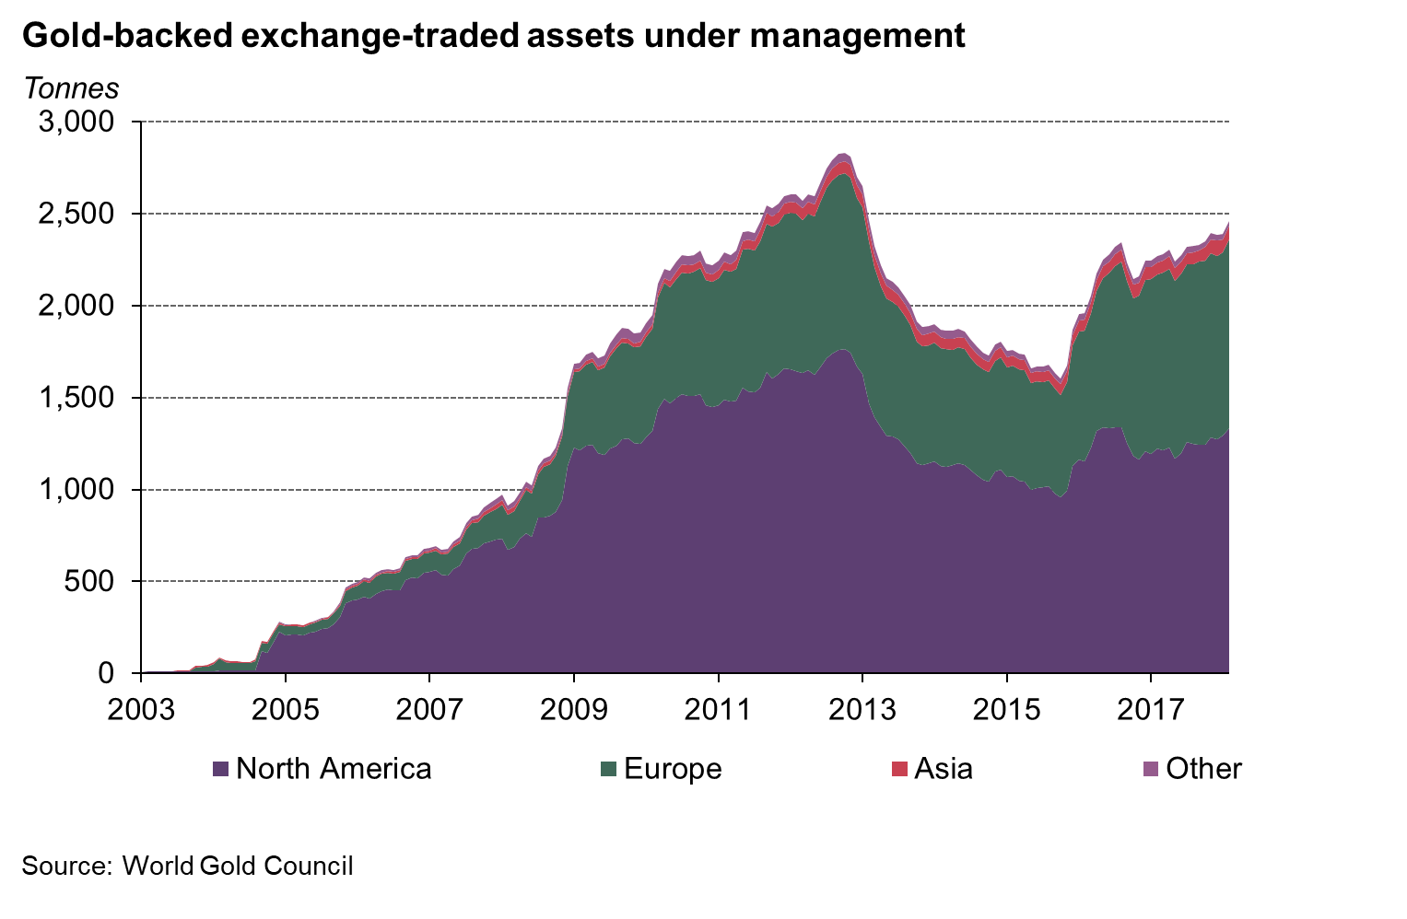
ETFs made gold more accessible

Slide 9


Shari’ah standard on gold has been set

Slide 10
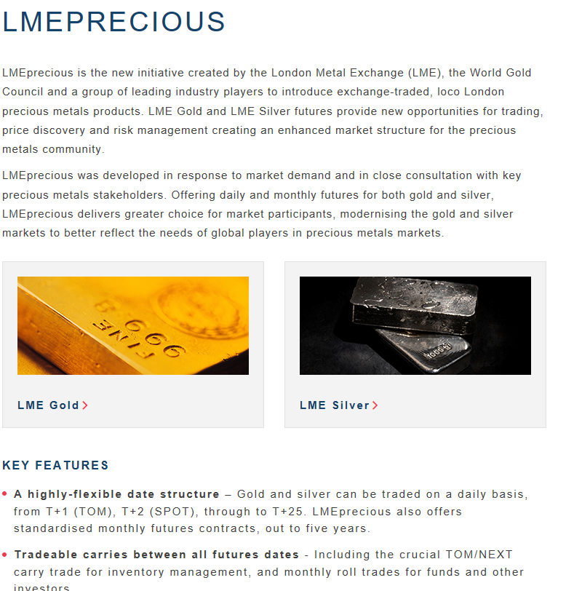
Launch of LME Precious

Slide 11

An Indian gold spot exchange

Slide 12
New markets could open up and infrastructure for gold market can change
ETFs demonstrate how infrastructure can be game-changing
Tapping new classes of investors - Shari’ah gold
New trading venues
    Shanghai Gold Exchange – an example from the past decade
    LME Precious – launched and changing the market
    India Spot Gold Exchange – under development

Slide 13
Technology could disrupt the market

Slide 14



















Gold-fintech is a rapidly developing landscape
World Gold Council | Gold markets in next five years : Opportunities and Challenges | August 2018
14

Slide 15




We think of four gold-fintech concepts
Online Vaulted Gold | Crypto Gold Tradeable Token | Crypto Gold Payments & Collateral | Crypto Gold Trading
World Gold Council | Gold markets in next five years : Opportunities and Challenges | August 2018
15

Slide 16
Technology could disrupt the market
The gold-fintech landscape is evolving quickly
No obvious ‘Killer Apps’ visible yet
But it may become a catalyst for change in the gold market

Slide 17
India specific drivers

Slide 18
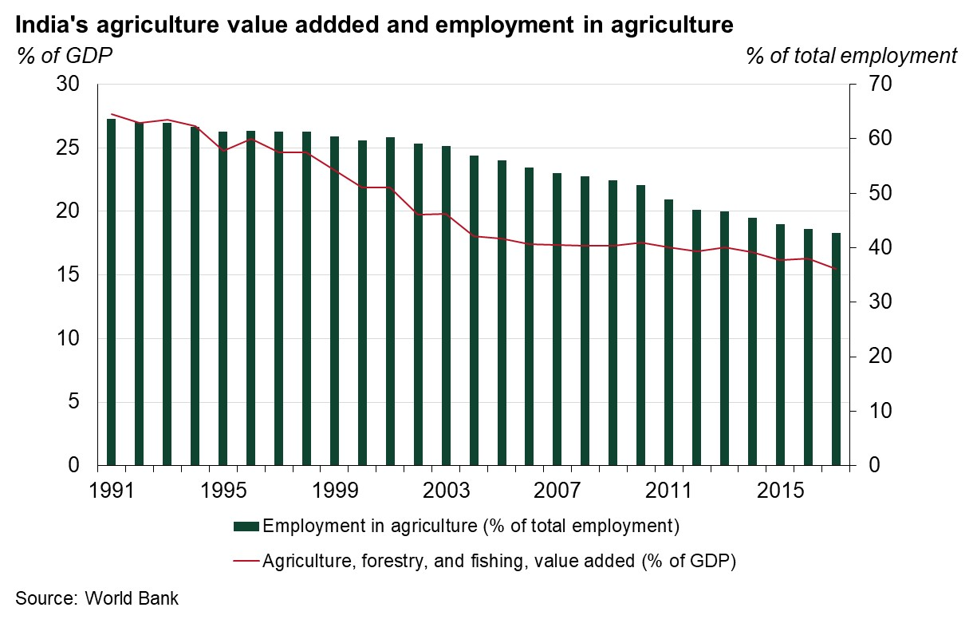
Agriculture still vitally important in India
World Gold Council | Gold markets in next five years : Opportunities and Challenges | August 2018
18

Slide 19
Rural focus will drive gold demand
Agriculture plays larger role in India as rural India accounts for 60% of gold demand
Key decisions were taken during the last year Union budget to support rural income:
    the current government aims to double farmers income by 2022
    raise Minimum Support Price (MSP) to 1.5 times the cost of production
    link existing mandis to pan-India electronic trading platform
World Gold Council | Gold markets in next five years : Opportunities and Challenges | August 2018
19

Slide 20
Fundamental markets

Slide 21
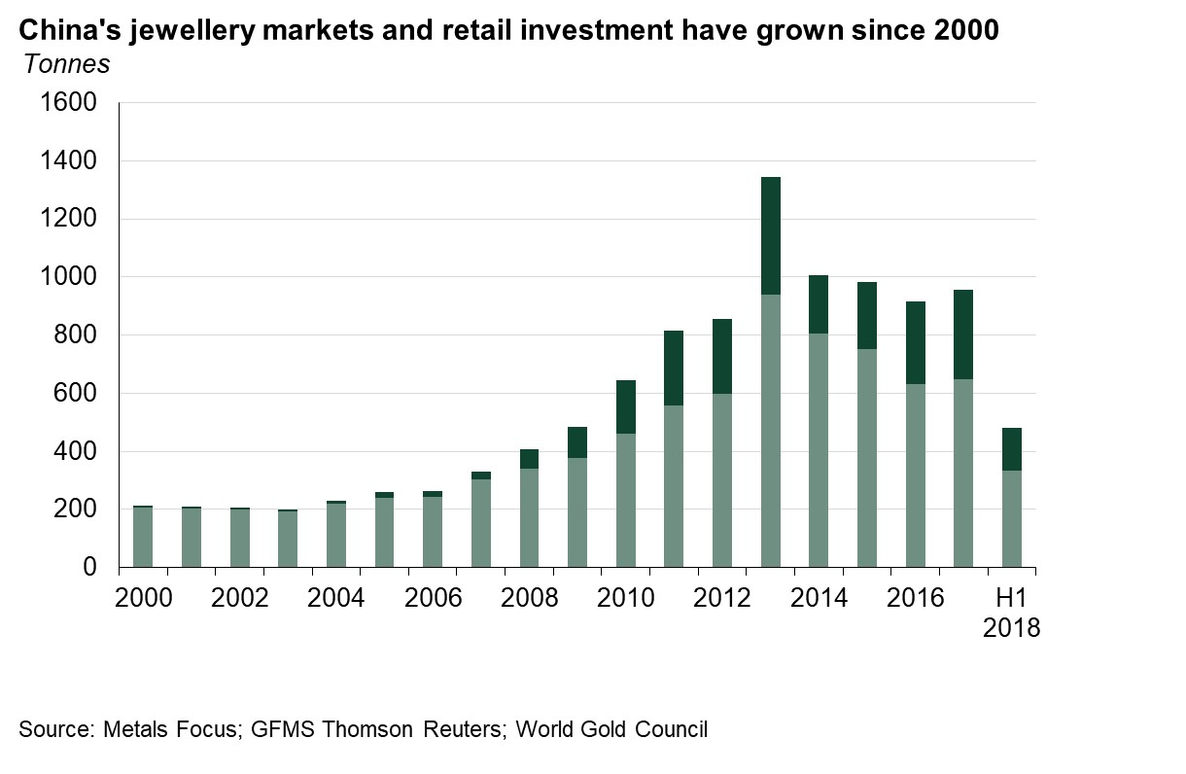
China is now a 1000t gold market
World Gold Council | Gold markets in next five years : Opportunities and Challenges | August 2018
21

Slide 22
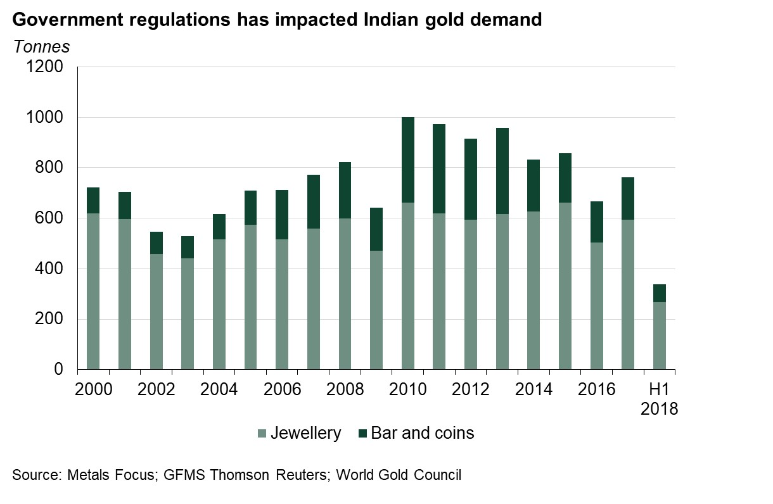
Indian demand to recover over the next few years
World Gold Council | Gold markets in next five years : Opportunities and Challenges | August 2018
22

Slide 23
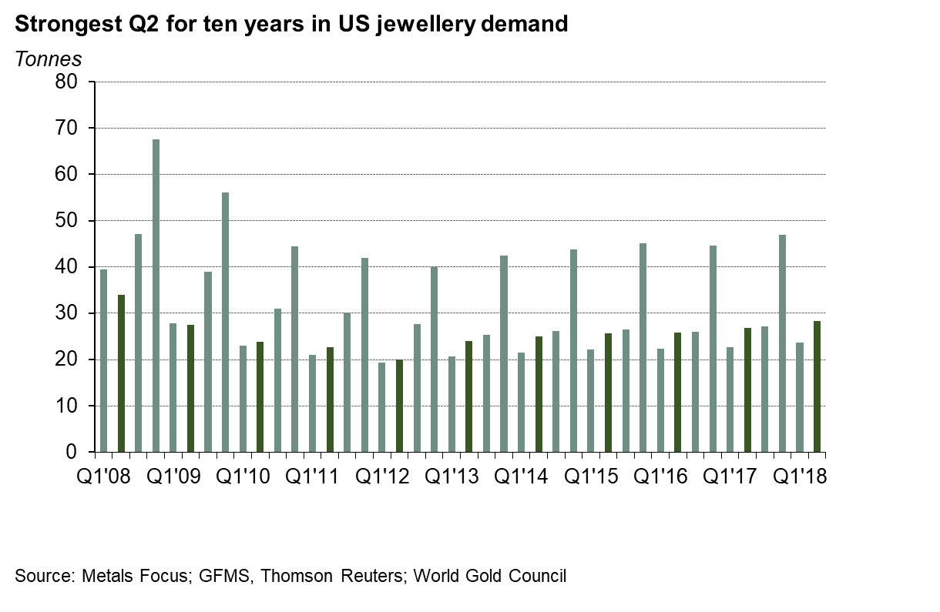
US jewellery demand improving
World Gold Council | Gold markets in next five years : Opportunities and Challenges | August 2018
23

Slide 24
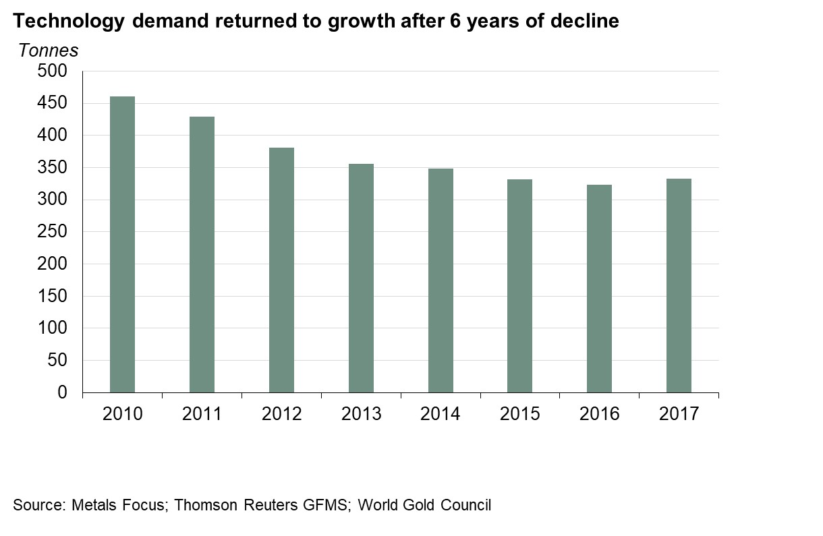
Technology showing signs of recovery
World Gold Council | Gold markets in next five years : Opportunities and Challenges | August 2018
24

Slide 25
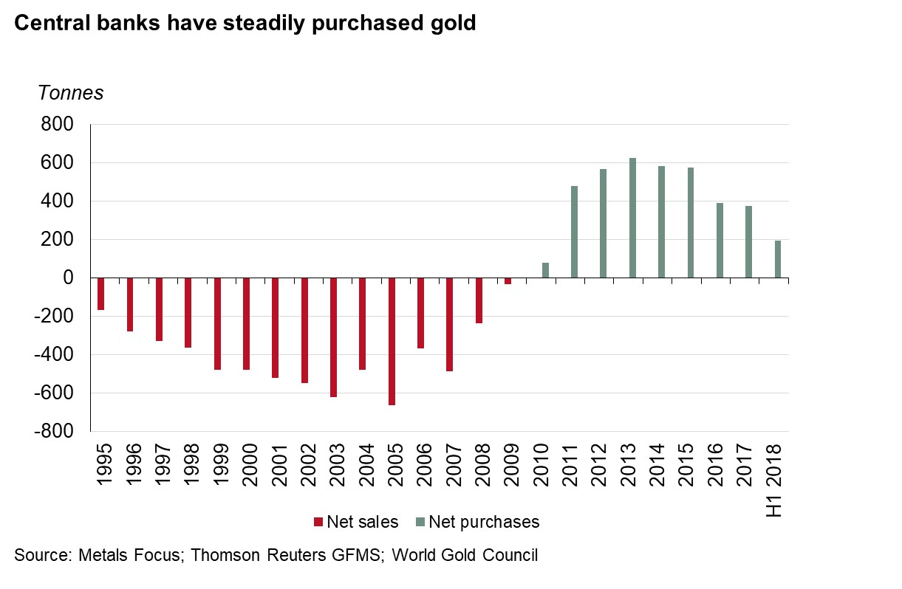
Central banks continue to purchase gold
World Gold Council | Gold markets in next five years : Opportunities and Challenges | August 2018
25

Slide 26
Challenges

Slide 27
Tax and regulations

Slide 28
Tax and regulations will impact demand
Introduction of 5% VAT in UAE from 1st Jan 2017 has impacted demand
GST in India although good in long term but has impacted demand in short term
20% VAT on gold bars in Russia to be implemented from 1st Jan 2019
World Gold Council | Gold markets in next five years : Opportunities and Challenges | August 2018
28

Slide 29
Millennials propensity to purchase gold

Slide 30
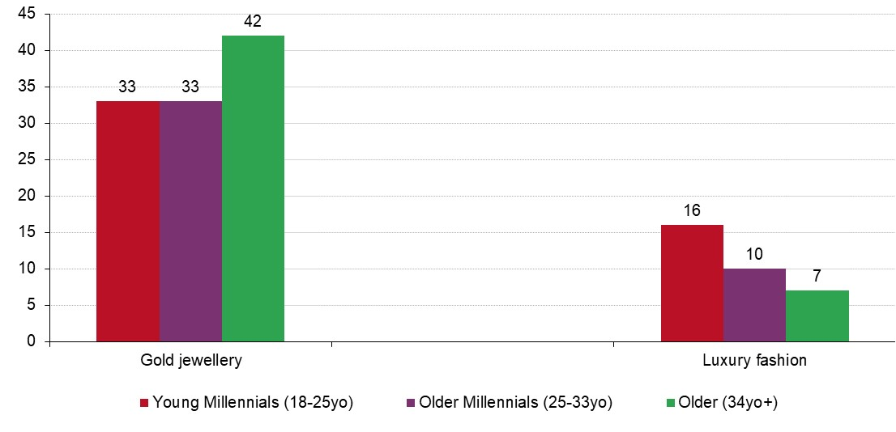
Aspiration to purchase gold jewellery lower among Millennials in urban India
% who would buy each item if given 50,000Rs
Source: Kantar TNS; World Gold Council
Base: All younger Millennials (18-25yo) (256)/ Older Millennials (26-33yo) (254)/ Older (34yo+)(490)
World Gold Council | Gold markets in next five years : Opportunities and Challenges | August 2018
30

Slide 31
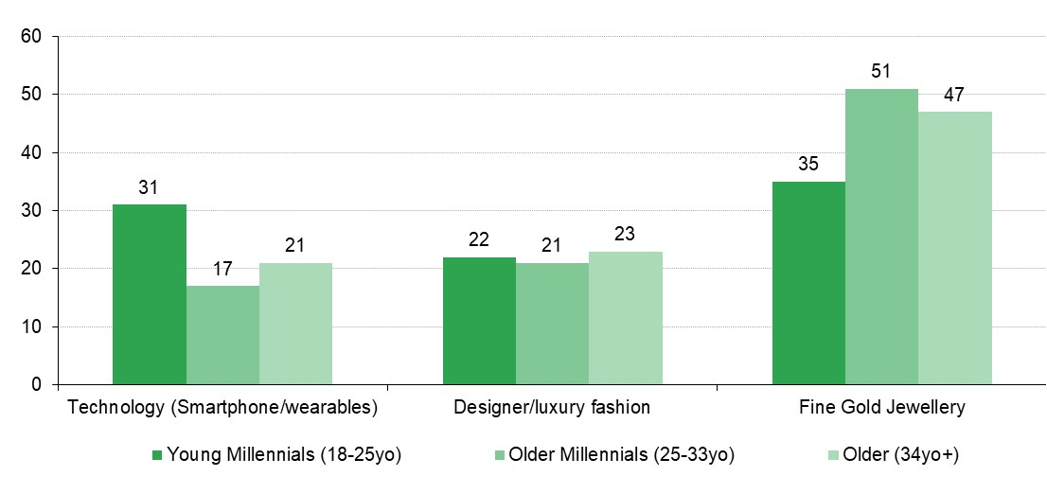
Technology is more appealing than gold for younger Millennials in China
% who would buy each item if given RMB 5,000
Source: Kantar TNS; World Gold Council
Base: All younger Millennials (18-25yo) (397)/ Older Millennials (26-33yo) (455)/ Older (34yo+)(1150)
World Gold Council | Gold markets in next five years : Opportunities and Challenges | August 2018
31

Slide 32
Decline in mine production

Slide 33
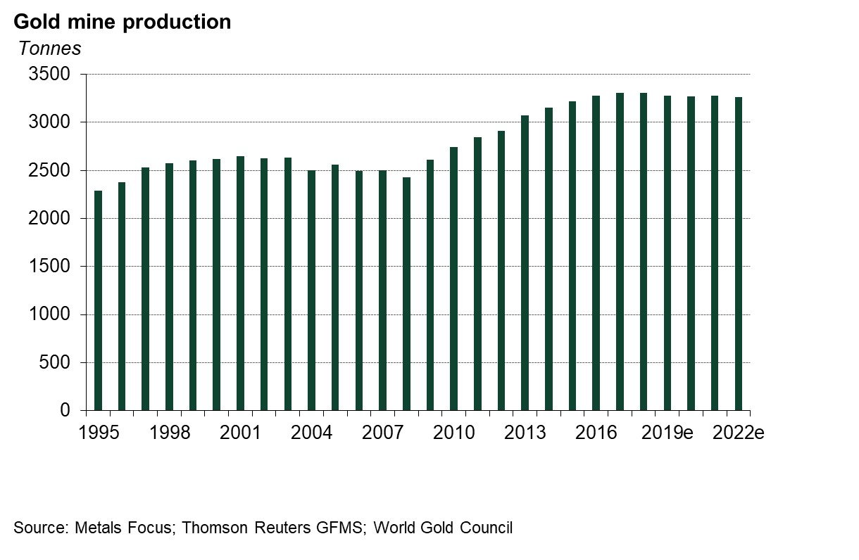
Gold mine production will marginally decline
World Gold Council | Gold markets in next five years : Opportunities and Challenges | August 2018
33

Slide 34
Gold production will marginally decline
Discoveries have been scant; permitting times long and extended
Capital costs for next generation of large, low grade open cast mines beyond readily fundable levels
Environmental, social and governance (ESG) requirements are becoming more challenging
Operating costs have risen and political risk has increased in many prospective regions
34

Slide 35
Summary

Slide 36
In next 5 years ….
People across the globe along with China and India will be richer…
…but their tastes will have changed.
New markets will have opened up…
…but technology may have changed the entire gold marekt
Fundamental factors for gold demand will generally be supportive
        Demand support from China and India
        Supply constrained
        Central Bank purchases
But taxes and regulations will also play key role for global gold markets

Slide 37




Connect with us
@JReade_WGC
@AHewitt_WGC
@goldcouncil
www.gold.org

