Slide 1


MCX Options - Hedging Instruments for
Bullion & Jewellery industry

Slide 2
MCX GOLD FUTURES: FEATURES OF the UNDERLYING
MCX Price is the benchmark for value-chain and end-consumers alike: Most Pricing is done MCX(+/-)
MCX Bullion prices in-build: Hedge for: Gold price, USD-INR, Import duty changes, prevailing premium/discount; which enables all major value-chain participants:
Strong correlation with international benchmarks as well as Domestic Spot:
  CME(INR Eq.- Import Parity)-MCX 98.93%; MCX-Domestic Spot 98.02%
Trading hours on MCX gold futures market are stretched till almost midnight to match trading time in the global markets. So, Indian participants are able to manage price risks as efficiently as global counterparts.
Quality benchmark: London Bullion Markets Association(LBMA) approved Refiners’ Bars & coins with tamper proof packing
Transparency, Convenience & Assurance of Delivery
Bullion Trader
Branded Jeweler
Retail Jeweler
Importer
Exporter

Slide 3
Why Options?
An option contract offers the best of both worlds. It will offer the buyer of the contract protection if the price of the underlying moves against him but allows him to walk away from the deal if the underlying price moves in his favour.
Options:
Give buyer the “right”, but not the “obligation”
To buy or to sell an agreed amount of underlying asset (Notional Value)
On or before an agreed future date (expiry date)
At an agreed exchange rate (Strike Price)
In exchange for fee (Option Premium)

Slide 4
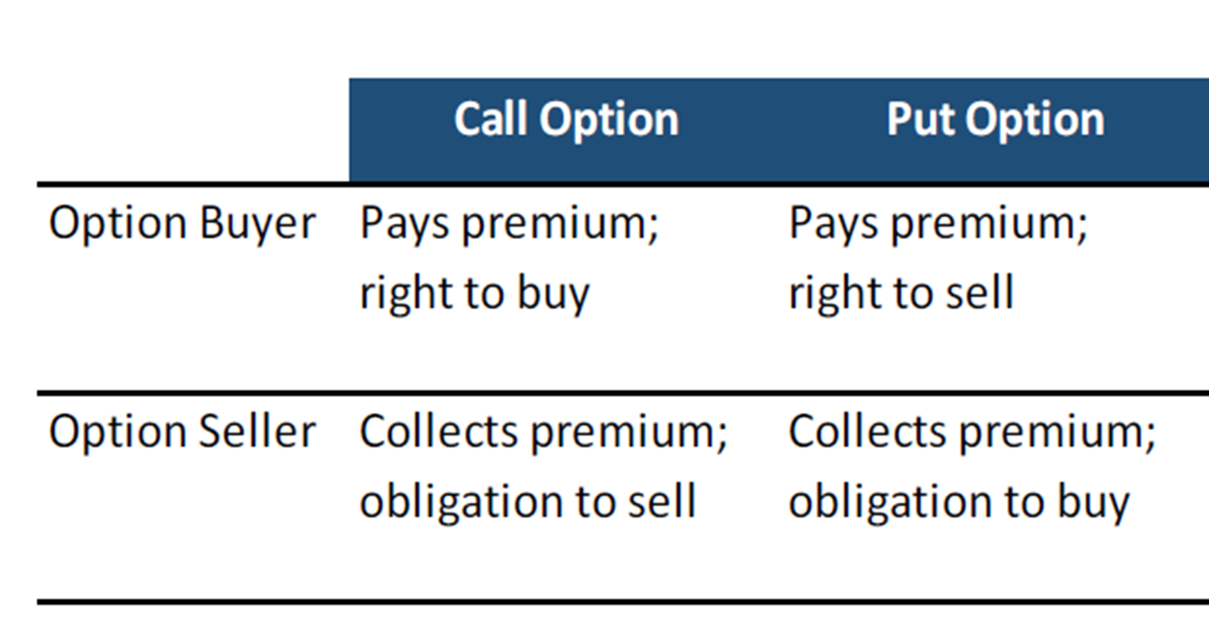
What are OPTIONs?
An option is the right, but not the obligation, to buy or sell a futures contract & buyer of an option acquires this right.
Commodity Call Option : Buy asset (futures contract) in the future at a pre-determined decided rate today.
Commodity Put Option : Sell asset (futures contract) in the future at a pre-determined decided rate today.

Slide 5
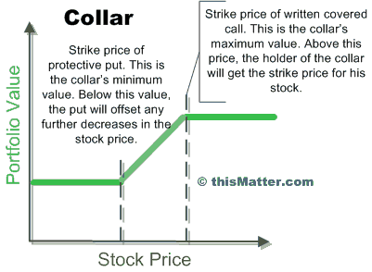

Options-Usage by PHYSICAl INdustry
Producer/Bullion Dealer Hedging:
Gold Producers sell above the money Calls at Premiums (Ceiling) & buy protective Puts below the money; (to create Floor price): achieving low/zero cost Collar - hedge against fall in expected price of future production/inventory. This is a Costless Collar Strategy.
Flexible Pricing Schemes by Jewellers:
Offer Lower of current price /Akshaya Tritiya price:
Buy Put at Current Prices.
If prices rise, won’t exercise and loss will be the premium paid
If prices fall then will Sell the same Put and take profit.
Inventory Hedging- Monetising idle stock by way of Premium
  Write Calls above the Money when Implied Volatility (IV)
  is higher (and so is Premium)
Protection from rising prices against Fixed quotes
ⱴ

Slide 6
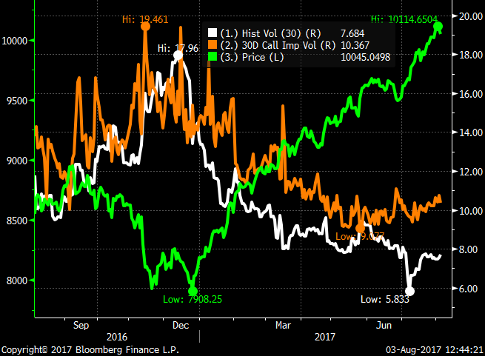
Implied Volatility & Premium
Volatility is a function of price movement…
Standard deviation of daily returns…expressed in annualised terms.
Measure of uncertainty of asset returns / degree of price fluctuation
High IV causes options premiums to increase – sometimes very dramatically.
Lower volatility- premiums decline

Slide 7
Example – Hedging Strategies
Options represent a form of Price Insurance, cost of which is the Option Premium determined during its trading by markets
Improves market Liquidity, Transparency
Maximum Loss to the extent of Premium paid for Buyer
Possible apportioning of Hedging cover as may be needed
Basic hedging strategies:
Call or Put Protection Buying Calls ( for metal consumers having bought Unfixed Gold from Banks , Importers , Wholesalers etc) | Buying Puts ( for metal consumers having bought Fixed Gold from Banks, Importers, Wholesalers etc)

Slide 8
OPTION Strategy for Bullion Dealer: Protecting inventory – Fixed Gold
Bullion Dealer: Risk of depreciation in Gold
(CMP 30000)
Buy Put option: Strike price 30000 Premium Rs.300
Prices go up
Prices go down
Loss: Maximum up to Rs.300
Profit: Actual loss is Compensated by appreciation in the premium price
The loss is limited to the extent of the premium paid i.e. Rs. 300/= & no MTM

Slide 9
Example: Protecting inventory – Fixed Gold
Buy Put option : Strike price 30000 Premium Rs.300
P&L Payoff at Expiration Matrix (Premium: 300)
Underlying Price At Expiry | Payoff from options | Physical Stock | Net Profit/Loss
29500 | 200 | -500 | -300
29600 | 100 | -400 | -300
29700 | 0 | -300 | -300
29800 | -100 | -200 | -300
29900 | -200 | -100 | -300
30000 | -300 | 0 | -300
30100 | -300 | 100 | -200
30200 | -300 | 200 | -100
30300 | -300 | 300 | 0
30400 | -300 | 400 | 100
30500 | -300 | 500 | 200
Having hedge through options Bullion dealer protect himself against downside risk and also avails opportunity profit if prices go beyond 30300/- in physical markets

Slide 10
Options Strategy for Jewelers:
Buying Unfixed Gold
Exporter : Risk of appreciation in Gold post receiving order
(CMP 30000)
Buy Call option
Strike price 30000
Premium Rs.300
Prices go down
Prices go up
Loss: Maximum up to Rs.300
Profit: Actual loss is Compensated by appreciation in the premium price
The loss is limited to the extend of the premium paid i.e. Rs. 300/- & no MTM

Slide 11
Example : Buying Unfixed Gold
Buy Call option Strike price 30000 Premium Rs.300
P&L Payoff at Expiration Matrix (Premium: 300)
Underlying Price At Expiry | Payoff from options | Physical Stock | Net Profit/Loss
29500 | -300 | 500 | 200
29600 | -300 | 400 | 100
29700 | -300 | 300 | 0
29800 | -300 | 200 | -100
29900 | -300 | 100 | -200
30000 | -300 | 0 | -300
30100 | -200 | -100 | -300
30200 | -100 | -200 | -300
30300 | 0 | -300 | -300
30400 | 100 | -400 | -300
30500 | 200 | -500 | -300
Having hedge through options Jeweller protect himself against upside risk and also avails opportunity profit if prices break below 29700 in physical markets

Slide 12
Theoretical Examples of Other Hedging Strategies

Slide 13
Example : SHORT STRANGLE
Gold CMP 29800. Strategy: Sell 29400 PE @200 and Sell 30200 CE @300
P&L Payoff at Expiration Matrix (Premium: 500)
Underlying Price At Expiry | Payoff from 29800 PE Sell | Payoff from 30200 CE Sell | Net Profit/Loss
28800 | -400 | 300 | -100
29000 | -200 | 300 | 100
29200 | 0 | 300 | 300
29400 | 200 | 300 | 500
29600 | 200 | 300 | 500
29800 | 200 | 300 | 500
30000 | 200 | 300 | 500
30200 | 200 | 300 | 500
30400 | 200 | 100 | 300
30600 | 200 | -100 | 100
30800 | 200 | -300 | -100

Slide 14
Example : LONG STRANGLE
Gold CMP 29800. Strategy: Buy 29400 PE @200 and Buy 30200 CE @300
P&L Payoff at Expiration Matrix (Premium: -500)
Underlying Price At Expiry | Payoff from 29800 PE Buy | Payoff from 30200 CE Buy | Net Profit/Loss
28800 | 400 | -300 | 100
29000 | 200 | -300 | -100
29200 | 0 | -300 | -300
29400 | -200 | -300 | -500
29600 | -200 | -300 | -500
29800 | -200 | -300 | -500
30000 | -200 | -300 | -500
30200 | -200 | -300 | -500
30400 | -200 | -100 | -300
30600 | -200 | 100 | -100
30800 | -200 | 300 | 100

Slide 15
Example : CALL WRITTING
Gold CMP 29800. Strategy : Sell 30200 CE @300
P&L Payoff at Expiration Matrix (Premium: 300)
Underlying Price At Expiry |  | Payoff from 30200 CE Sell | Net Profit/Loss
28800 |  | 300 | 300
29000 |  | 300 | 300
29200 |  | 300 | 300
29400 |  | 300 | 300
29600 |  | 300 | 300
29800 |  | 300 | 300
30000 |  | 300 | 300
30200 |  | 300 | 300
30400 |  | 100 | 100
30600 |  | -100 | -100
30800 |  | -300 | -300

Slide 16
Example : COLLAR
Gold CMP 29800. Strategy : Buy 29400 PE @200 and Sell 30200 CE @300
P&L Payoff at Expiration Matrix (Premium: 100)
Underlying Price At Expiry | Payoff from 29400 PE Buy | Payoff from 30200 CE Sell | Net Profit/Loss
28800 | 400 | 300 | 700
29000 | 200 | 300 | 500
29200 | 0 | 300 | 300
29400 | -200 | 300 | 100
29600 | -200 | 300 | 100
29800 | -200 | 300 | 100
30000 | -200 | 300 | 100
30200 | -200 | 300 | 100
30400 | -200 | 100 | -100
30600 | -200 | -100 | -300
30800 | -200 | -300 | -500

Slide 17
Taxation upon exercise of Gold options
Transaction Taxes on Gold 1 kg Options contract with a notional value of Rs 30 lakh and option premium of Rs 30,000 (@ 1% of notional value)
Particulars | Call Option |  | Put Option
 | Buyer | Seller | Buyer | Seller
CTT on premium (@ 0.05% of premium – Seller) |  | 15 |  | 15
CTT on exercise (@ 0.0001% of FSP – Buyer) | 3 |  | 3
Transaction Fees on Options # | - | - | - | -
On conversion of option position to futures position on exercise (@ 0.01% on futures position – Seller) | - | 300 | 300 | -
If chooses not to take physical delivery, but squares position in futures | 300 | - | - | 300
Total Transaction Taxes | 303 | 315 | 303 | 315

Slide 18
Taxation upon exercise of Silver options
TRANSACTION TAXES ON SILVER 30 KG OPTIONS CONTRACT WITH A NOTIONAL VALUE OF RS 12 LAKHS AND OPTION PREMIUM OF RS 12,000 (@ 1% OF NOTIONAL VALUE)
PARTICULARS | CALL OPTION |  | PUT OPTION
 | BUYER | SELLER | BUYER | SELLER
CTT on premium (@ 0.05% of premium – Seller) |  | 6 |  | 6
CTT on exercise (@ 0.0001% of FSP – Purchaser) | 1.2 |  | 1.2
On conversion of option position to futures position on exercise (@ 0.01% on futures position – Seller) | - | 120 | 120 | -
Transaction Fees on Options # | - | - | - | -
If chooses not to take physical delivery, but squares position in futures | 120 | - | - | 120
Total Transaction Taxes (Rs./lot) | 121.2 | 126 | 121.2 | 126
Final Settlement Price #Transaction fees on Options Contracts are waived till September 30, 2018. Note : For detailed contract specifications, kindly refer exchange Circular No. MCX/TRD/185/2018, dated 18th May, 2018

Slide 19
Benefits - Amendments to section 43(5)
The Finance Act, 2013 has removed this anomaly and provided for coverage of commodity derivatives transactions undertaken in recognized commodity exchanges too under the ambit of Section 43(5) of the Income Tax Act, 1961, on the lines of the benefit available to transactions undertaken in recognized stock exchanges.
Hedgers are no longer forced to undertake physical delivery of commodities in order to prove that their transactions are in the nature of hedging and not ‘speculation’. This is clearly a great impetus for the growth of the commodity derivatives market in India.

Slide 20
THANK YOU

Slide 21
Performance – Bullion contracts
GOLD FUTURES | Avg. Daily Turnover in ( Rs. Crs.) | Volumes (Kgs) | Open Interest (Kgs)
FY 2017-18 | 2,876 | 9.82 | 9.36
FY 2018-19 (YTD) | 2,826 | 9.17 | 8.72
SILVER FUTURES | Avg. Daily Turnover in ( Rs. Crs.) | Volumes (MT) | Open Interest (MT)
FY 2017-18 | 2,493 | 637.67 | 680.92
FY 2018-19 (YTD) | 2,403 | 633.25 | 675.54
Options | Avg. Daily Turnover in ( Rs. Crs.) | Volumes (MT) | Open Interest (MT)
Gold | 249.02 | 0.815 | 1.433
Silver | 40.44 | 9.97 | 23.61
Highest Turnover in ( Rs. Crs.) | 17 Oct 2017 | 29 May 2018 | 24 July 2018
Gold Options | 1560.07 | 2020.99 | 2930.64
Highest Turnover in ( Rs. Crs.) | 15 June 2018 | 14 June 2018 | 18 June 2018
Silver Options | 202.02 | 130.73 | 107.30

Slide 22
Hedger awareness meet details
Year | No. of Events | Associations | Location | Attendees
FY 17-18 | 101 | 64 | 72 | 16,718
FY 18-19 (YTD) | 38 | 17 | 35 | 6,768

Slide 23
OPTION TERMINOLOGY
Option price: Option price is the price which the option buyer pays to the option seller. It is also referred to as the option premium.
Expiration date: The date specified in the options contract is known as the expiration date, the exercise date, the strike date or the maturity.
Strike price: The price specified in the options contract is known as the strike price or the exercise price.
European options: European options are options that can be exercised only on the expiration date itself.

Slide 24
Some terms unique to options trading
In the Money for Call Option: Futures contract value is above strike price
In the Money for Put Option: Futures contract value is below strike price
At the Money: Futures contract value equals strike price
Out of Money for Call Option: Futures contract value is below strike price
Out of Money for Put Option: Futures contract value is above strike price
Open interest: The total number of options contracts outstanding or open in the market at any given point of time.

Slide 25
Gold Options and Silver Options Contract Specification
TRADING UNIT | One MCX Gold futures contract (1 KG) | One MCX Silver futures contract (30 KG)
OPTION TYPE | European Call & Put Options | European Call & Put Options
STRIKES | 15 In-the-money, 15 Out-of-the-money and 1 Near-the-money. (31 CE and 31 PE). | 10 In-the-money, 10 Out-of-the-money and 1 Near-the-money. (21 CE and 21 PE).
STRIKE PRICE INTERVALS | Rs. 100 | Rs. 250
TICK SIZE | Rs. 0.50 | Rs. 0.50
PROFIT OR LOSS PER TICK | Rs. 50 | Rs. 15
MARGINS | The Initial Margin shall be computed using SPAN (Standard Portfolio Analysis of Risk) software, which is a portfolio based margining system. | The Initial Margin shall be computed using SPAN (Standard Portfolio Analysis of Risk) software, which is a portfolio based margining system.
SETTLEMENT | On expiry of options contract, the open position shall In-the-Money (ITM) – Devolve into underlying Futures unless ‘explicit instruction’ given for not devolving into futures. Close to the Money(CTM) – Devolve into underlying futures only on explicit instruction Out of the Money (OTM) – Expire Worthless (No devolvement) | On expiry of options contract, the open position shall In-the-Money(ITM) – Devolve into underlying Futures Close to the Money(CTM) – Devolve into underlying futures only on explicit instruction Out of the Money (OTM) – Expire Worthless (No devolvement)
EXPIRY DAY | Three business days prior to the first business day of Tender Period of the underlying futures contract. | Three business days prior to the first business day of Tender Period of the underlying futures contract.

Slide 26
EXERCISE MECHANISM AT EXPIRY
Option series having strike price closest to the Daily Settlement Price (DSP) of Futures shall be termed as At the Money (ATM) option series. This ATM option series along with two option series each having strike prices immediately above and below ATM shall be referred as ‘Close to the money’ (CTM) option series.
In case the DSP is exactly midway between two strike prices, then immediate two option series having strike prices just above DSP and immediate two option series having strike prices just below DSP shall be referred as ‘Close to the money’ (CTM) option series
All option contracts belonging to ‘Close to the money’ (CTM) option series shall be exercised only on ‘explicit instruction’ for exercise by the long position holders of such contracts.
All In the money (ITM) option contracts, except those belonging to ‘CTM’ option series, shall be exercised automatically, unless ‘contrary instruction’ has been given by long position holders of such contracts for not doing so.
All Out of the money (OTM) option contracts, except those belonging to ‘CTM’ option series, shall expire worthless.

Slide 27
OPTION SETTLEMENT PROCESS
Expiry Day (Last trading day): Three business days prior to the first business day of Tender Period of the underlying futures contract.
Pre Tender Margin : Exchange shall levy pre tender margin on the long buy positions entering the option tender period.
On expiry of options contract, the open position shall devolve into underlying futures position as follows:-
long call position shall devolve into long position in the underlying futures contract
long put position shall devolve into short position in the underlying futures contract
short call position shall devolve into short position in the underlying futures contract
short put position shall devolve into long position in the underlying futures contract
All such devolved futures positions shall be opened at the strike price of the exercised options

Slide 28
Organised hedge books in Wake Of GST:
Opening Up Of Additional Delivery Locations
Objectives & Expectations:
Nationalization of benchmark contract Price
Penetration into regional consumption centres
Infusion of new small/medium jewellers/buyers into MCX eco-system
Smoothening of Disparity across centres & creating price stability
Logistical convenience

Slide 29
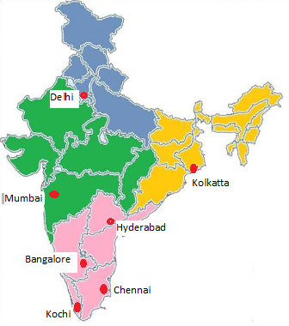
Commodity Exchange Penetration
MCX may plan its vaulting facilities.
Presence spread across locations in India which will
enable participants to give and take delivery of the precious metal
across the country
Cities and towns | 1,200+
Members | 669
Authorised persons | 51,575
Unique client code | 29 lacs +
Trading terminals (including CTCL) | 11,06,743
^ Total Applications submitted to SEBI (Includes 33 Members who have applied for Surrender of Membership)

