Slide 1
Blockchain Evolution
From Efficiencies to Network Plays
Date: August 3rd 2018
Location: 15th India International Gold Convention 2018, Kochi

Slide 2
Agenda
Blockchain is …
  Cryptocurrency and Blockchain
Blockchain Use Cases
  Use Cases
An Adoption Approach

Slide 3
Blockchain is …

Slide 4
The Problem Statement
A transaction is a transfer of assets between two parties to build value …
Asset Type | Ownership | Transaction | Operations | Intermediary | Challenges
Tangible Assets
House / Property / Plant | Title | Buy / Sell / Rent | Registration, Transfer of title, Stamp Duty | Government, Financers | Ownership Disputes, Valuation
Minerals and Precious Metals | Title or Contract | Buy / Sell / Rent / Pay Per Use | Authenticity Checks, Value Certification, Performance Checks | Some Certification Authorities, None | Provenance, Supply Management, Quality, Regulation
Intangible Assets
Utilities, Internet, Cloud, Electricity, Gas | Contract or SLA | Rent / Pay per use | Monitoring, Metering and Performance Checks | None | Invoice Disputes, Service Quality, Regulation
Personal Services – Medical, CA, Insurance | Contract or SLA | Premium / Pay per use | Monitoring, Metering and Performance Checks | None | Invoice Disputes, Service Quality
Ledger is THE system of record for a business. Business will have multiple ledgers for multiple business networks in which they participate
4
Notes:
Utilites are one time consumption while fixed assets can be transacted multiple times.

Slide 5
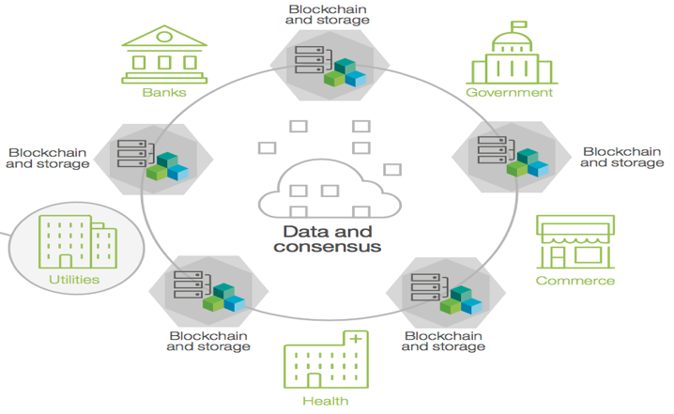
What is Blockchain?
Blockchain
Node
One “shared” business reality …
… leveraging Trusted,
Transparent, Cross-
company business
processes built on
a Blockchain network.
Blockchain
Node
Blockchain
Node
… allowing multiple and diverse business parties to transact with trust guaranteed through cryptographic security, automated consensus, and shared yet distributed standards.
An example of an
ecosystem …
Blockchain
Node
Blockchain
Node
Achieved through:
Consensus
Provenance
Immutability
Finality
All participants agree that a transaction is valid.
Participants know where the asset came from and how its ownership has changed over time.
No participant can tamper with a transaction once complete. If a transaction was in error, a new is needed to make a correction.
There is one place to determine the ownership of an asset or completion of a transaction. This is the role of the shared ledger.
!
Blockchain is
not Bitcoin
bitcoin: unregulated, censorship-resistant shadow currency offering “anonymity”
bitcoin: first Blockchain application pioneer of Blockchain technology
Notes:
Key takeaway:
Blockchains are good for building trusted, transparent cross-company processes.

Slide 6
Crypto Currency & Blockchain

Slide 7
Age old problems Historic Solutions …
1983: DAVID CHAUM introduced the idea of digital cash in a research paper.
1990: DIGICASH, an electronic cash company, in Amsterdam, is founded by Chaum to commercialize the ideas in his research. It filed for bankruptcy in 1998.
1997: COCA-COLA offered buying from vending machines using mobile payments.
1996: E-GOLD founded and backed by gold
1999: PAPYPAL was developed and launched as a money transfer service at Confinity in 1999
2006: LIBERTY RESERVE let users convert dollars or euros to Liberty Reserve Dollars or Euros
2008: BITCOIN is introduced, setting up a wave of digital currencies
Money Transfers
had to transfer money internationally, and been whacked with both a sizable fee and a terrible exchange rate?
tried to understand why transfers take many hours or even several days, when ATMs function instantaneously?
Used an international ATM, and paid five-dollar fees?
Not able to use your debit cards outside of their own nation?
Banking
Been to a country where majority of the population is unbanked?
had to change money on the black market?
left a country with local currency that was essentially worthless, unexchangeable, once you left its border behind?
had to deal with export controls, or hyperinflation?
Notes:
Business never operates in isolation. They are participants in a business network.
Business Networks will connect customers, suppliers, banks and regulators and will cross geographical boundaries.
WEALTH is generated as goods and services move across this network; this flow is referred to as a MARKET.
Growth of wealth can be constrained if the network is heavily silo’d or inefficient.

Slide 8
GOLD v/s Fiat Currency v/s Bitcoin
Why is gold valuable? Not for itself.
Those who speak of “the gold standard” as if its worth were axiomatic, rather than a collective hallucination, forget that the value of an ounce of gold is vastly more imputed than intrinsic.
If we valued gold only for its shine, malleability, and conductivity, it would be worth much less.
Why is bitcoin valuable? For the same reason that gold is valuable.
The most epochal financial transaction of this century, to date, occurred on May 22, 2010. it took place in Jacksonville, Florida. It was a purchase of two Papa John’s pizzas, in exchange for a payment whose present value currently exceeds US $4 million.
The decision by the provider of the pizza, 18-year-old Jeremy Sturdivant, that the compensation he received—10,000 units of a newly birthed currency, one called into being from the ether of the Internet, and backed by no bank or nation—was worth real bread and cheese.
Those pepperoni pizzas were the first real-world bitcoin transaction.
Is Gold a solution??
hard to counterfeit; easy to refine,
merge,
subdivide,
and transport;
and exceedingly scarce.
All the gold ever mined would not fill 4 (four) Olympic-sized swimming pools.
It is these attributes, and only these attributes, which make gold an effective medium of exchange, unit of account, and store of value … or, more succinctly, money.

Slide 9
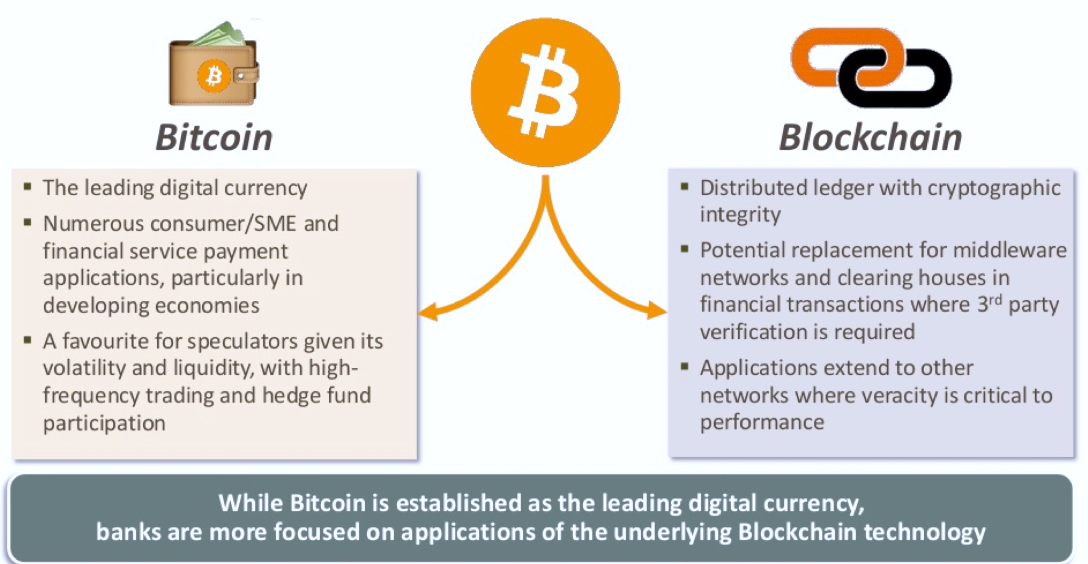
Bitcon v/s Blockchain
9
Notes:
Customer expectations are continuing to rise. No longer do we have “rate payers”, but we have “customers and consumers” who are exhibiting significant interest in controlling their own energy use and they want products and services that will help them do it.
Cost remains the most powerful motivator for desire for control and willingness to change behavior, more so than environmental concerns, reliability concerns, or other factors
Consumers are having a hard time getting (or understanding) information about the availability of new utility programs
In particular, provider messages are not reaching the youngest consumers in our survey (18-34 years old)
This is an emerging issue of concern, because this age bracket is most likely to be willing to pay for new products and services
Major generational shifts in how information is obtained imply that multiple communication channels across a broad array of old and new media are needed to be effective
Over 90% of respondents indicated that they would like to see a smart meter and tools for managing their usage available at their home, with 55-60% of those respondents willing to pay a fixed or monthly fee for that capability
Source: “Plugging in the Consumer” IBM IBV study, 2007
https://w3-03.sso.ibm.com/services/practitionerportal/ppServlets/displayDocument.wss?syntheticKey=Q957980N08460S49
Source: “Lighting the Way” IBM IBV paper, 2009
Additionally, new Entrants are entering the market to meet these expectations:
Cleantech – supporting and encouraging new entrants with “green technologies” – provided venture investment of $7.8 billion in 2010, up by 28% compared to 2009
Apple, Microsoft and Google – each beginning to offer energy management products and make renewable investments – have a combined market capitalization exceeding $700 Billion
Also, see chart in Appendix related to the broadband market comparing infrastructure investors to services investors. This situation is not unlike the transformation we’ve seen in the telecommunications business over the last 20-25 years. The winners are not necessarily the incumbents nor the participants that built and own the infrastructure.
Source: Yahoo Finance (first two bullets) and “Smart Metering & Beyond” IBM E&U Academy call 1/28/2011.
The utility that understands that this consumer evolution intersects the utility’s objectives to manage and optimize the grid as efficiently as possible is the utility that understands the “Smarter Energy” business model:
They see visibility across the network as the key to managing in real-time and garnering better reliability and safety.
They know that the knowledge others in the value chain are seeking will help them too.
And, finally, they understand that by taking intelligent action, they will achieve their own objectives while enhancing their corporate citizenship by addressing these desired societal outcomes.

Slide 10
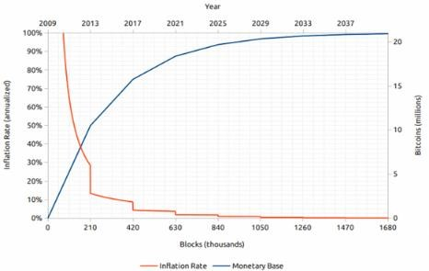
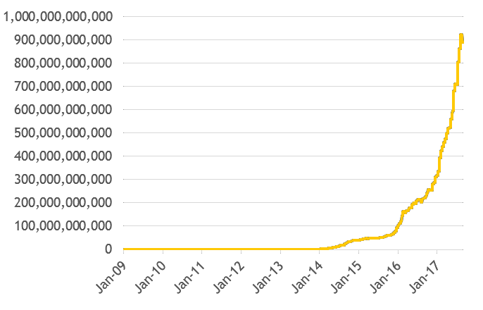
The Supply of Cryptocurrency
bitcoin supply and inflation forecast
A cryptocurrency’s supply is predetermined before its creation.
Bitcoin will reach a limit of 21 million around the year of 2140 then stop to grow. The speed of bitcoin growth is fixed. Currently ~80% of bitcoins have been mined.
In contrast, Ether’s supply will grow infinitively as of now, subject to future changes.
All Ripple was distributed upon its creation. No additional Ripple will be created or mined.
Note: The cloned coins born in a fork in a way create competing supply (bitcoin cash as an example)
bitcoin mining difficulty has dramatically increased due to intensified competition
10

Slide 11
Blockchain Use Cases

Slide 12






Blockchain Use Cases Across the Mining Value Chain
Exploration & Extraction
Compliance & Regulations
Mining & Processing
Trading & Commercial
Marketing & Supply Chain
Track/ trace for commodity& parts supply chain
3
6
Reduce supply chain costs by automation and transparency
8
10
Reduce Capital spend on major projects by better visibility of spend
Trading of unmined assets and create new revenue
Digitalisation of supply chain to reduce costs and improve efficiencies
1
Improve visibility of unmined assets and capitalise this on blockchain
Green House Gas (GHG) emissions tracking and reporting
2
4
Manage lifecycle of equipment maintenance activities
Over the Counter (OTC*) hub to create new revenue and reduce risk
7
9
11
Commodity trade finance to reduce costs and improve efficiency
Track/ trace usage and disposal of hazardous materials
Provenance, quality and authenticity to customer
5
12
*OTC – Over the counter: Bilateral trading of products including Copper, Nickel, Platinum, Gold, Diamond etc. involving a buyer and seller that is not on a regulated exchange
New value
Cost reduction
Risk Management
12

Slide 13
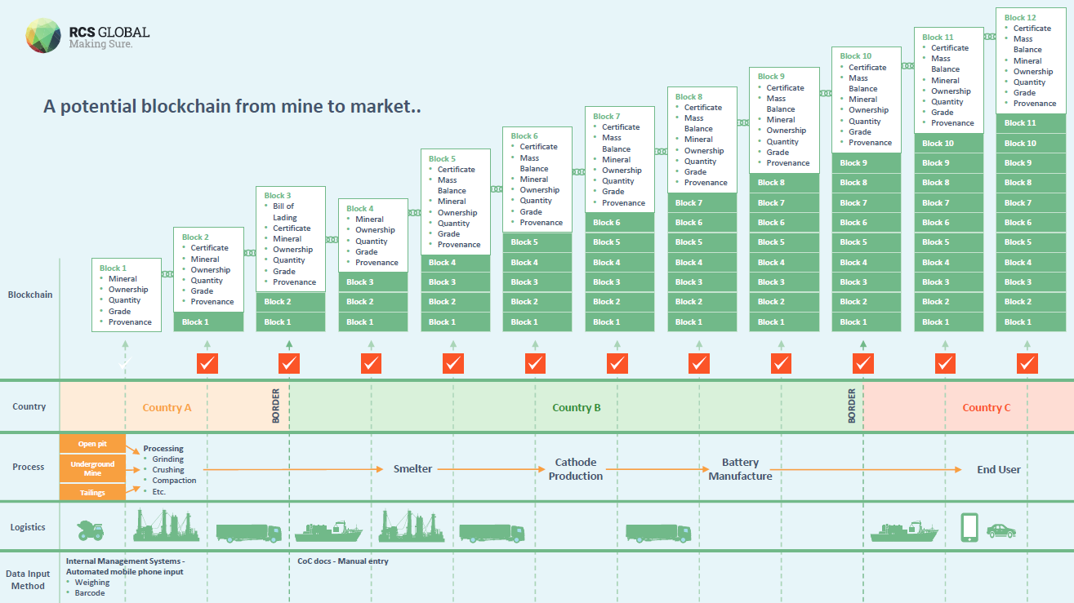
IBM & RCS Global collaboration for Mining
13

Slide 14





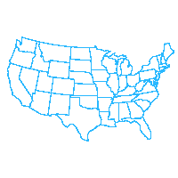



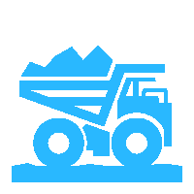







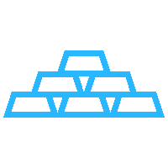







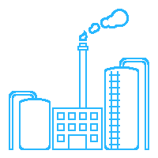





IBM & RCS Global collaboration for Mining
Current State Asset Provenance Value Chain Environment
Future State Asset Provenance Value Chain Environment
Tax, Regulatory, Compliance, Environmental, Safety, Hazardous, Reports, Filings, Certifications, Paperwork, Documentation, Etc.
Drilling
Blasting
Mining
Mucking
Interstate / Intrastate Agencies
Mining
Logistics
Companies
Cross Boarder Agencies
Trucking
Processing / Refining
Waste
Disposing
Local Regulatory
Agencies
Simplified Gold Mining Operations
Digital
Distributed
Ledger
Shared,
Permissioned, Replicated
Dore Gold
Reclamation
State Regulatory
Agencies
Traders, Exporters, Banks
Customs
Paperwork/Documentation
(Contracts, Assays, Inspection, Quality Check, Certification, Filings, Bill of Lading, Customs, etc.)
Local,
State,
Federal,
Tax,
Etc.
Federal Regulatory
Agencies
Environmental
Refineries / Smelters
Regulatory Agencies
Trucking
Companies
Wholesales / Retailers
Security
Companies
Trucking
Companies
Helicopter
Companies
Airplane Companies
Customs
Refiners
Traders /Exporters
Banks
Wholesalers
Retailers
International
Borders
14

Slide 15







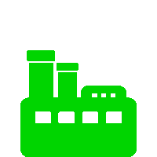







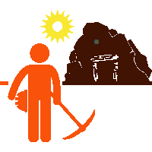
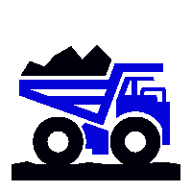

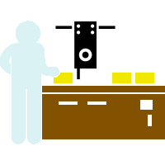



Illustrative Art of the Possible: Non Conflict Gold Value Chain
Geo
Sys
Source Sys
Analytics &
Cognitive
Reports / Analysis
Source Sys
Reports
Analysis
ERP
Data Lake
Local,
State,
Federal,
Tax,
Etc.
Logistics
Companies
Traders, Exporters, Banks
Cross Boarder Agencies
Environmental
Batch/Lot
Geo/Region
Refineries / Smelters
Regulatory Agencies
Mine Video
Assays
Certificates
Bill of Lading
Contracts
Customs
Filings
Blockchain Network
IoT Mobile App
IoT GPS Tracking Sensor Device
Refineries
Banks
Retailers
Mining
Trucking
Processing
Refining Plant
Quality Certificates
Gold
Logistic Carriers
Customs
Smelters
15

Slide 16
An Adoption Approach

Slide 17


Blockchain Innovation
RAPID ENGAGEMENT MODEL
Post-
Deployment
Optimize Value Captured
Week 3-4
Select and Test Use Cases
Week 8-12
Deliver Capability
Week 4-8
Design and Develop Solution
Week 2
Identify
Internal / External
Partners and Stakeholders
Week 1
Decipher the Market; Define Business
Objectives
Model the impact of costs and value
Assess price and value realization
Explore further joint strategic investments that can unlock greater shared revenue
Consider networked ecosystem expansion to drive greater new revenue and growth
25 | IB M CO N F I D EN T I A L
Create
the business case to align with business goal(s) and review target market / network
players to optimize goals
Identify the platform, delivery models and skills needed
Deliver and run the blockchain enabled business offering
Significantly remove process friction, releasing capital and identifying new revenue growth
Design architecture and define product backlog of the business offering
Identify cognitive interaction points
Develop and deploy the offering in incremental sprints
Reimagine business models
and new markets by collapsing already digitized processes through IBM Design
Thinking Workshop and identify new eco-system partners
Drive clarity, understanding and action on the market opportunity or threat for your business

Slide 18
Public blockchain vs Private blockchain
Public blockchain
Private blockchain
Consortium blockchain
Example: Bitcoin, Ethereum
Public blockchain allows everyone to access and contribute to its database. Since there is no central owner/operator of the ledger, everybody on the chain is responsible for the integrity of the database.
Advantage: Immutable, high security, individual anonymity
Disadvantage: Relatively slow transaction speed, scalability constraint
Use case: Cryptocurrency
Example: Ripple
A private blockchain has a company writing and verifying each transaction. This allows for much greater efficiency and transactions on a private blockchain will be completed significantly faster.
Advantage: High transaction speed, privacy
Disadvantage: Low decentralized security
Use case: Enabling traditional business
Example: R3, Hyperleder, Enterprise Ethereum Alliance
Consortium blockchain is partly private, allowing a few selected
nodes to write and verify transactions.
Advantage: High transaction speed, privacy
Disadvantage: Low decentralized security
Use case: Cross platform cooperation
18

Slide 19

IBM Blockchain Strategy – Making Blockchain Real for Business
IBM Blockchain
Ecosystem
Support
Education, support and GTM services to create a thriving ecosystem for Blockchain on Fabric
Blockchain Solutions
Provide
Solutions to transform business processes and industries by creating and operating Blockchain business Networks with enterprise participants
Build
Operate
Invest
IBM Blockchain
Platform
Provide
Infrastructure, developers tools, reusable assets and network services to enable the creation and management of Blockchain business networks
Invest
With the Linux Foundation community to ensure the best possible foundation for Blockchain
Fabric
19

Slide 20

High Level Roadmap – Success of the Pilot will depend on immediate mobilization of resources from all stakeholders within IBM and Clients
Phase 0
Phase 1
Phase 2
Phase 3
Phase 4
Stakeholder Definition
Project Charter
UAT Testing
Mgmt sign-Off, Training
Partner Discussions
Partner Decision
Mgmt
sign-Off,
Requirements planning, Use Case Testing, Change Management
Your Organization
Resource Planning
1 Week | 1 Week | 4 – 12 weeks (Based on project scope) | 2-6 weeks | 2 weeks
Solution Discussions
Process requirement
Solution Build, Integration analysis, Infrastructure analysis, Change Management
Partner Sign-off
Business Process analysis
Solution Updates, Parallel Testing
PLEASE NOTE: Timelines denoted above are indicative and based on our experiences at your peers. Accurate roadmaps will be created only after scope is confirmed with client
20

Slide 21
Commercials – Key Cost Factors
# | Cost Component | Description | Dependencies
1) | Blockchain Development Cost (Services) | Consulting services for developing the chain code for the business logic agreed with the bank (e.g. Smart contracts) Liaison with business to draft functional and technical requirements Overall engagement management for client and IBM | Business functionalities selected as part of the development phase
 | Developer Team: Chain Code, Java, UI and UX Architects, Application architects, Solution Architects, etc.,
 | Business Team: Project Manager, Business Analyst, etc.,
2) | AMS Cost (Applicable to production only) | On-going maintenance of blockchain business logic code developed in #1 above | Complexity of business functionality selected in #1
3) | Blockchain Software / Hardware Cost | Cloud hosting services and hardware cost
4) | AMC Support Cost (Applicable to production only) | Support staff assigned for #3
5) | Onboarding New Participants ($ per participant) | Onboarding new participants and customization of interface based on agreed business rules. On a case by case basis the cost will have 2 components - | Evolution of pilot by adding additional roles to the network
 | Techno functional Consulting | Building business logic for the participant
 | Technical and Environmental Support | Infrastructure impact from adding new participants
6) | Intellectual Property | Licensing and IP related costs based on agreed T&Cs
PLEASE NOTE: All cost components mentioned in the table below are indicative. Actual components will be determined after detailed scoping and process decomposition discussions with clients
21

Slide 22
IBM References
Northern Trust: http://www-03.ibm.com/press/us/en/pressrelease/51655.wss
Maersk: http://www-03.ibm.com/press/us/en/pressrelease/51712.wss
HSBC, Bank of America, IDA: http://www.coindesk.com/hsbc-bank-america-blockchain-supply-chain/
ABN AMRO: https://www.abnamro.com/en/newsroom/blogs/arjan-van-os/2016/walking-the-walk-exploring-the-power-of-blockchain.html
Crédit Mutuel Arkéa: http://www.coindesk.com/ibm-completes-blockchain-trial-french-bank-credit-mutuel/
JPX: http://www.ibm.com/press/us/en/pressrelease/49088.wss
Kouvola Innovation: http://www.ibm.com/press/us/en/pressrelease/49029.wss
London Stock Exchange: http://www.ibtimes.co.uk/linux-foundation-blockchain-consortium-digital-asset-ibm-credits-london-stock-exchange-board-1533798
Mizuho: http://www.coindesk.com/mizuho-digital-currency-powered-blockchain-settlement/
IBM Global Finance: http://www.coindesk.com/ibm-building-blockchain-dispute-resolution-system/
Everledger: https://www-03.ibm.com/press/us/en/pressrelease/50169.wss
Bank of Tokyo Mitsubishi: https://www-03.ibm.com/press/us/en/pressrelease/50544.wss
China UnionPay: http://www.coindesk.com/ibm-china-unionpay-blockchain-loyalty-exchange/
CLS: http://www.coindesk.com/cls-to-develop-blockchain-payment-service-on-ibm-fabric/
UBS: http://www.coindesk.com/ubs-blockchain-prototype-trade/

Slide 23
IBM Contact Details
IBM Participant | Role | Contact Details
Jitan Chandanani | Blockchain Leader – India & South Asia | chandan1@in.ibm.com (+91) 99870 - 09777

