Slide 1


Quality, Reliability & Indian Benchmark
India International Gold Convention, Goa , 12th Aug 2017

Slide 2
Benefits of any Good Delivery accreditation
Today
Tomorrow
GOOD DELIVERY
1
Quality inconsistency; no benchmark
Not accepted by banks & exchanges
Trust deficit
Not-acceptable for export of jewellery
1
Consistent, independent verifiable quality
Accepted by banks & commodity exchanges
Full traceability
Common industry platform facilitates domestic gold policy formulation
2
2
3
3
4
4

Slide 3
What does India Good Delivery require ?
Flexibility
Enabling INDIANISATION
Responsible
Gold
Industry Reputation
Quality
TRUST & CREDIBILITY across gold value chain
Conformity

Slide 4
Consultative Process to ensure guidelines that work for everyone
Draft
Closed
In Process
To Initiate
In Process, to close in Q3 2017
Industry Feedback
In Process, to close in Q3 2017
Multiple Regulatory Inputs
Within Q4 2017
Final Draft

Slide 5
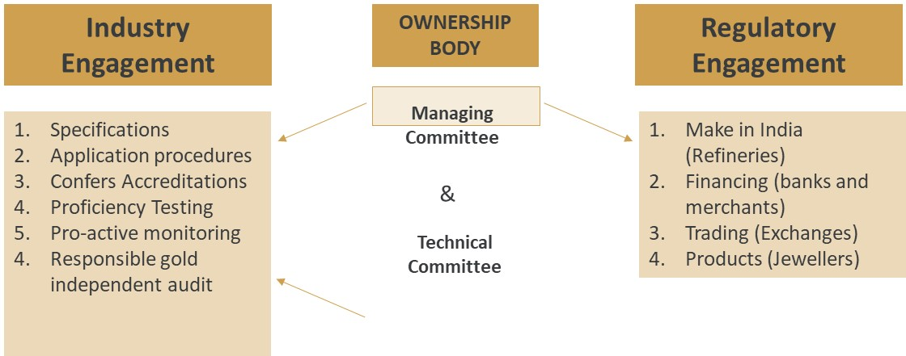
“By the industry, for the industry”

Slide 6
What next ?
Comments are invited on :-
Specifications
Application Procedures
Proficiency testing
Pro-active monitoring
Responsible Gold Audit

Slide 7


THANK YOU

