Slide 1


CORPORATE
OVERVIEW

Slide 2


Slide 3
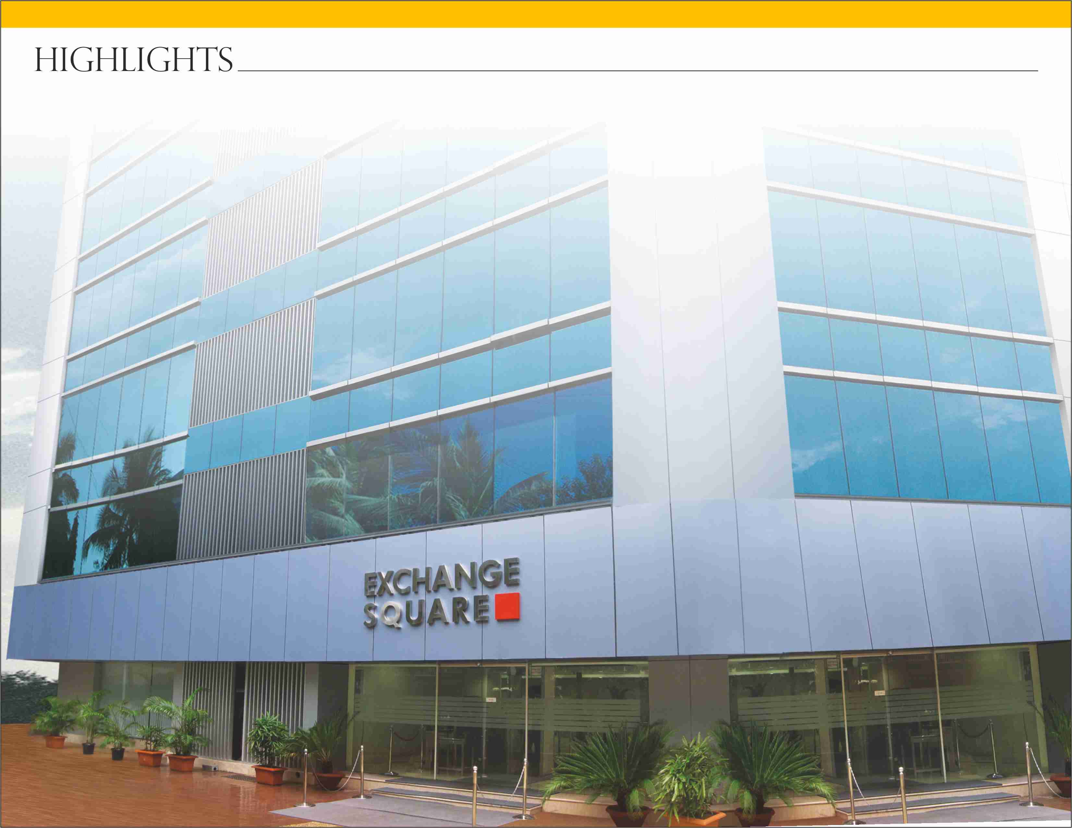

India’s no. 1
commodity futures exchange

Slide 4
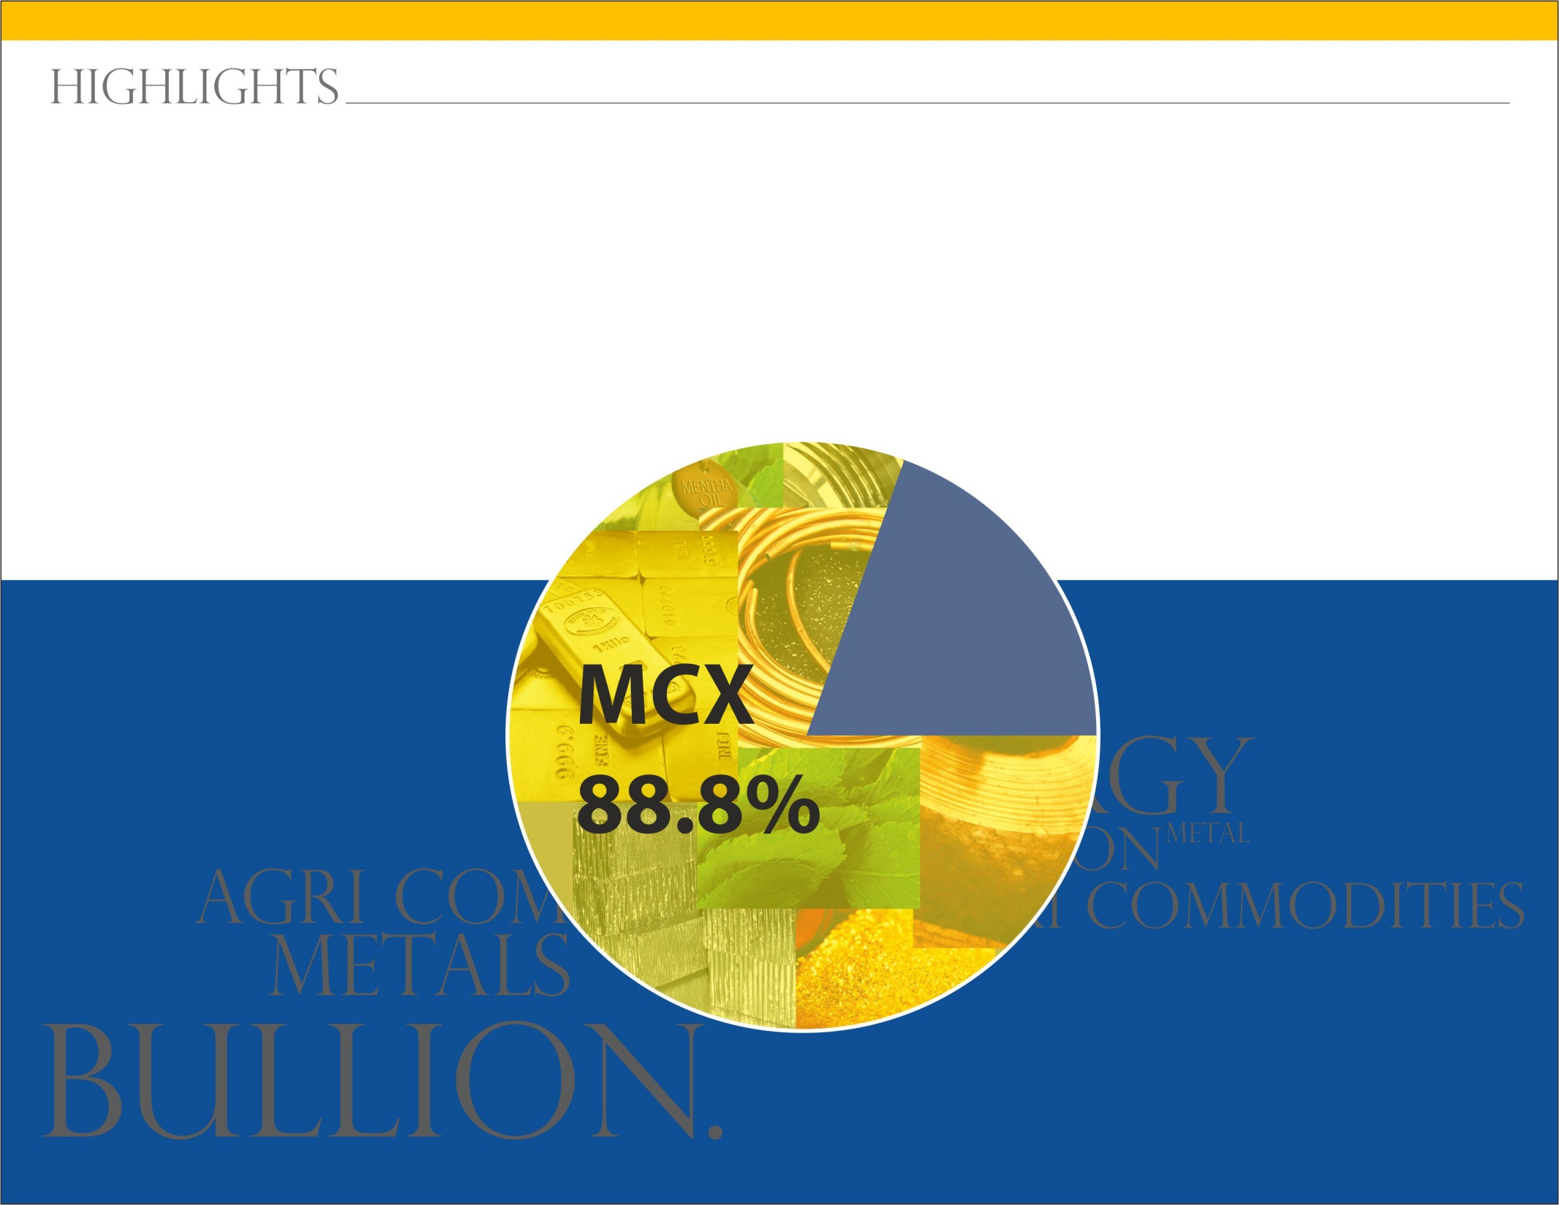
Market share
in Q1 - FY 2016-17

Slide 5
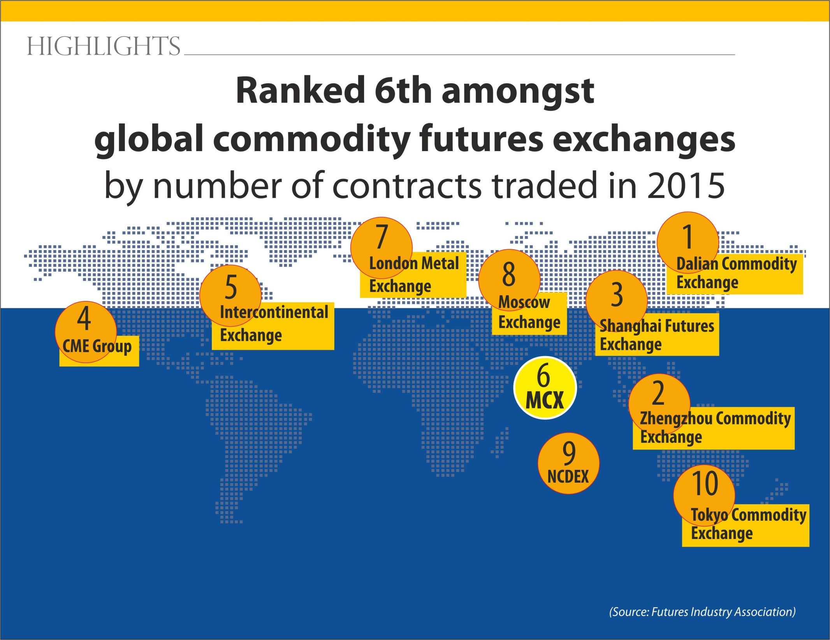

Slide 6
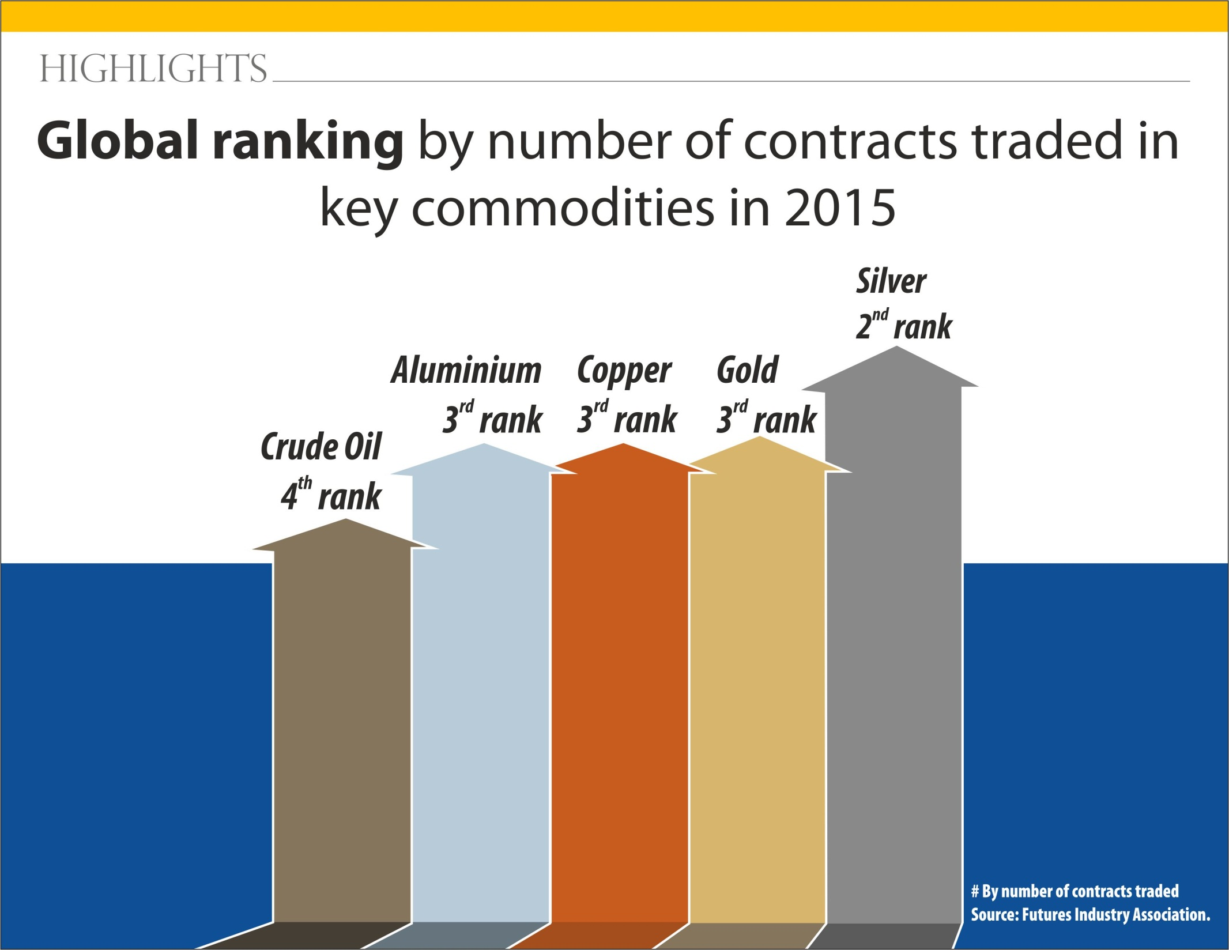

Slide 7

Bullion Global Ranking
Gold Ranking
 | 2015 | 2014
Exchange | Lots
CME Group | 1 | 1
SHFE | 2 | 2
MCX | 3 | 3
TOCOM | 4 | 5
Moscow Exchange | 5 | 4
Silver Ranking
 | 2015 | 2014
Exchange | Lots
SHFE | 1 | 1
MCX | 2 | 2
CME Group | 3 | 3
Moscow Exchange | 4 | 5
ICE | 5 | 4
Rankings are based on (i.) Total number of futures traded in terms of lots for all variants of the commodity traded on an exchange in the year. Source: FIA Annual Data/ MCX Research & Planning

Slide 8
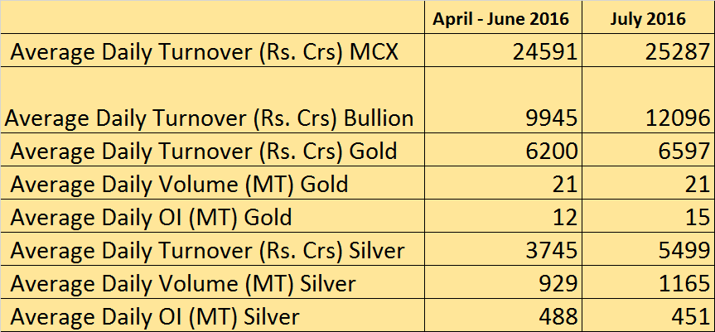
MCX Bullion Performance FY 16-17

Slide 9
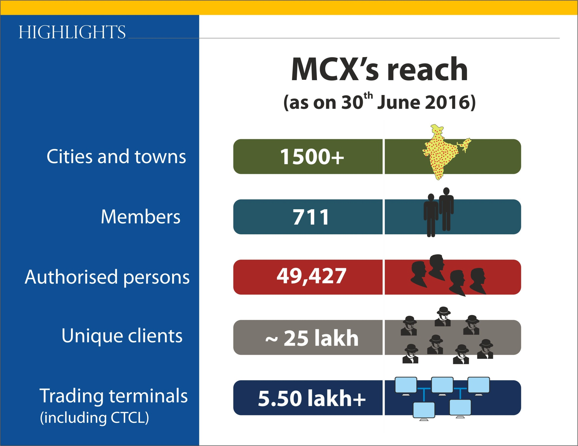

Slide 10


Slide 11


Slide 12


Slide 13


Slide 14
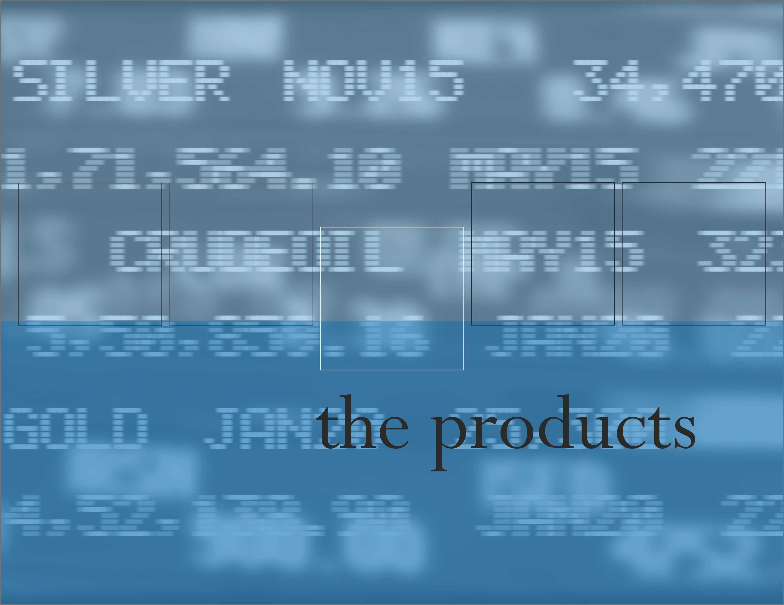

Slide 15
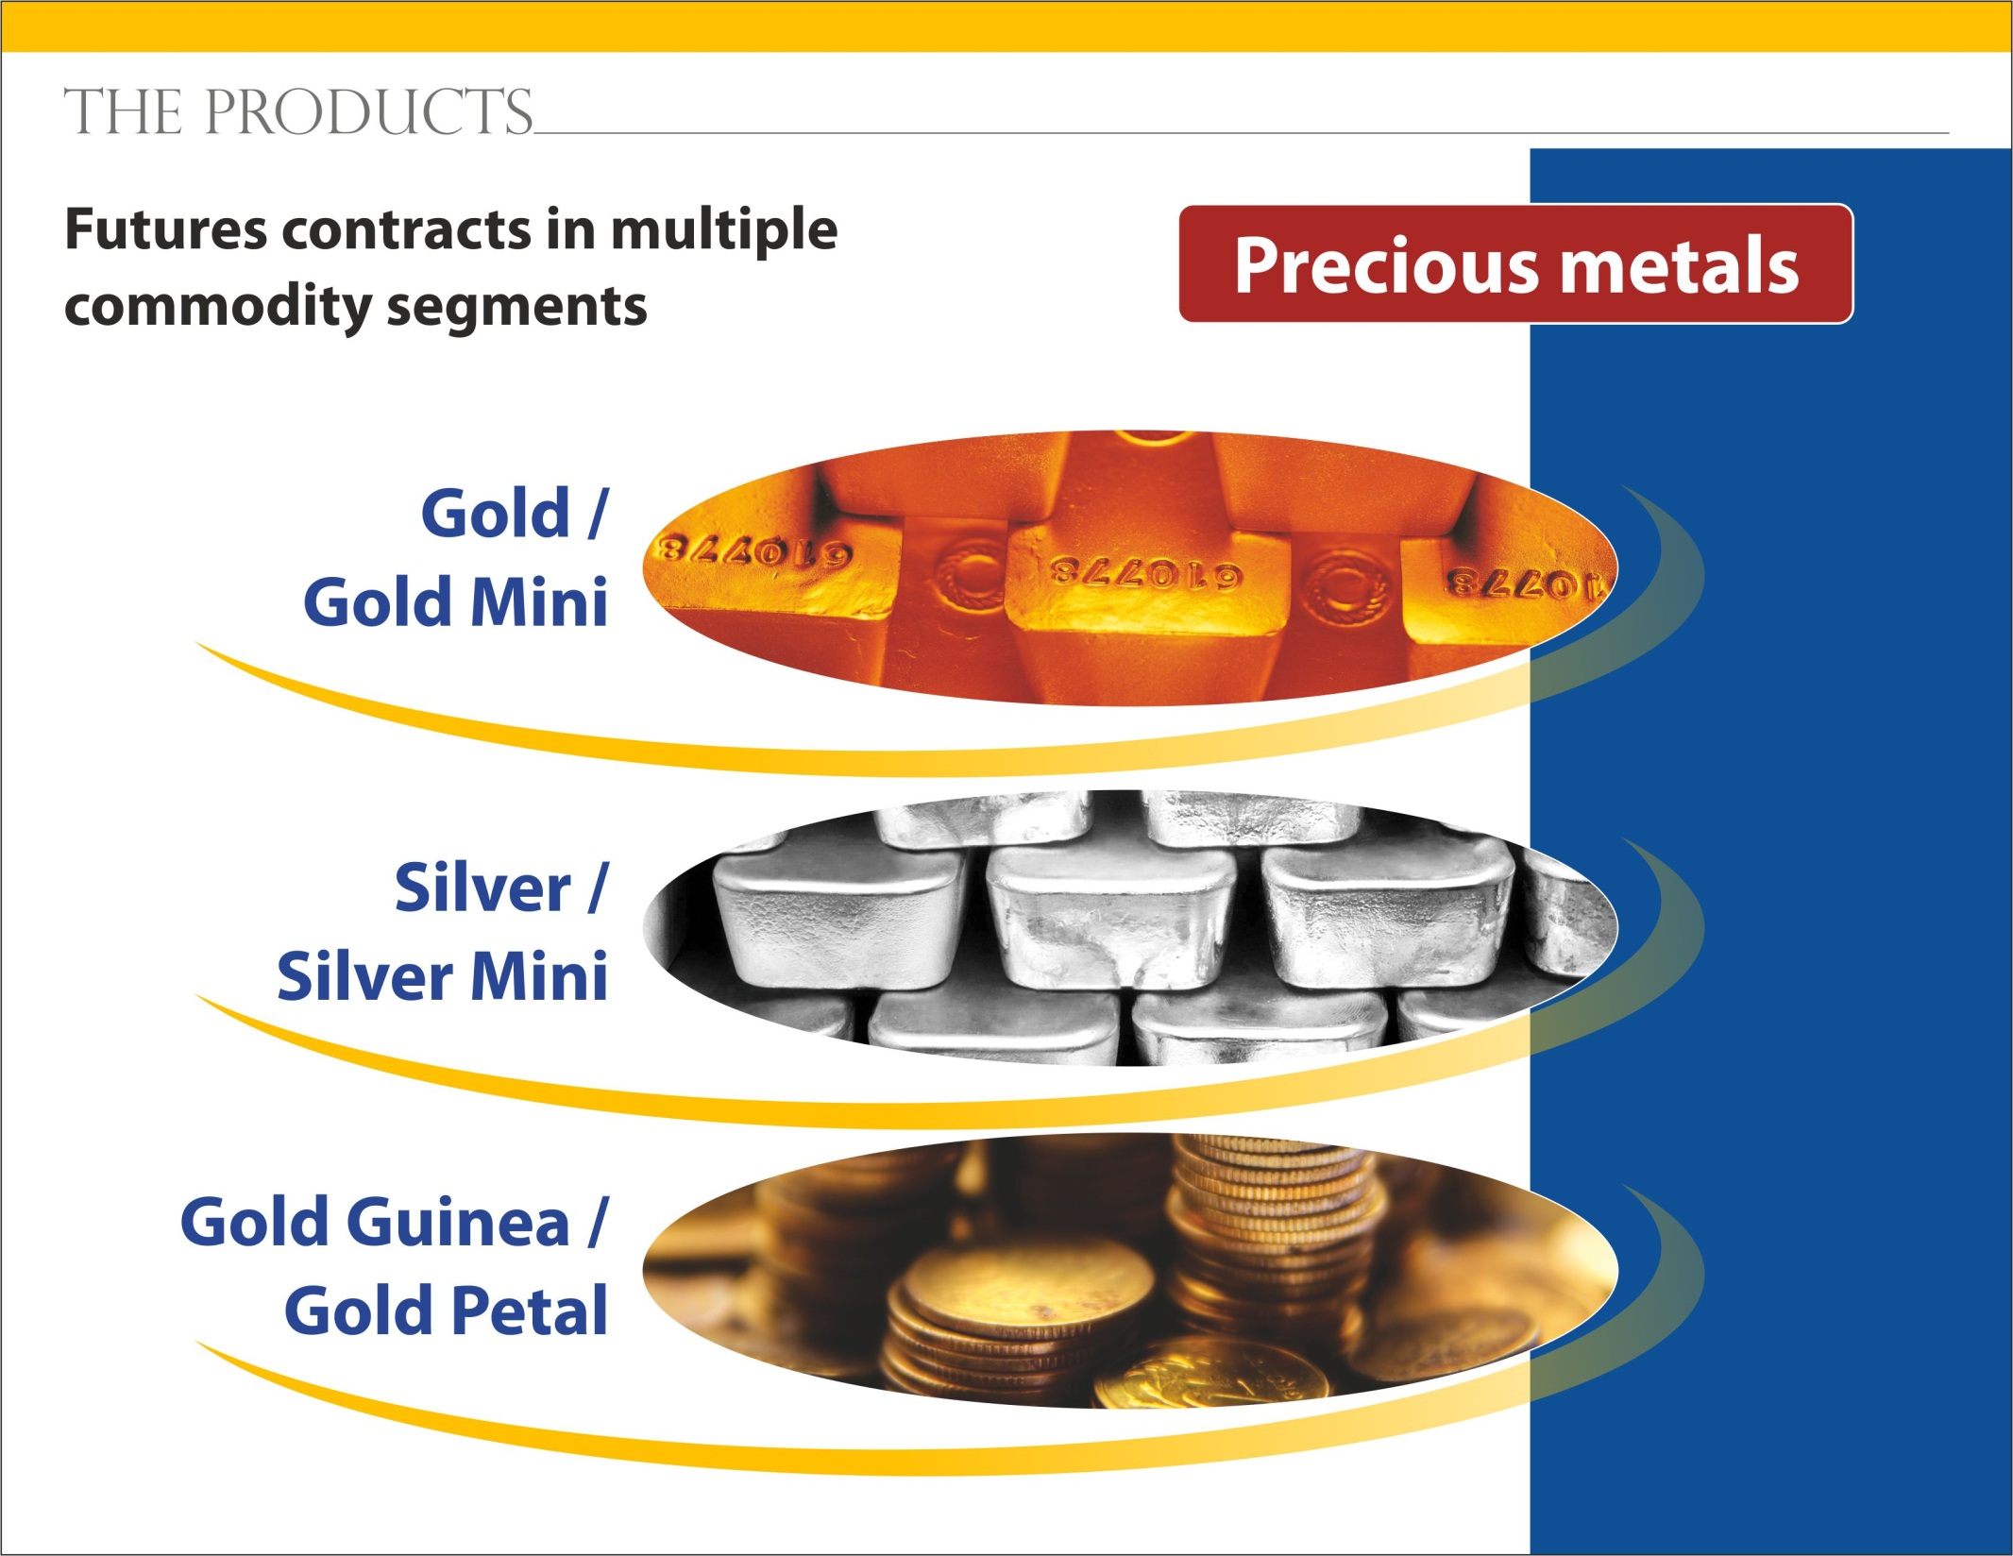

Slide 16
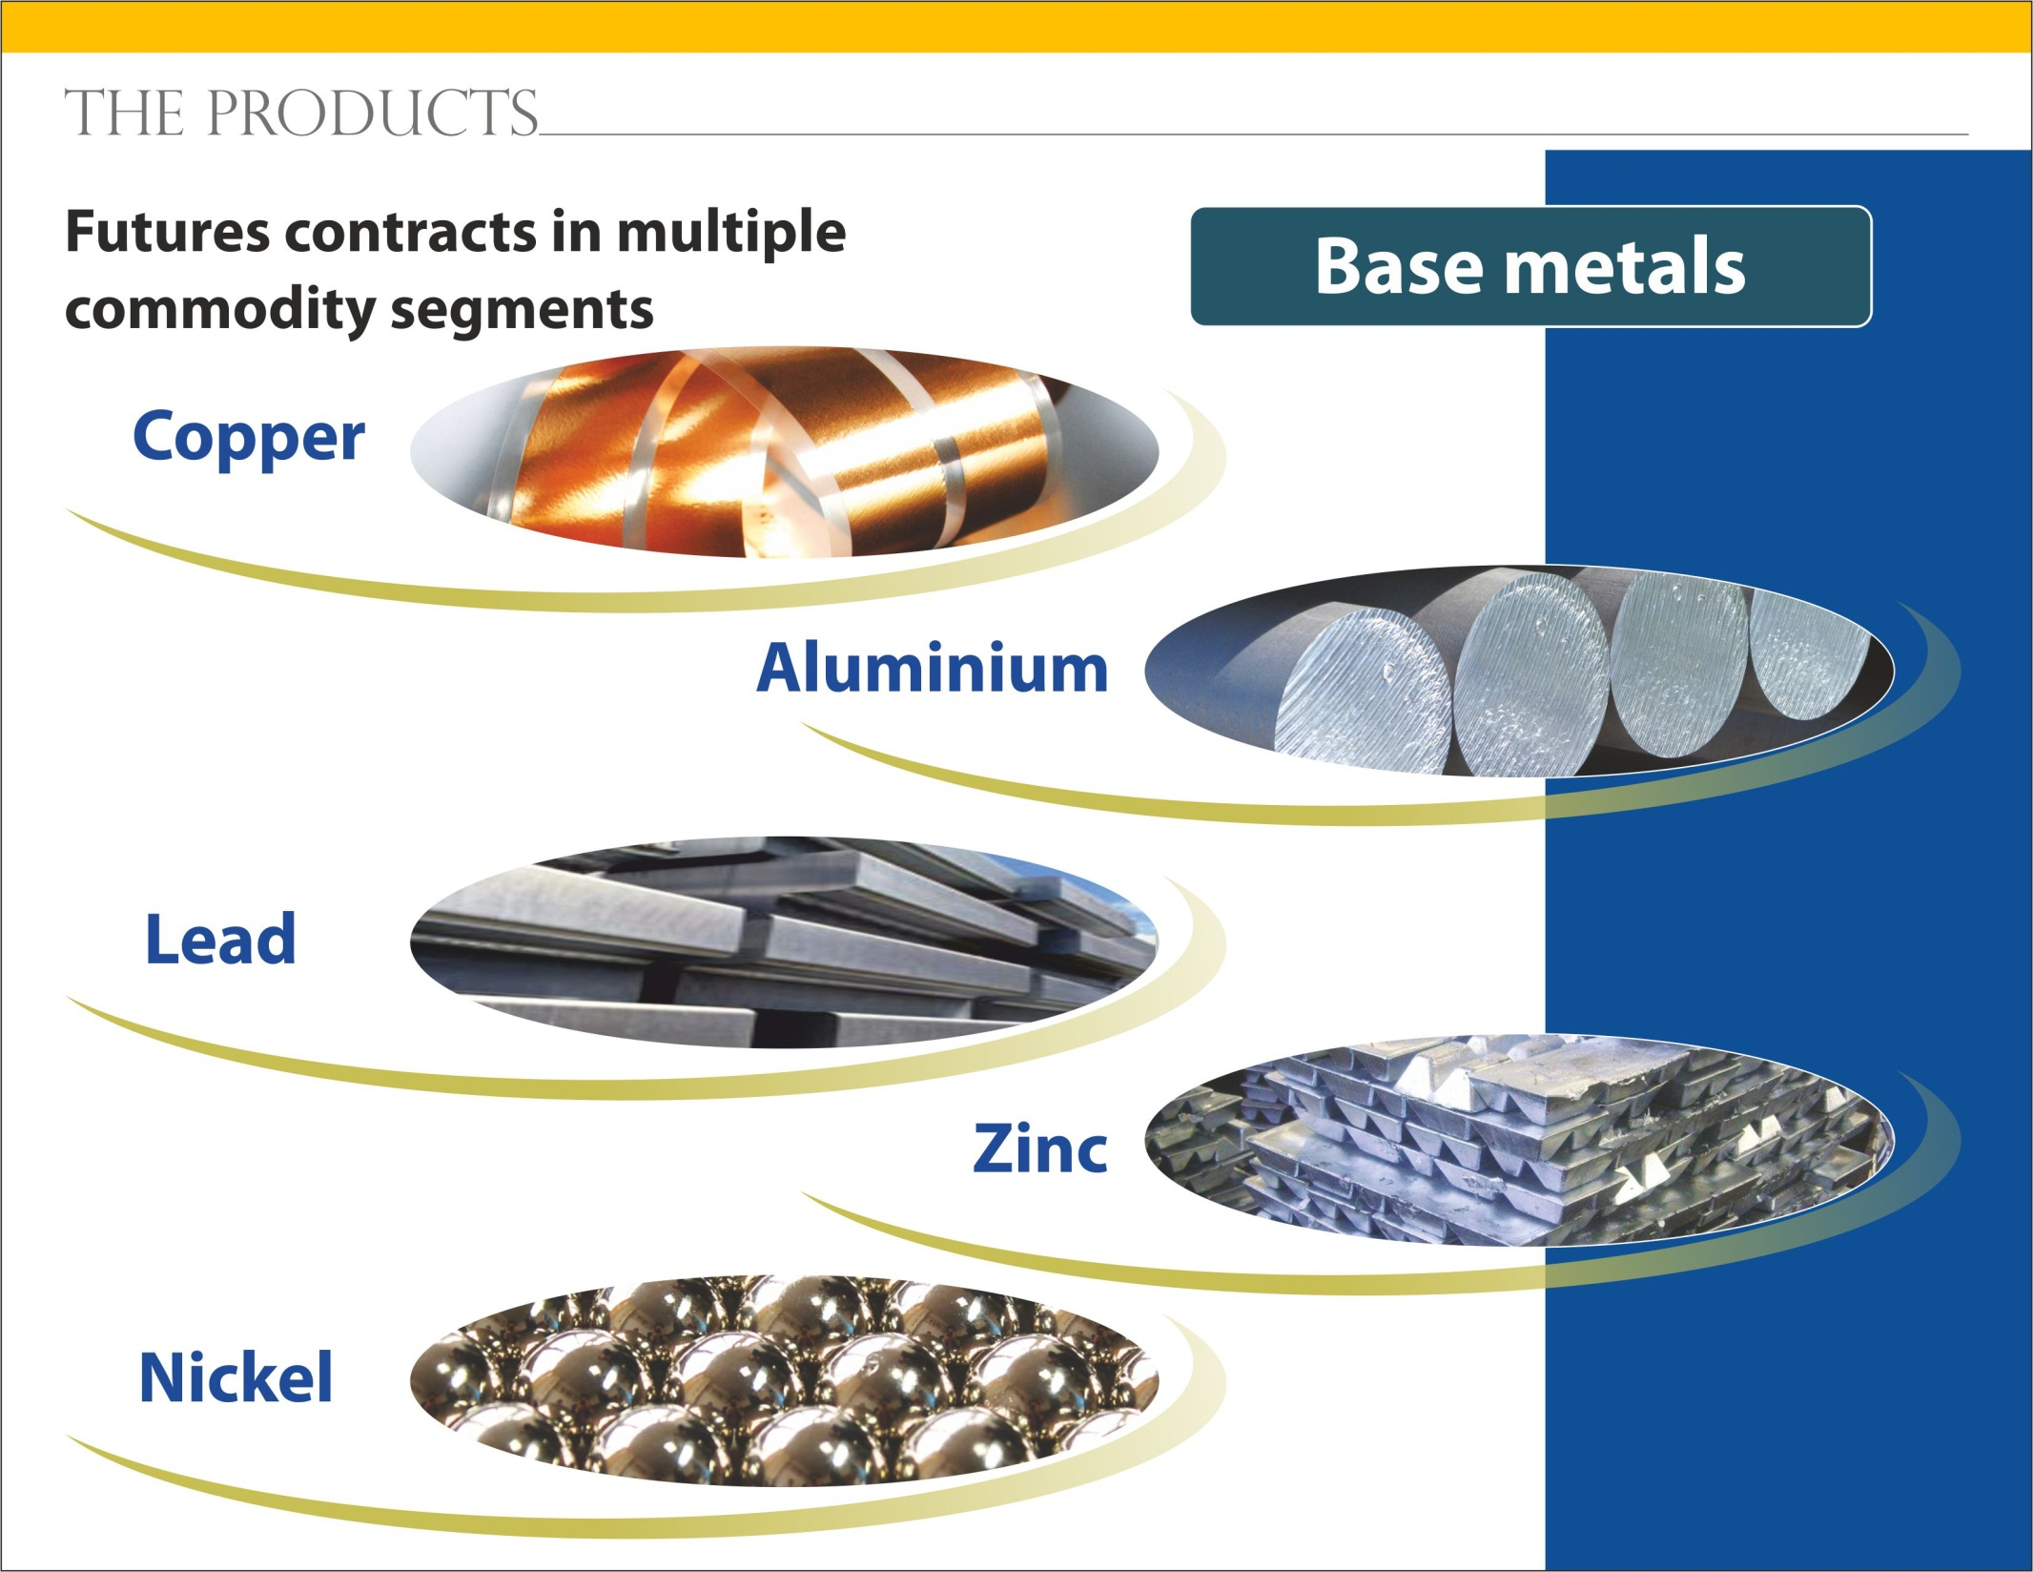

Slide 17
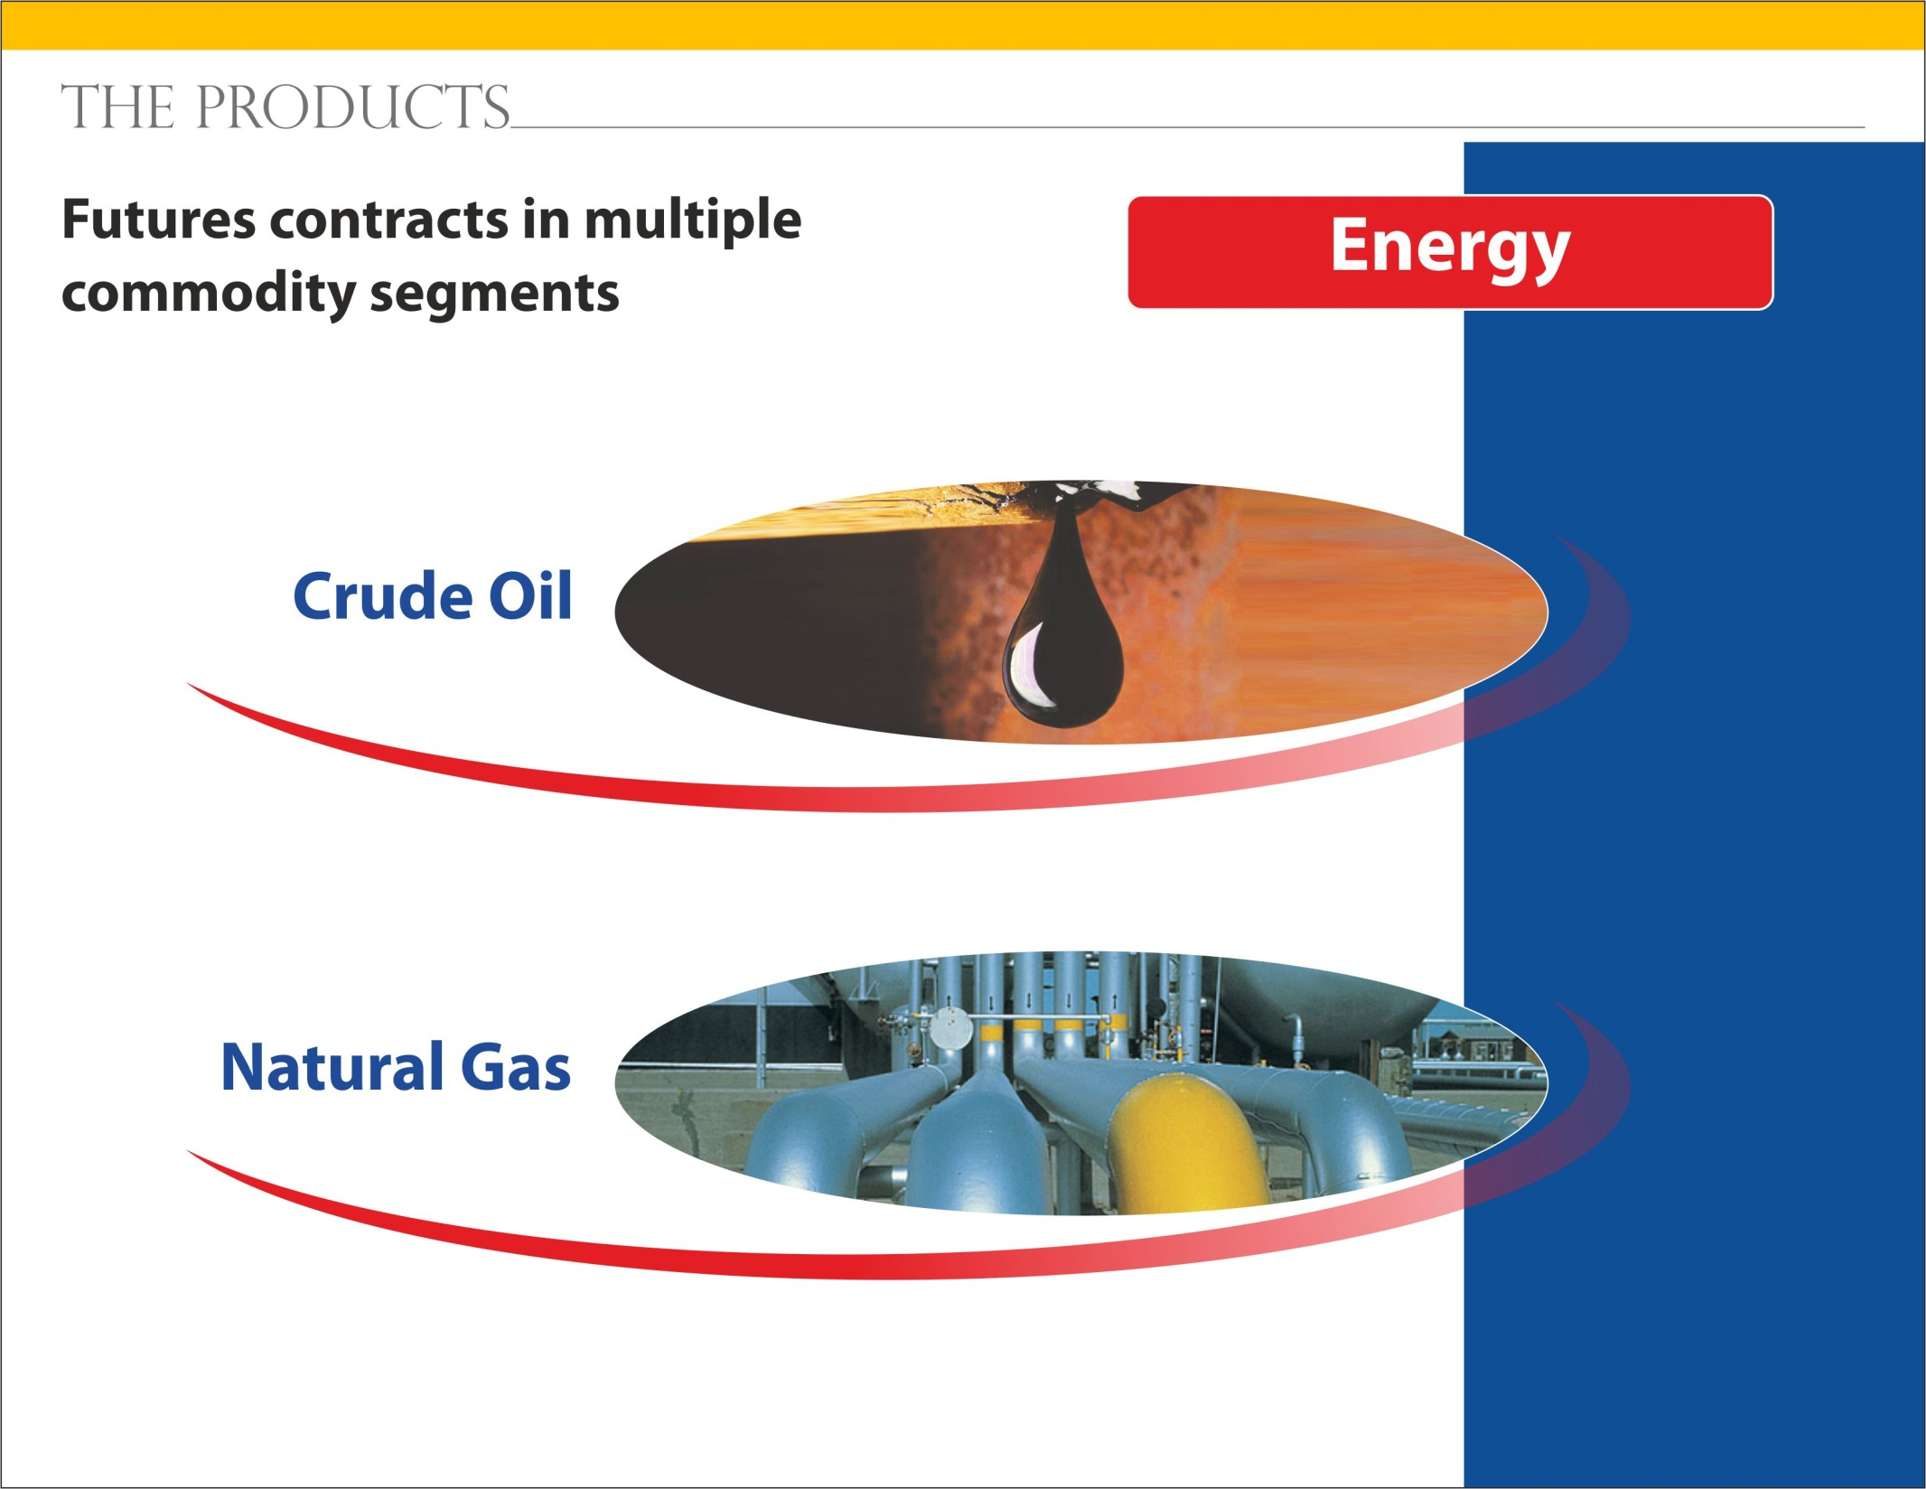

Slide 18
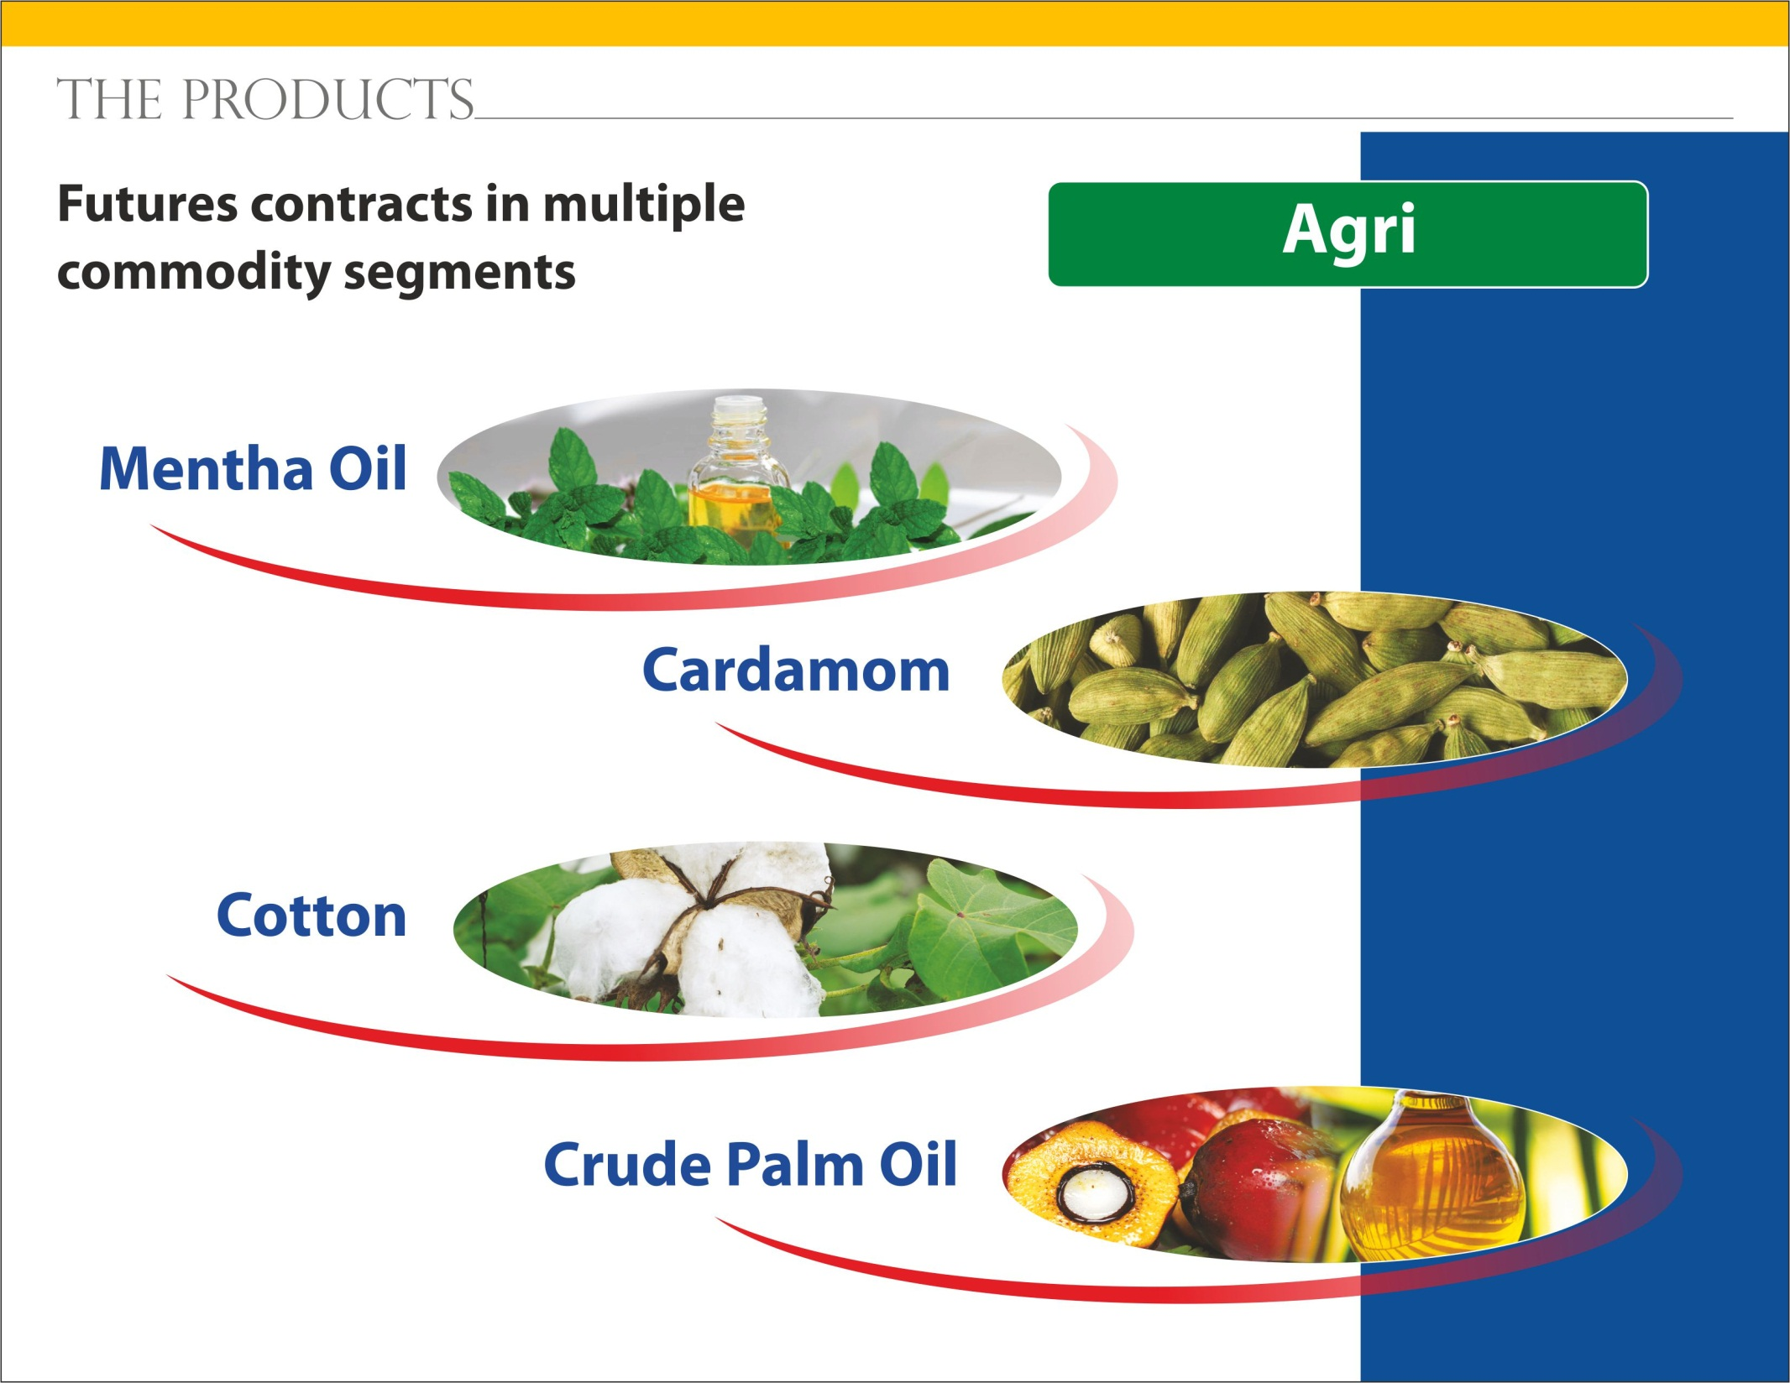

Slide 19


Slide 20


