Slide 1


DORE & SCRAP SOURCING
Emerging regulatory framework on responsible sourcing
Sakhila Mirza, Executive Board Director / General Counsel
12 August 2017

Slide 2

LBMA VISION & MISSION
The World’s Competent Authority for Precious Metals
Develop the precious metals market landscape to meet current and future needs by developing and enhancing services, corporate structure, and governance.
Clearing System
Benchmarks
Metal Accounts
Vaulting Services
New Services
Good Delivery

Slide 3
GLOBAL PRECIOUS METALS CODE (PMC)
To promote integrity and effective functioning
 | Chapter | Principles
1 | Ethics | High ethical and professional standards; manage conflicts of interest
2 | Governance, Compliance, Risk Management: | Appropriate oversight; compliance and risk management frameworks; escalation’ independent reviews/assessments
3 | Information sharing | Handling confidential information; provide for clear, accurate communication
4 | Business conduct | Pre-trade and execution; due diligence; handling orders fairly; guidance on Mark-ups; benchmark auctions
5 | Business conduct | Post-trade (confirmation process, netting, settlement, shipping)
 | Annex | Illustrative examples: definitions, conventions

Slide 4
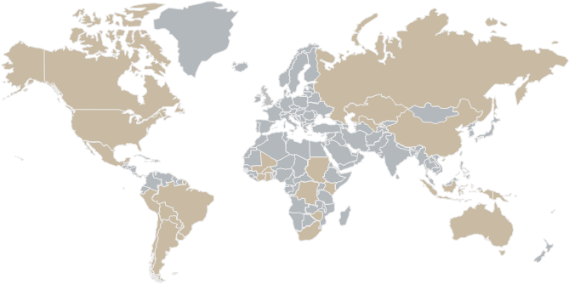
GOLD DORE SUPPLY & REFINING
GDL Refiners
Gold Producing Countries

Slide 5

LBMA GOOD DELIVERY LIST
Includes the world’s pre-eminent refiners of gold and silver located in 31 countries.
Annual production of 71 LBMA Gold Refiners
~85-90% of annual world gold production.
The List is widely recognized as the de facto standard for the quality of gold and silver market bars and is used by precious metal exchanges around the world to define in whole or in part the refiners whose gold and silver bars are accepted in their own markets.

Slide 6

LBMA RESPONSIBLE SOURCING
Ensuring long term integrity of the wholesale gold market
LBMA Responsible Gold Guidance
Global Risk Assessment
Encourages engagement
Tailored due diligence for all feedstock (mined, ASM & recycled)
Independent 3rd party audit
Emphasis on Public Reporting
Refiners Toolkit

Slide 7

DUE DILIGENCE APPROACH
Continuously Review and Monitor
Auditors
Review, approval and training of auditors.
Incident Management
Procedure in place for any incidents (media reports etc.) which occur outside of the regular RGG review cycle.
This may involve the requirement for further conversation or assurance from auditors (11 Steps)
Report reviews & Corrective Actions
Reports which may require complex decision making are referred to the Audit Review Panel
From initial application, to annual review the ‘fitness to practice’ of auditors is always in focus.
Reports are reviewed to ensure enough detail is provided to allow LBMA to make an informed approval decision

Slide 8
Continuous Review and Actions
Incident Management Process
This procedure is invoked in response to a particular stimulus of a reputational nature; this includes any incident that affects the credibility of the GDL
Iterative process, particularly in situations where new information is produced or the situation escalates or deteriorates.
Any public disclosure by the LBMA must be approved appropriately and disseminated through correct channels.
If at any point in the procedure it is established that the issue could relate to Anti-Money Laundering (AML), step 6) Refiner Contact may be omitted and the relevant specific action taken.
1. Receipt/Logging of Complaint/Issue
2. Media and Market Review
3. RGG Audit (or equivalent) Review
4. Auditor Review and Interaction
5. Legal Review
6. Refiner Contact
7. Physical Committee Reporting and Escalation and/or Legal Consultation
8. Action/Sanction
9. Public Disclosure
10. Lessons Learnt
11. LBMA Communication

Slide 9
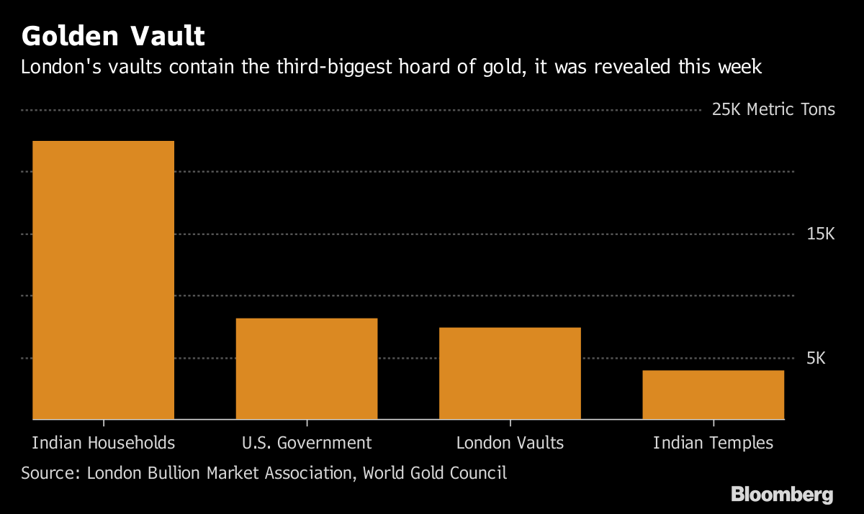
TRANSPARENCY: VAULT HOLDINGS
London Market
7,449 tonnes of gold, valued at $298 billion.
This equates to approximately 596,000 gold bars
All responsibly sourced from GDL refiners
Market confidence

Slide 10

A date for your diaries!
LBMA Precious Metals Conference 2017
Hotel des Artes, Barcelona
15-17 October

Slide 11
Sakhila.mirza@lbma.org.uk
www.lbma.org.uk

