Slide 1


20 Gold Mines in India ?
= 100 tonnes domestic gold dore per year
Make in India

Slide 2
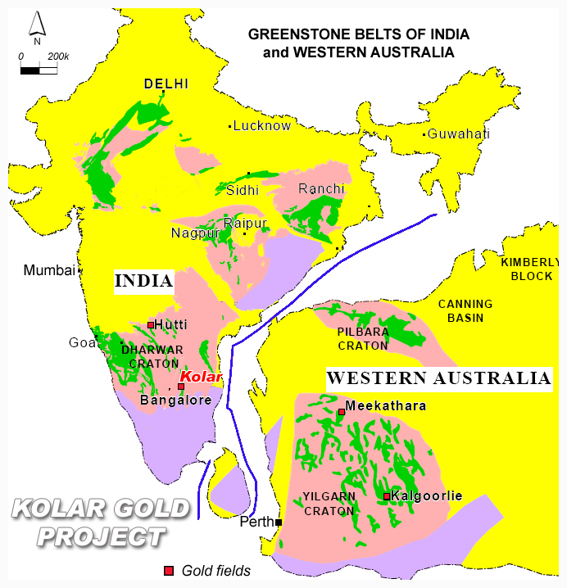
Sister Geologies – India, Australia, Africa
Massive Archaean Greenstone Gold Belts
Project A
1 Mine prodn 1.4t in 2015
850t consumed 2015
  5000yrs ancient gold mining,
  300+ mineralized gold projects
  600t Gold defined in the ground.
  incl 100t reserve ready to mine.
  400,000 km2 issued for RP gold expln.
  Only 500 km2 converted to PL !!
Africa
prodn
350tpa
~50 Gold Mine prodn
250 tonnes in 2015
Greenstone Gold Belts

Slide 3
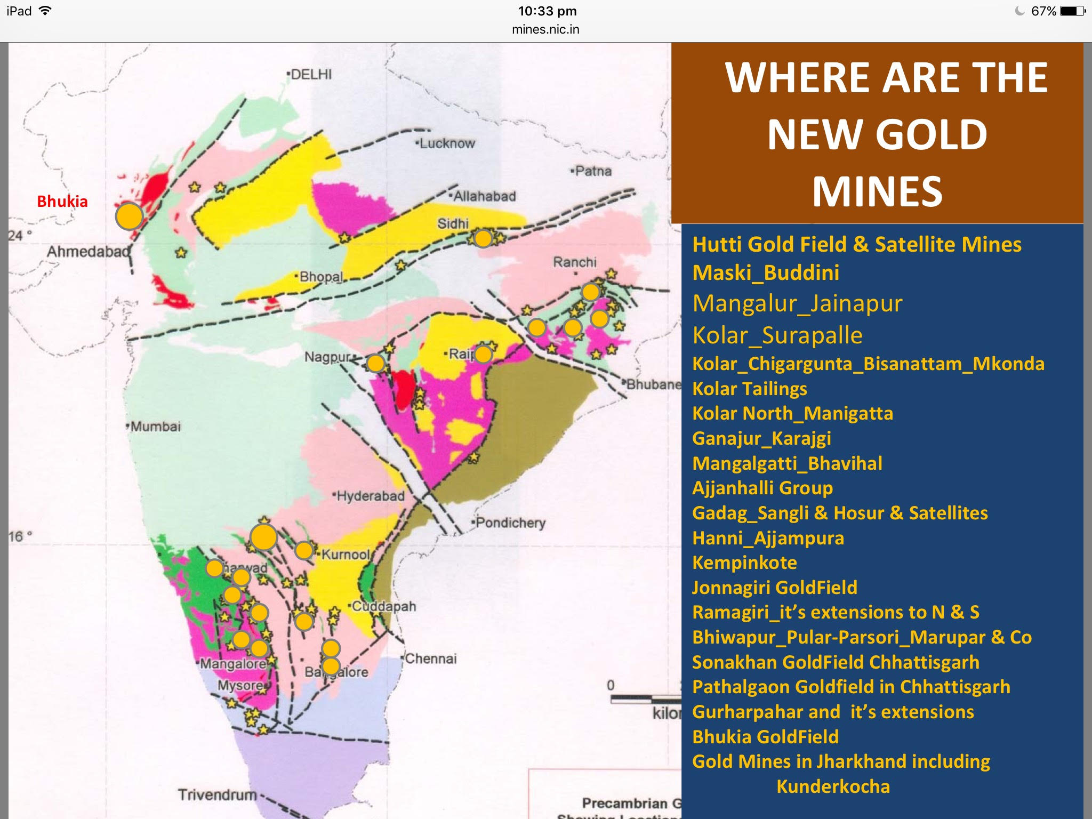
GoI MoM 12th 5yr plan has set a goal… to produce 100t gold per yr by 2025.
All lease areas are held by Gold mining companies with expertise and funds available
to develop 20 gold mines

Slide 4
India Gold Mining Challenges
PERMITTING
120+ steps to get a mining licence!
Only 1 gold ML granted last 15yrs, which took 6yrs work!
Forestry and MoEF severe bottle necks, 1-2yrs+
17 of the 20 gold projects are stalled/stuck in permitting
Currently <$3m pa private gold exploration work underway…
vs $25bn gold resource
NO GOLD MINING PLAN or PRIORITY
MoM Gold projects are buried under weight of coal and iron ore mining
No gold mining incentive or assistance or govt priority
Most gold explorers have left India - not investor friendly
MoM, GSI, MECL do expln & feasibility?
Should do quality geoscientific data and efficient permitting
MMDR needs to be world competitive and attractive, refer Canada, Australia, Sth Amercia & China…

Slide 5
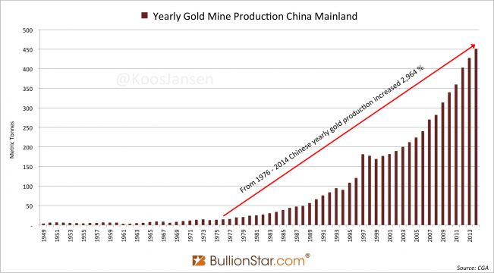
China Gold Mining : 10t to 450t per yr
Via fast track permits issued to gold experts + Govt edict/incentives

Slide 6
How can India build 20 Gold Mines?
Create Gold Mining Policy as part of an Indian Gold Policy
Central Govt agency, Single window permit assistance
MoM + MoF + PMO + State Govts to commit to 20 priority gold mines
- senior resources to monitor and push
Joint Mine Development : Lease owners + partners + funding + Govt asst
Incentivise gold mine devt: tax, water, power, data, permit fast track
MMDR reviewed, tailored and improved for gold
Gold Industry Supply Chain: Gold mining > Refiners > Jewellers > Retail
Assist Gold Industry to secure gold dore supply in India, Africa & Australia
Let us build these gold mines together, Thankyou

