Slide 1


Structuring India's Gold Policy.
New Delhi, 5 Aug 2017

Slide 2
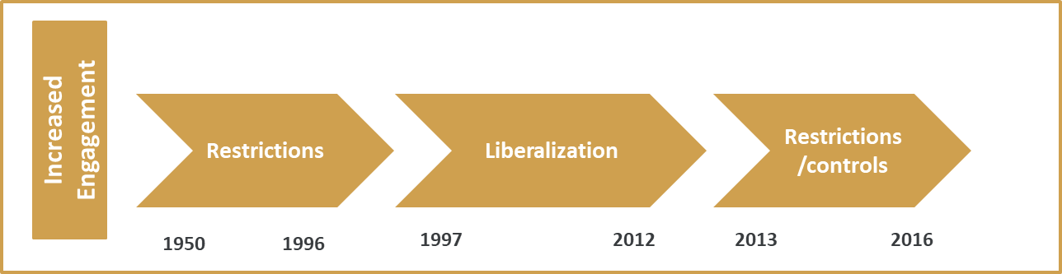
Historical perspective
Fully restricted policy
Banks freely engage
Import of Gold
Removal of restrictions on derivatives
Imports by Status Holders
Ban import of coins
80:20 introduction and removal
Increase in customs duty from 0-4-10%
1% Excise on jewelry
GST regime w.e.f. 01 July

Slide 3
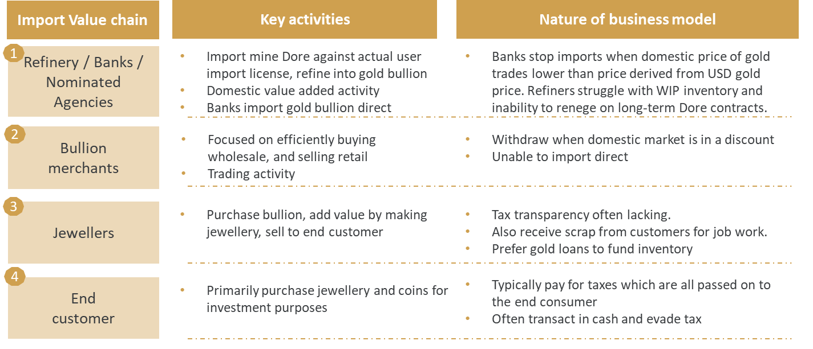
The official gold market value chain has four distinct players
Notes:
https://thelogicalindian.com/news/how-gold-obsessed-is-india-know-the-facts-about-private-gold-why-govt-need-it/
World Gold Council 2015 report
http://in.reuters.com/article/india-gold-deposit-bank-interest-idINKBN0O41JP20150519

Slide 4
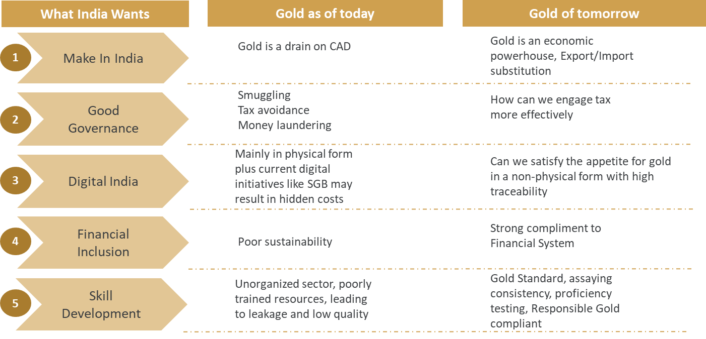
How should we harmonize Gold policy with Indian’s broader vision

Slide 5
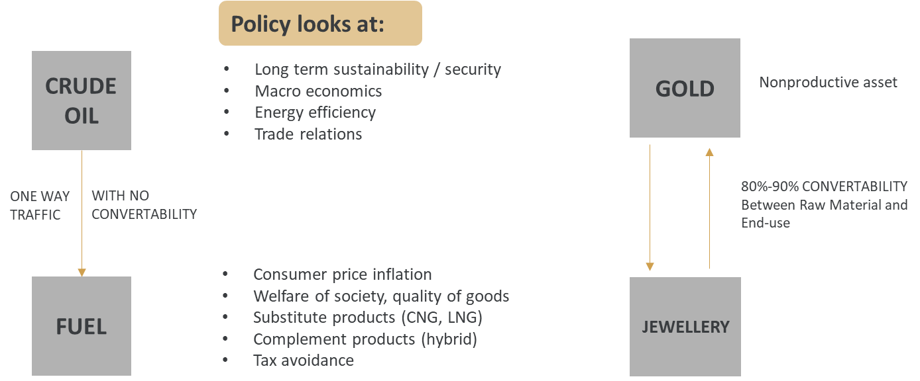
Why has framing gold policy been instinctively challenging?
Comparing Oil and Gold

Slide 6
The real economic potential of gold can only be unlocked by
drawing on collective wisdom
INTERNATIONAL
COMMODITY
CENTRAL BANKS
GOLD VALUE CHAIN
FINANCIAL INCLUSION
GLOBAL STANDARDS
EXPORTS
BANKING SYSTEM

Slide 7
ONE STEP AT A TIME

Slide 8
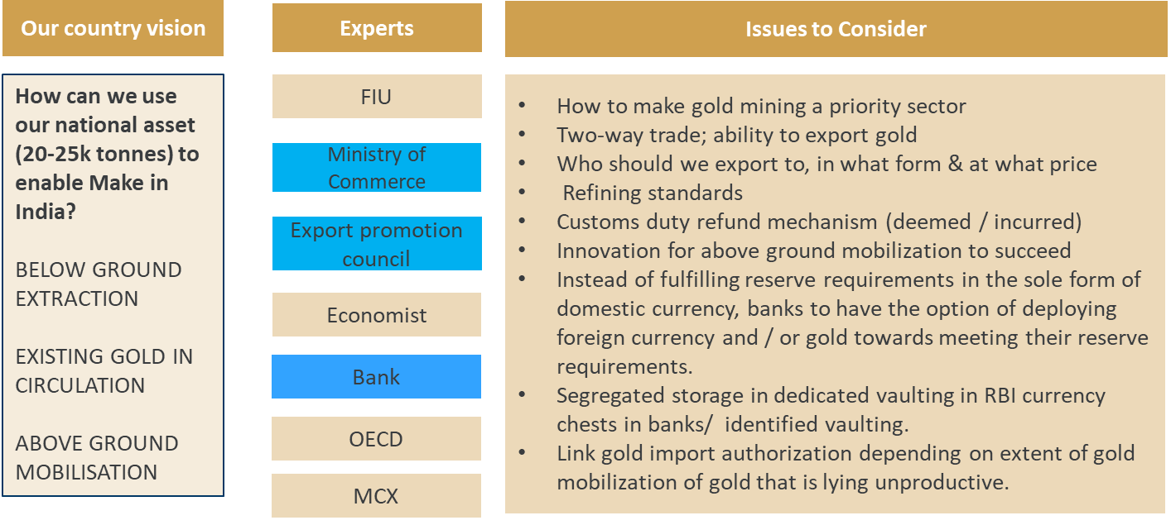
Make in India – Export / Import
Notes:
https://thelogicalindian.com/news/how-gold-obsessed-is-india-know-the-facts-about-private-gold-why-govt-need-it/
World Gold Council 2015 report
http://in.reuters.com/article/india-gold-deposit-bank-interest-idINKBN0O41JP20150519

Slide 9
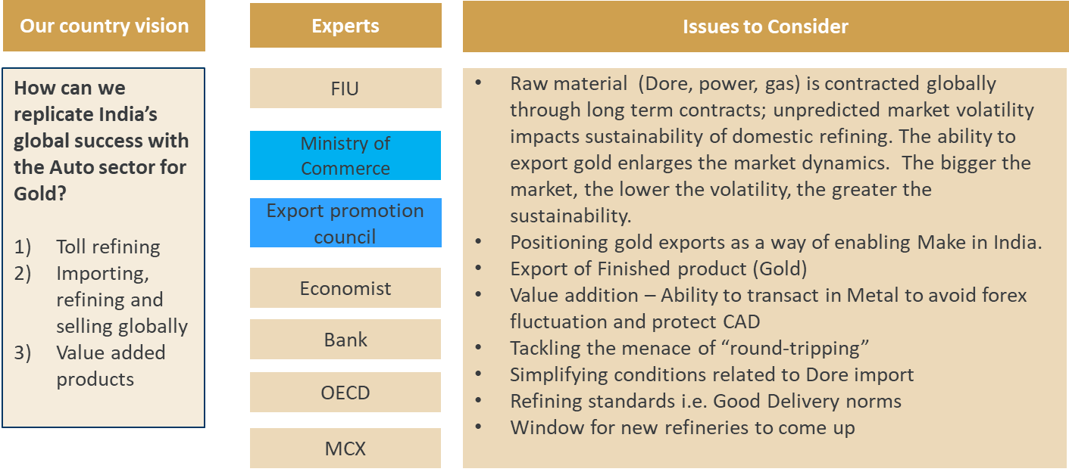
Make in India – Export / Import
Notes:
https://thelogicalindian.com/news/how-gold-obsessed-is-india-know-the-facts-about-private-gold-why-govt-need-it/
World Gold Council 2015 report
http://in.reuters.com/article/india-gold-deposit-bank-interest-idINKBN0O41JP20150519

Slide 10
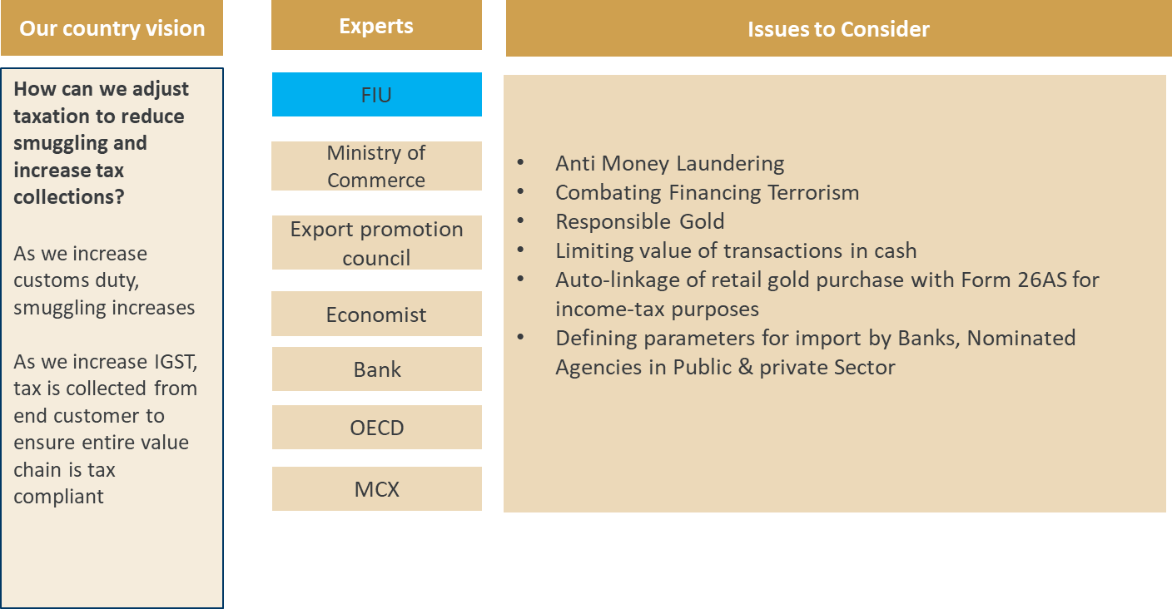
Good Governance
Notes:
https://thelogicalindian.com/news/how-gold-obsessed-is-india-know-the-facts-about-private-gold-why-govt-need-it/
World Gold Council 2015 report
http://in.reuters.com/article/india-gold-deposit-bank-interest-idINKBN0O41JP20150519

Slide 11
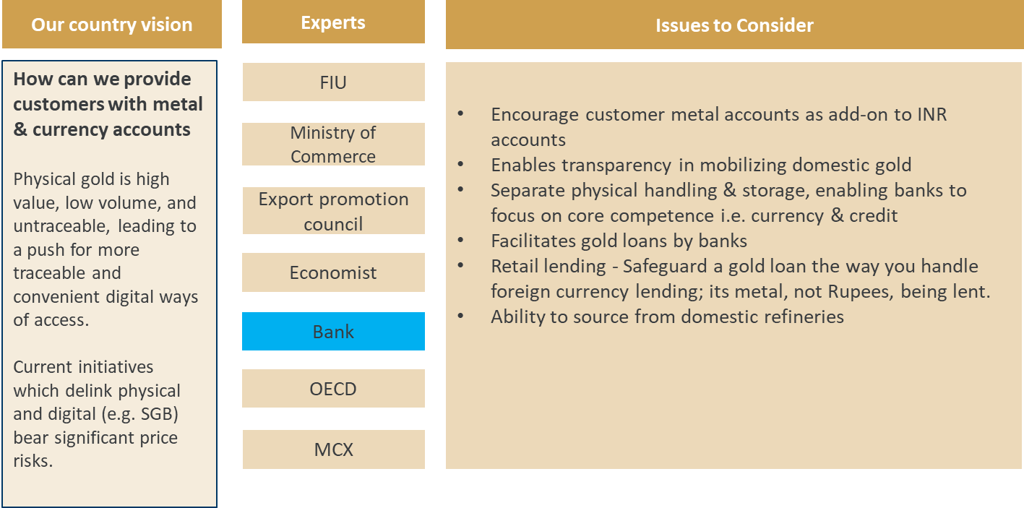
Digital India
Notes:
https://thelogicalindian.com/news/how-gold-obsessed-is-india-know-the-facts-about-private-gold-why-govt-need-it/
World Gold Council 2015 report
http://in.reuters.com/article/india-gold-deposit-bank-interest-idINKBN0O41JP20150519

Slide 12
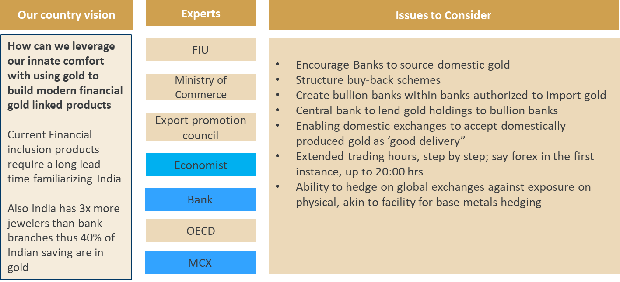
Financial inclusion
Notes:
https://thelogicalindian.com/news/how-gold-obsessed-is-india-know-the-facts-about-private-gold-why-govt-need-it/
World Gold Council 2015 report
http://in.reuters.com/article/india-gold-deposit-bank-interest-idINKBN0O41JP20150519

Slide 13
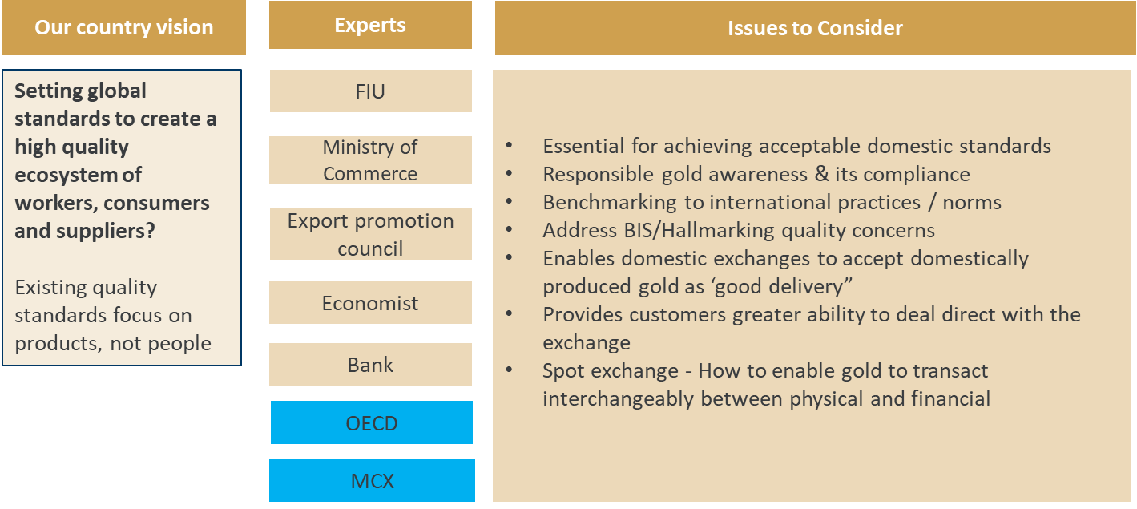
Skill Development in India
Notes:
https://thelogicalindian.com/news/how-gold-obsessed-is-india-know-the-facts-about-private-gold-why-govt-need-it/
World Gold Council 2015 report
http://in.reuters.com/article/india-gold-deposit-bank-interest-idINKBN0O41JP20150519

Slide 14
At any time, India accounts for around 25% of the demand for gold in the global economy. This demand straddles all sections of society. A gold policy must harmonize with India’s broader vision.

Slide 15

THANK YOU

