Slide 1
Responsible Jewellery Council
ASSURANCE, GROWTH, CONFIDENCE

Slide 2

Our vision and mission
Our Vision is a responsible world-wide supply chain that promotes trust in the global fine jewellery and watch industry.
Our Mission is to be the recognised standards and certification organisation for supply chain integrity and sustainability in the global fine jewellery and watch industry.

Slide 3
About the RJC
Founded in 2005, we are an international standards setting and certification organisation for the fine jewellery and watch industry.
Created for industry, by industry to promote consumer confidence in the diamonds, gold and platinum group metals supply chain from ‘Mine to Retail’.
The RJC is a whole of supply chain standards initiative for the jewellery supply chain, from mine to retail. It is unique in its participation of organisations at every step in the value chain, each bringing a commitment to a responsible supply chain and implementation of responsible business practices
The RJC COP offers comprehensive, common and credible standards for the industry
RJC is a full member of the ISEAL Alliance, the global membership association for sustainability standards. RJC complies with ISEAL’s mission and Code of Ethics and complies with ISEAL’s Codes of Good Practice

Slide 4

RJC membership benefits
Join a Community of Confidence
Demonstrate Due Diligence
Manage Your Risk; Protect Your Reputation
Consumer Assurance
Get noticed; Create Awareness
Improved relations within the industry
Stay ahead of Legislation

Slide 5





RJC at a Glance - Global
1,059
76
MEMBERS
681
CERTIFIED MEMBERS
8,628
COUNTRIES
CERTIFIED FACILITIES
404,979
EMPLOYEES COVERED BY CERTIFICATION
Notes:
Data as of 9 August

Slide 6
RJC at a glance - India
134
MEMBERS
76
CERTIFIED MEMBERS
307
CERTIFIED FACILITIES
44,547
EMPLOYEES COVERED BY CERTIFICATION
Notes:
HOW MAY RJC members are in this room , raise your hands pls?
Data as of July 20 2017
13% of all RJC members are headquartered in India
53% yearly increase in Indian RJC membership for the past 3 years.

Slide 7

Membership
Eligibility: all businesses and associations: small, medium and large, participating in the diamond gold and platinum metals jewellery supply chain, and / or engaged in activities that have a potential impact on consumer confidence in diamond gold or platinum metals jewellery
Commercial Member must obtain certification against the Code of Practices, within two years of joining the RJC. Current number of RJC commercial members:
Association Member are not required to seek RJC certification. RJC currently has 10 Trade Association members.
8 70 15 321 496 59

Slide 8
























A glimpse into RJC membership
Notes:
A selection of RJC members from the UK and beyond.

Slide 9
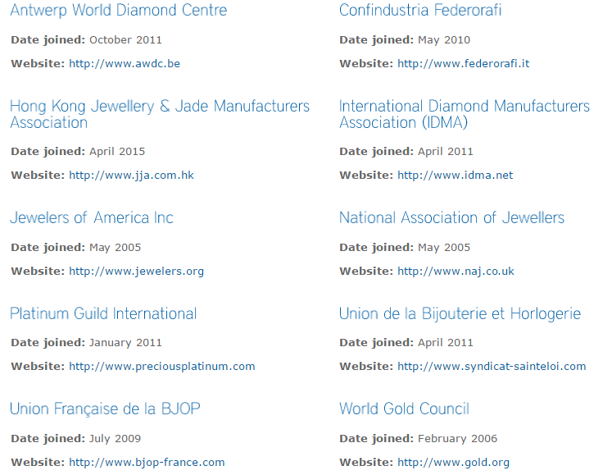
Current Trade Association Members

Slide 10






Standards harmonisation & recognition

Slide 11
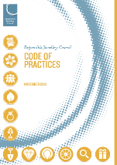
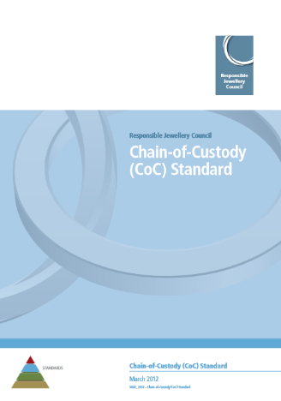
RJC Standards
RJC Code of Practices (COP)
Addresses responsible business practices including on environmental performance, bribery and corruption & labour and human rights
The standard is about the Member company – how it runs itself
It is compulsory for RJC Commercial Members
Chain-of-Custody Standard (CoC)
Addresses flow of gold and platinum group metals through supply chains, including conflict-sensitive sourcing
The standard is about the material – are there responsible business practices at each step?
It is voluntary for RJC Commercial Members

Slide 12
RJC Code of Practices (COP)
Covers a comprehensive spectrum of CSR issues relevant to the jewellery supply chain
Can be applied by any size of business, in all parts of the supply chain, from mining to retail
Based on national and international law, established international and industry standards, and sound business practice
The objectives of the Code of Practices are to:
Provide a common standard for RJC Members that builds on international standards for responsible business practices
Set out the mandatory expectations for the establishment, implementation and maintenance of policies, procedures and practices in order to manage issues within a Member’s control
Establish provisions that can be independently audited to provide objective evidence for the granting of RJC Certification
Drive improvement of business practices for the Diamond, Gold and Platinum Group Metals Jewellery supply chain

Slide 13
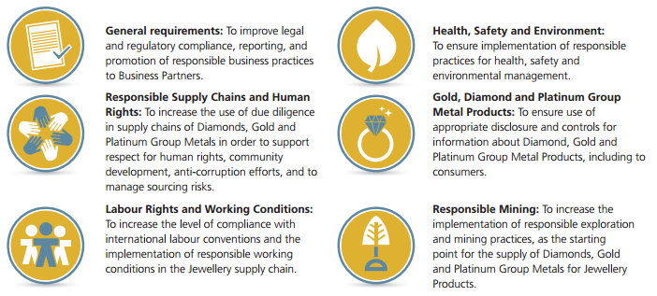
RJC Code of Practices (COP) - Provisions
The scope of the Code of Practices is defined by the following core elements and objectives for RJC Members and ultimately the jewellery supply chain as a whole:

Slide 14
RJC Code of Practices (COP)
There are 6 main sections, and a total of 40 individual provisions
Provisions 29-40 are applicable to mining companies only

Slide 15
RJC Code of Practices (COP) - Critical Breaches
A COP Critical Breach is Major Non-Conformance against a Provision deemed to be critical to the integrity of the RJC Code of Practices.
If any of findings attributed to these Critical Provisions are rated as a Major Non-Conformance, then the Member is deemed to be in a situation of Critical Breach of the RJC Code of Practices and certification is not granted
COP Provision | #
16 Discipline and Grievance Procedures | 16.1
17 Child Labour | 17.1, 17.2
18 Forced Labour | 18.1
23 Hazardous Substances | 23.2
24 Waste and Emissions | 24.2c
26 Product Disclosure | 26.1
27 Kimberley Process Certification Scheme and World Diamond Council System of Warranties | 27.1
Notes:
A COP Critical Breach is Major Non-Conformance against a Provision deemed to be critical to the integrity of the RJC Code of Practices. Critical Provisions are identified in this table.
If any of findings attributed to these Critical Provisions are rated as a Major Non-Conformance, then the Member is deemed to be in a situation of Critical Breach of the RJC Code of Practices.

Slide 16

RJC Chain-of-Custody (CoC)
RJC Chain-of-Custody (CoC) Certification aims to give Members the ability to demonstrate responsible sourcing for precious metals.
Provides a common standard for RJC Members or entities they control, that wish to implement Chain-of-Custody systems and have these independently audited.
CoC Certification means that:
RJC standards or equivalent for human rights, labour standards, environmental impact, and business ethics have been met right from the origin of the metal
Due diligence approaches for gold sourcing are aligned to the OECD Due Diligence Guidance
Appropriate inventory control systems are in place for handling and transferring CoC material

Slide 17
The RJC CoC Standard – at a glance
Voluntary standard for RJC Members launched in 2012 about systems to assure gold and platinum group metals (PGM) are from responsible sources
Provisions 1 – 3
Chain-of-Custody Management
Management system and responsibilities;
Provisions 4 – 6
Systems to Confirm Eligibility of Material
Eligible Mined Material;
Provisions 7 – 9
Issuing Chain-of-Custody Documentation
Eligible Material Declarations;
Internal material controls;
Outsourcing contractors and service companies.
Eligible Recycled Material;
Eligible Grandfathered Material.
CoC Transfer Documents;
Consumer claims.
Provision 10
Conflict-Sensitive Sourcing
Supply chain policy;
Complaints Mechanism;
Gold Refiners.

Slide 18
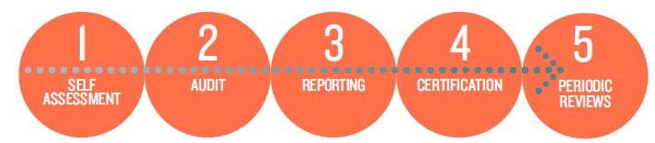
5 Steps to Certification
Step 1 Self Assessment: RJC Member carries out a Self-Assessment against the Standard
Step 2 Certification Audit: Member engages an RJC Accredited Auditor to conduct an independent Certification Audit.
Step 3 Reporting: Auditor provides the RJC and the Member with an Audit Report that documents the audit findings. Members are required to implement corrective action
Step 4 Certification Decision: RJC reviews the Auditor’s Report and the Statement of Conformance. The RJC then issues the Member either a 1 year (COP only) or 3 year certification based on the auditor’s recommendation
Step 5 Periodic Reviews: Periodic reviews are conducted during the certification period: Mid- Term Review (Code of Practices) or Surveillance Audit (Chain of Custody Standard) to verify that the Certified Member’s systems continue to work effectively. At the end of the Certification Period, a Re-Certification Audit is required to renew the Member’s Certification

Slide 19





RJC Training
HELPDESK

Slide 20

RJC standards review
RJC CODE OF PRACTICES (COP)
Review period starts Q2 2017
Public and Member consultation
Release in Q4 2018
CHAIN-OF-CUSTODY STANDARD (COC)
Review underway from Q1 2016
Public and Member consultation
Release in Q4 2017
COLOURED STONES & SILVER
Planned to dovetail with COP release
Sector outreach is underway

Slide 21


