Slide 1

MCX- INTRODUCTION TO GOLD OPTIONS

Slide 2
MCX bullion Futures : snapshot
Performance FY-17 | MCX Gold | MCX Silver
Average Daily Volumes ( In MT) | 15 | 783
Open Interest ( In MT) | 12 | 509
Average Daily Turnover (in Rs. Cr) | 4501 | 3353
Unique Client Codes (UCC) FY - 17 | 201,575
Options on Gold Futures
(Most diversified participation)
  Highest number of traded members
  Highest number of hedgers
  Significant OI to Volume ratio
Significant retail client participation
Significant ALGO trading
Well defined value chain
Physically settled contract – enables three legs of trading via MCX platform i.e. futures, options and physical delivery through futures/options

Slide 3

MCX GOLD: the Hedging Platform of choice
MCX Price is the benchmark for value-chain and end-consumers alike: Most Pricing is done MCX(+/-)
MCX Bullion prices in-build: Hedge for: Gold price, USD-INR, Import duty changes, prevailing premium/discount; which enables all major value-chain participants:
Strong correlation with international benchmarks as well as Domestic Spot:
  CME(INR Eq.- Import Parity)-MCX 98.93%; MCX-Domestic Spot 98.02%
  Trading hours on MCX gold futures market are stretched till almost midnight to match trading time in the global markets. So, Indian participants are able to manage price risks as efficiently as global counterparts.
Bullion Trader
Branded Jeweler
Retail Jeweler
Importer
Exporter
www.mcxindia.com

Slide 4
Bullion Deliveries: shows Acceptance of Price
BY PHYSICAL INDUSTRY
MCX Bullion - Delivery Volume (MT)
Month | 2004 | 2005 | 2006 | 2007 | 2008 | 2009 | 2010 | 2011 | 2012 | 2013 | 2014 | 2015 | 2016 | 2017 | Total
Gold | 0.4 | 2.55 | 7.17 | 6.17 | 4.89 | 10.26 | 12.82 | 7.56 | 8.45 | 14.82 | 11.19 | 5.9 | 5.64 | 2.62 | 100.44
Silver | 15.30 | 131.46 | 148.11 | 208.35 | 300.81 | 247.80 | 86.16 | 267.45 | 310.83 | 282.78 | 111.99 | 252.06 | 359.61 | 57.54 | 2778
Deliveries of 100.44 MT of Gold & and over 2778 MT of Silver have taken place on MCX since inception.
Silver: 360 MT in CY 2016 (highest ever)
MCX launched Gold & Silver Futures trading on 10th Novemeber,2003
Gold ADTV – 6656 Cr (Since Inception)
Silver ADTV – 5941 Cr ( Since Inception)

Slide 5
Options as hedging instrumentS
Options offer the buyer an Insurance against adverse movement, but allow for participation on favourable side
Maximum Loss to the extent of Premium paid for Buyer
Exchange Traded options free from counter party risk
Futures & Options combination (both risk management tools): gives leverage of futures with safety of options: Profit from change in future prices but limit losses via Options
Participants can devise hundreds of effective hedging strategies
Better Cash-flow management
 | Call Option | Put Option
Option Buyer | Pays premium; right to buy | Pays premium; right to sell
Option Seller | Collects premium; obligation to sell | Collects premium; obligation to buy
Options on Commodity Future were permitted by SEBI on June 13, 2017 via Circular SEBI/HO/CDMRD/DMP/CIR/P/2017/55

Slide 6

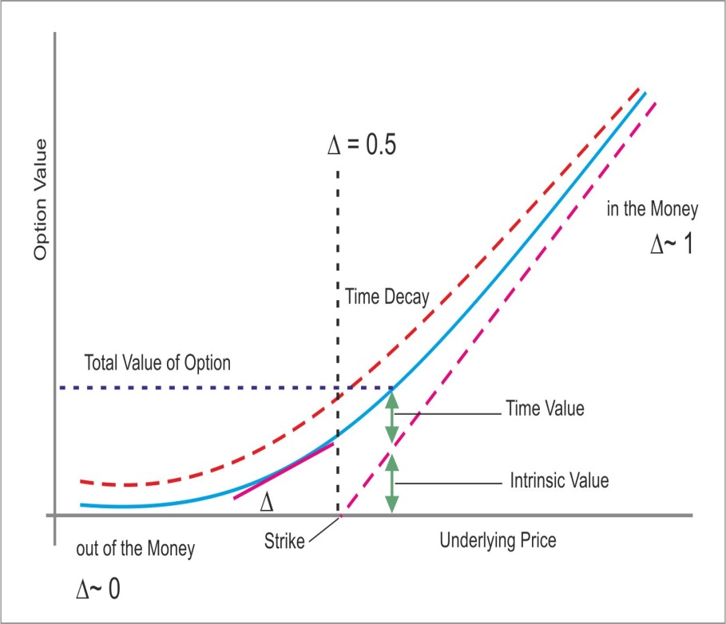
OPTION PRICING: COMPOSITION OF PREMIUM
Current Future Prices – Strike Price
(for “in the money” options)
Option premium= Intrinsic value + Time value
Depends on:
• Time remaining to Expiration
• Moneyness of the option (how far is the futures prices from the Strike?)
• Volatility of the underlying futures prices
Option value is higher for >>> longer time to expiry, futures price closer to Strike, and Higher Volatility (Vol)
Moneyness terms >>> At-the-money (ATM), In-the-money (ITM), Out-of-the-Money (OTM)

Slide 7

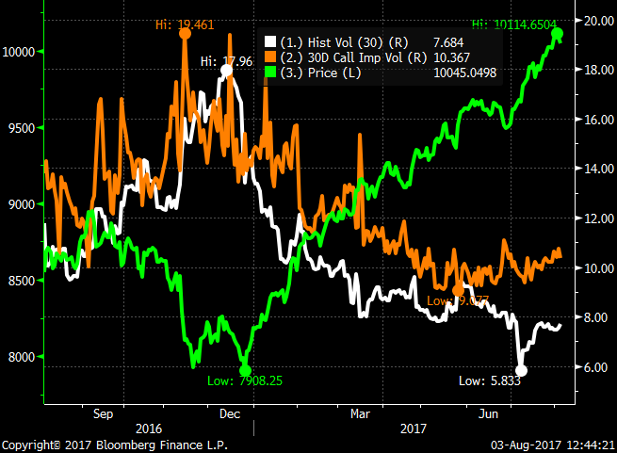
Gold price & IVOL: Implication on Hedge type
Volatility is a function of price movement…
Volatility is the standard deviation of daily returns…expressed in annualised terms.
Measure of uncertainty of asset returns / degree of price fluctuation
When prices are rising or falling substantially, volatility is said to be high
When a futures contract shows little price movement, volatility is said to be low
High volatility generally causes options premiums to increase – sometimes very dramatically. Lower volatility environments generally cause options premiums to decline
Chart Source – Bloomberg

Slide 8
Option Greeks
DELTA:
Delta measures the rate of change of an option value with respect to a price change in the underlying futures contract. Delta is a measure of price sensitivity at any given moment.
GAMMA:
Change in Delta on account of a unit change in the underlying
VEGA:
Change in value on account of change in volatility
THETA:
Time value of an option erodes as each day passes, accelerating as expiration nears. This characteristic of options is referred to as “time-decay”. If time passes and the underlying futures contract does not move far enough by expiry,
the option’s time value will eventually decay to zero.

Slide 9
Option Greeks & what they imply
Underlying Price | 28500 | The current base price of the instrument
Exercise Price | 28700 | The price at which the underlying instrument will be exchanged. Also called Strike Price
Today's Date | 03-08-2017
Expiry Date | 27-09-2017 | The Date which the contract expires
Historical Volatility | 7% | The Historical Volatility of the asset's returns
Risk Free Rate | 6.52% | The current risk free interest rate i.e. your return on cash held in the bank
Dividend Yield | 0.00% | The Annualized Dividend Growth Rate of the Stock
 | Call Option | Put Option
Theoretical Price | 350.47 | 269.88
Delta | 0.54 | -0.45 | The amount that the theoretical price will change if the market moves up/down 1 point
Gamma | 0.0005 | 0.0005 | The amount that the Delta will change if the market moves up/down 1 point
Theta | -5.51 | -0.43 | The amount that the theoretical price will change when 1 day passes.
Vega | 43.83 | 43.8305 | The amount that the theoretical price will change if the volatility of the asset moves up/down by 1 percentage point
Black Scholes Model

Slide 10
Hedging applications of options
Producer/Bullion Dealer Hedging
Flexible Pricing Schemes by Jewellers
Inventory Hedging
Protection from rising prices against Fixed quotes

Slide 11
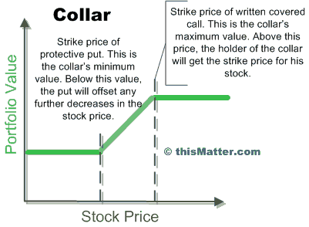
Example-Gold producer hedging
Hedging applications of options
Australian Gold Producers (FX Contango) sell above the money Calls to utilise Premiums (Ceiling) & buy protective Puts below the money; (to create a Floor price): achieving low/zero cost Collar hedge against any fall in expected price of future production/inventory.
This is a Costless Collar Strategy.
A Collar=
A Covered Call
+
PUT
(Downside Protection)

Slide 12
Flexible Pricing Scheme OFFERED BY JEWELLERS
Hedging applications of options
Jewelers may offer lower of current price /Diwali price as Festive Scheme :
Strategy: Buy Put at Current Prices
If at Diwali prices rise, he won’t exercise and loss will be the premium paid
If at Diwali prices fall then he will Sell the same Put and take profit.
#- Indicative Premium mentioned as an example

Slide 13
OPTION Strategy for Bullion Dealer: Protecting inventory – Fixed Gold
Hedging applications of options
Bullion Dealer: Risk of depreciation in Gold
(CMP 30000)
Prices go up
Buy Put option: Strike price 30000 Premium Rs.300
Prices go down
Loss: Maximum up to Rs.300
Profit: Actual loss is Compensated by appreciation in the premium price
The loss is limited to the extent of the premium paid i.e. Rs. 300/= & no MTM

Slide 14
Example: Protecting inventory – Fixed Gold
Hedging applications of options
Buy Put option : Strike price 30000 Premium Rs.300
P&L Payoff at Expiration Matrix (Premium: 300)
Underlying Price At Expiry | Payoff from options | Physical Stock | Net Profit/Loss
29500 | 200 | -500 | -300
29600 | 100 | -400 | -300
29700 | 0 | -300 | -300
29800 | -100 | -200 | -300
29900 | -200 | -100 | -300
30000 | -300 | 0 | -300
30100 | -300 | 100 | -200
30200 | -300 | 200 | -100
30300 | -300 | 300 | 0
30400 | -300 | 400 | 100
30500 | -300 | 500 | 200
Having hedge through options Bullion dealer protects himself against downside risk and also avails opportunity profit if prices go beyond 30300/- in physical markets

Slide 15
Options Strategy for Jewelers: Buying Unfixed Gold
Hedging applications of options
Exporter : Risk of appreciation in Gold post receiving order
(CMP 30000)
Prices go down
Prices go up
Buy Call option
Strike price 30000
Premium Rs.300
Loss: Maximum up to Rs.300
Profit: Actual loss is Compensated by appreciation in the premium price
The loss is limited to the extend of the premium paid i.e. Rs. 300/- & no MTM

Slide 16
Example : Buying Unfixed Gold
Hedging applications of options
Buy Call option Strike price 30000 Premium Rs.300
P&L Payoff at Expiration Matrix (Premium: 300)
Underlying Price At Expiry | Payoff from options | Physical Stock | Net Profit/Loss
29500 | -300 | 500 | 200
29600 | -300 | 400 | 100
29700 | -300 | 300 | 0
29800 | -300 | 200 | -100
29900 | -300 | 100 | -200
30000 | -300 | 0 | -300
30100 | -200 | -100 | -300
30200 | -100 | -200 | -300
30300 | 0 | -300 | -300
30400 | 100 | -400 | -300
30500 | 200 | -500 | -300
Having hedge through options Jeweller protects himself against upside risk and also avails opportunity profit if prices break below 29700 in physical markets

Slide 17
Impact Of CTT was highest on Bullion FUTURES
Commodity | Current Price | Contract Value | Profit Per Tick | TO charges @187/crore | Stamp Duty | Service Tax @ 12.36% | Total cost pre CTT | No of ticks for breakeven | TO charges @260/crore | Stamp Duty | GST @ 18% | CTT @0.01% | Total cost post CTT | No of ticks for breakeven
Gold (1 Kg) | 28200 | 2820000 | 100 | 105.468 | 56.4 | 13.03584 | 174.9038 | 2 | 146.64 | 56.4 | 26.3952 | 282 | 511.435 | 6
Silver | 37500 | 1125000 | 30 | 42.075 | 22.5 | 5.20047 | 69.77547 | 3 | 58.5 | 22.5 | 10.53 | 112.5 | 204.03 | 7
( 30 Kg)

Slide 18
Taxation upon exercise of options
Transaction | STT rate in equity markets | Charged on
Purchase | 0.125% | Settlement price, on exercise
Sell | 0.05% | Premium
Transaction Taxes on Gold 1 kg Options contract with a notional value of Rs 30 lakh and option premium of Rs 30,000 (@ 1% of notional value)
Particulars | Call Option |  | Put Option
 | Buyer | Seller | Buyer | Seller
CTT on premium (@ 0.05% of premium – Seller) |  | 15 |  | 15
CTT on exercise (@ 0.125% of FSP – Buyer) | 3,750 |  | 3,750
On conversion of option position to futures position on exercise (@ 0.01% on futures position – Seller) | - | 300 | 300 | -
If chooses not to take physical delivery, but squares position in futures | 300 | - | - | 300
Total Transaction Taxes | 4,050 | 315 | 4,050 | 315
  We have represented to Authorities on Taxation aspect on Options that devolve into futures.

Slide 19
OPTIONS: LOW TRANSACTION COST
Gold 1 Kg/ 1 Lot
 | Cost
Exchange Fees | 30
Stamp Duty | 0.6
CTT | 3
Service Tax @15% | 4.5
Total expense per lot | 38.1*
* Calculated for ATM strike as indicative premium

Slide 20
PROPOSED Gold Options Contract Specification
Description | OPTION ON GOLD FUTURES
Instrument Type | OPTFUT
Symbol | GOLD
Option type | CE (European Call) & PE (European Put)
Trading
Trading Unit | 1 MCX Gold futures contract
Underlying Quotation/ Base Value | 10 grams
Underlying Price Quote | Ex-Ahmedabad (inclusive of all taxes and levies relating to import duty, customs but excluding sales tax and VAT, any other additional tax or surcharge on sales tax, local taxes and octroy / or GST as applicable)
Strike Price | 15 In-the-money, 15 Out-of-the-money and 1 At-the-money. (31 CE and 31 PE). The Exchange, at its discretion, may enable additional strikes intraday, if required.
Strike Price Intervals | 100
Base price | Base price for the next day shall be theoretical price on Black 76 option pricing model: (a) on the first day of the contract and (b) on days when the contract is illiquid on the previous day. For all other days, it shall be the daily settlement price of the contract.
Tick Size (Minimum Price Movement) | Re. 0.50
Daily Price Limit | The upper and lower price band shall be determined based on statistical method using Black76 option pricing model and relaxed considering the movement in the underlying futures contract
Initial Margin | SPAN based margins
Short Option Minimum Charge | 2.5% subject to Margin Period of Risk (MPOR)
Premium | Premium of buyer shall be blocked upfront on real time basis.
Extreme Loss Margin | 1%
Pre Tender Margin | 2.5% incremental margin for 2 days i.e till expiry day.
Additional and/ or Special Margin | At the discretion of the Exchange when deemed necessary
Maximum Allowable Open Position | Client - wise : 10 MT or 5% of the market wide open positions whichever is higher - For all Gold option contracts combined together. Member - wise : 100 MT or 20% of the market wide open positions, whichever is higher - For all Gold option contracts combined together.

Slide 21
PROPOSED OPTION SETTLEMENT PROCESS
Settlement of premium /Final Settlement: T+1 day
Expiry Day (Last trading day): Three business days prior to the first business day of Tender Period of the underlying futures contract.
Pre Tender Margin : Exchange shall levy pre tender margin on the long buy positions entering the option tender period.
Due Date Rate (Final Settlement Price): Daily settlement price of underlying futures contract on the expiry day of options contract
On expiry of options contract, the open position shall devolve into underlying futures position as follows:-
long call position shall devolve into long position in the underlying futures contract
long put position shall devolve into short position in the underlying futures contract
short call position shall devolve into short position in the underlying futures contract
short put position shall devolve into long position in the underlying futures contract
All such devolved futures positions shall be opened at the strike price of the exercised options
1st October
Tender Period Starts for Gold Futures Contract
27th September
Option Expiry
25th & 26th September
Pre Tender Margin/Sensitivity Report
www.mcxindia.com

Slide 22
PROPOSED EXERCISE MECHANISM AT EXPIRY
Option series having strike price closest to the Daily Settlement Price (DSP) of Futures shall be termed as At the Money (ATM) option series. This ATM option series along with two option series each having strike prices immediately above and below ATM shall be referred as ‘Close to the money’ (CTM) option series.
In case the DSP is exactly midway between two strike prices, then immediate two option series having strike prices just above DSP and immediate two option series having strike prices just below DSP shall be referred as ‘Close to the money’ (CTM) option series
All option contracts belonging to ‘Close to the money’ (CTM) option series shall be exercised only on ‘explicit instruction’ for exercise by the long position holders of such contracts.
All In the money (ITM) option contracts, except those belonging to ‘CTM’ option series, shall be exercised automatically, unless ‘contrary instruction’ has been given by long position holders of such contracts for not doing so.
All Out of the money (OTM) option contracts, except those belonging to ‘CTM’ option series, shall expire worthless.
www.mcxindia.com

Slide 23
THANK YOU
www.mcxindia.com

Slide 24
FACTORS AFFECTING OPTION PRICES
Implied Volatility
How much does the Futures move?
More Futures fluctuation >> Option more likely to be exercised >> Higher risk >> Higher Price
Time
How much time left for the Futures to move?
More time left >> Option more likely to be exercised >> Higher Risk >> Higher Price
Strike Rate
What is the rate that the Option becomes effective?
Strike Rate closer Forward Rate >> Option more likely to be exercised >> Higher Risk >> Higher Price
Futures Direction (View)
Which direction is the Futures likely to move?
Expected favourable Futures movement >> Option more likely to be exercised >> Higher Risk >> Higher Price
Tail Risk
Hugely ITM or OTM Options are costlier than theoretical values

Slide 25

OPTION TERMINOLOGY
Option price: Option price is the price which the option buyer pays to the option seller. It is also referred to as the option premium.
Expiration date: The date specified in the options contract is known as the expiration date, the exercise date, the strike date or the maturity.
Strike price: The price specified in the options contract is known as the strike price or the exercise price.
European options: European options are options that can be exercised only on the expiration date itself.

Slide 26
MONEYNESS
In-The-Money
An option is in-the-money if it has exercise value.
In other words, a call option is in-the-money if the current futures price is above the strike price because it can be exercised at the strike price and sold at the current futures price for a gain.
A put option is in-the-money if the current futures price is below the strike
price.
At expiration, the value of a given option will be whatever amount, if any, that the option is in-the-money.
Out-Of-The-Money
An out-of-the-money option has no exercise value or intrinsic value.
A call option is said to be out-of-the-money if the option strike price is currently above the underlying futures price. A put option is out-of-the- money if the strike price is below the underlying futures price. Out-of-the- money options have no intrinsic value.

Slide 27
Futures vs Options – Volumes
Major global exchanges (like CME,ICE,LME and others) offers Commodity options trading.
Commodity Options trading volume at CME
Volumes (in lots) at CME for CY 2016
Commodity Contract | Futures | Options | Options as % of Futures
Gold 100 Tr. Contract | 57,564,840 | 9,916,049 | 17.23%
Source: FIA
Note: Select few major commodity contracts at CME are considered; Source: MCX Research

Slide 28
Impact of CTT on transaction cost
Pre-CTT and Post-CTT Transaction Cost
Gold (1 Kilogram Hedging Cost) |  |  | Post | Prior
(Contract value=apprx. Rs. 27 lakh) | CME | DGCX | MCX | MCX
Transaction Fee | 64.8 | 59.4 | 99.9 | 99.9
Stamp Duty |  |  | 54.0 | 54.0
Service Tax |  |  | 14.5 | 14.5
CTT |  |  | 270.0 | 0.0
Bid-ask Spread (Impact Cost)
Regulatory Fee |  | 4.0 | 10.8
Total Hedging Cost (in Rs.) | 64.8 | 63.4 | 449.2 | 168.4
*Ignoring rollover costs
Silver (30 Kilograms) |  |  | Post | Prior
(Contract value=apprx. Rs. 12 lakh) | CME | DGCX | MCX | MCX
Transaction Fee | 28.8 | 59.4 | 44.4 | 44.4
Stamp Duty |  |  | 24.0 | 24.0
Service Tax |  |  | 6.4 | 6.4
CTT |  |  | 120.0 | 0.0
Bid-ask Spread (Impact Cost)
Regulatory Fee |  | 4.0 | 2.4
Total Hedging Cost (in Rs.) | 28.8 | 63.4 | 197.2 | 74.8
*Ignoring rollover costs

Slide 29

Initiatives post-SEBI Merger
New Initiatives
Policy recommendations
Trading of commodity options
Permission for Category III AIF participation
LODR Regulations 2015 mandated all listed companies to disclose their commodity price risk and hedging activities in their Annual Reports
Integration of security and commodity brokers
Enhanced risk management norms
Gold ETFs to invest in gold futures
Other financial institution participations – Banks, FPI’s, Insurance and Pension Funds
New products like derivatives on intangibles, exotic indices like freight, rainfall etc.
Custodians to extend custodian services to commodities / warehouse (Vaults) receipts

Slide 30

Derivatives Volume – Global Scenario (2015)
Commodity | Options (in million lots) 2015 | Futures (in million lots) 2015 | Options as a % of futures | Options contract lot size
CME Group
Gold | 7.53 | 41.85 | 18.0% | 3.11 kgs
Silver | 1.22 | 13.45 | 9.1% | 155.51 kgs
Copper | 0.03 | 16.99 | 0.2% | 11.33 tonnes
Crude oil | 39.63 | 202.20 | 19.6% | 1000 barrels
Natural Gas* | 19.59 | 81.77 | 24.0% | 10,000 mmBtu
Soybean Oil | 2.16 | 28.90 | 7.5% | 27.22 tonnes
Corn | 24.15 | 83.09 | 29.1% | 127.06 tonnes
ICE (U.S.)
Cotton No. 2 | 1.74 | 6.73 | 25.9% | 22.68 tonnes
Sugar No. 11 | 6.16 | 34.40 | 17.9% | 50.80 tonnes
* European option; others are American option; The underlying for Options contracts are respective Futures contract and hence share same lot sizes; Source: Futures Industry Association

Slide 31

Derivatives volume – Global Scenario (2015)
Commodity | Options (in million lots) 2015 | Futures (in million lots) 2015 | Options as a % of futures | Options contract lot size
LME
Copper | 2.49 | 38.56 | 6.4% | 25 tonnes
Aluminium | 2.61 | 59.89 | 4.4% | 25 tonnes
Lead | 0.45 | 12.52 | 3.6% | 25 tonnes
Nickel | 0.73 | 19.96 | 3.6% | 6 tonnes
Zinc | 1.28 | 28.75 | 4.5% | 25 tonnes
ICE Europe
Brent Crude Oil | 13.60 | 183.85 | 7.39% | 1000 barrels
TOCOM
Gold | 0 | 7.93 | 0% | 1 Kg
Options are American type; The underlying for Options contracts are respective Futures contract and hence share same lot sizes; Source: Futures Industry Association

