Slide 1
Precious Metals Changing
Landscape & Relevance of India
Jeremy East
Jeremy.East@sc.com
Sept 2014

Slide 2
Precious Metals Changing Landscape & Relevance of India
THE GOLD MARKET IN TRANSITION IN 2013/2014
INDIA’S RELEVANCE DECLINES
      CHINA CHANGING THE LANDSCAPE OF THE GLOBAL MARKET
RMB INTERNATIONALISATION
CONCLUSION
Notes:
Start with market flows – drivers , then examine whats going on in china, then look at internationalisation of china

Slide 3
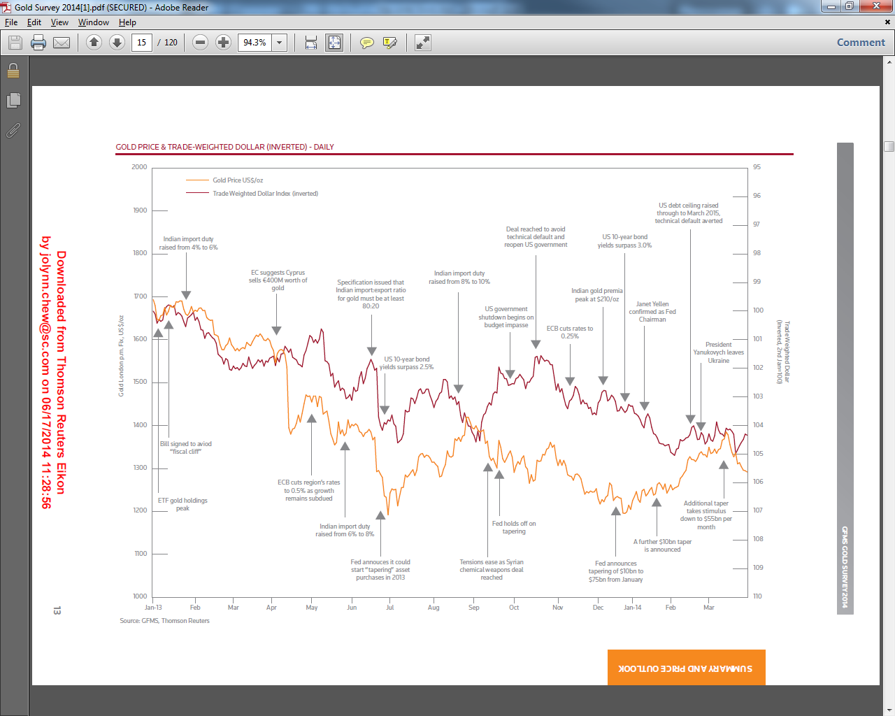
Price Trends & Key Market Events: Relevance of India
  Gold Price & Trade-Weighted Dollar (Inverted)
Source: GFMS, Thomson Reuters

Slide 4
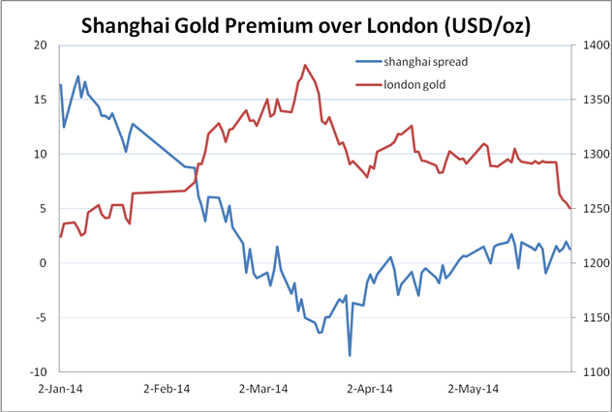
Price Trends & Key Market Events: Relevance of China
  Shanghai Gold Premium Over London (US$/oz, 20d MA)
Source: Bloomberg
Notes:
4

Slide 5
Gold ETFs as a Demand Indicator
  Major Physical ETFs for Gold
Sources: Bloomberg, Standard Chartered Research
Notes:
5

Slide 6





Physical Bar Flow West to East: ETF & Physical
  Major Gold Trade Flows
_{UK}
_{North}
_{America}
_{Switzerland}
China
_{Dubai}
_{India}
_{H.K.}
_{Singapore}
Key Gold Supply
Key Gold Demand
Gold Trade Flows
_{Australia}
_{S.A}
Notes:
6

Slide 7
Financial Pressures in India: Backdrop to Gold Policy
  India Current Account Deficit
Source: Ministry Of Finance, Government Of India
Source: Bloomberg

Slide 8
India’s Relevance Declines as the Government Strategy Changes
  India Demand
Sources: Bloomberg, Standard Chartered Research

Slide 9
India: Developments in the Domestic Market
BLACK MARKET
JOB LOSSES
500,000 workers lose jobs as jewellers curb gold imports
– Hindustan Times, Aug 01, 2013
UNOFFICIAL
IMPORTS
“The World Gold Council...estimates that some 200 tonnes of gold will be smuggled into India during this calendar year”
– Financial Times, Sep 03, 2014
ARRESTS
Gold Smuggling Arrests Jump 750% YoY in India
– Mineweb, Apr 11, 2014
DEFAULTS
Banks Might Tighten Loans to Jewellery Sector Owing to Winsome Group Default
–Business Standard, May 14, 2013

Slide 10
India’s Market Used to Dominate the Global Physical Stage
  India & China Demand
Source: WGC, GFMS
Notes:
Start with market flows – drivers , then examine whats going on in china, then look at internationalisation of china

Slide 11
China Overtakes India as the World’s Largest Gold Consumer
  Chinese & Indian Jewellery Consumption
  India & China Change in Demand YOY
Source: GFMS, Thomson Reuters
Source: GFMS, Thomson Reuters

Slide 12
China is Changing the Landscape of the Global Market
  China Gold Demand Indicator – HK Exports
Source: HK Census & Statistics Department
Notes:
Start with market flows – drivers , then examine whats going on in china, then look at internationalisation of china

Slide 13
      China’s Gold Friendly Strategy
  China Gold Total Demand
Sources: Bloomberg, Standard Chartered Research

Slide 14
China’s Exploding Purchasing Power
  Largest Economies (% of US GDP)
Source: World Bank

Slide 15
China’s Growing Financial Markets
  Shanghai Gold Exchange Turnover
Source: SGE
15

Slide 16
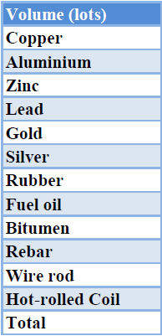
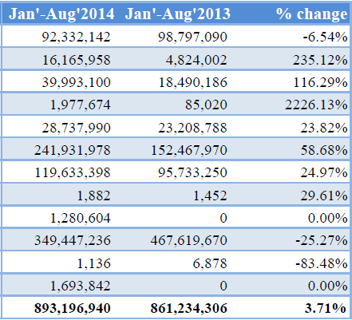
Shanghai Gold & Silver Contracts Take Off
  Shanghai Futures Exchange Contract Volumes
Source: SHFE

Slide 17
      China Moves from a Regional to a Global Market
  China Demand as % of World Demand
Source: Bloomberg
Based on Jewellery demand

Slide 18
      RMB Internationalisation – Impact on Price Setting
  COMMODITY IMPORTS INTO CHINA PRICING AGAINST LOCAL MARKETS IN RMB
  NEW RMB SETTLED CONTRACTS
  LOCAL BENCHMARKS AGAINST WHICH PHYSICAL CONTRACTS CAN BE PRICED

Slide 19
Conclusions
THE IMPLICATION OF THESE TRENDS

Slide 20
Global Disclaimer (page 1 of 2)
Analyst Certification Disclosure: The research analyst or analysts responsible for the content of this research report certify that: (1) the views expressed and attributed to the research analyst or analysts in the research report accurately reflect their personal opinion(s) about the subject securities and issuers and/or other subject matter as appropriate; and, (2) no part of his or her compensation was, is or will be directly or indirectly related to the specific recommendations or views contained in this research report. On a general basis, the efficacy of recommendations is a factor in the performance appraisals of analysts.
Global Disclaimer: Standard Chartered Bank and or its affiliates ("SCB”) makes no representation or warranty of any kind, express, implied or statutory regarding this document or any information contained or referred to on the document. The information in this document is provided for information purposes only. It does not constitute any offer, recommendation or solicitation to any person to enter into any transaction or adopt any hedging, trading or investment strategy, nor does it constitute any prediction of likely future movements in rates or prices, or represent that any such future movements will not exceed those shown in any illustration. The stated price of the securities mentioned herein, if any, is as of the date indicated and is not any representation that any transaction can be effected at this price. While all reasonable care has been taken in preparing this document, no responsibility or liability is accepted for errors of fact or for any opinion expressed herein. The contents of this document may not be suitable for all investors as it has not been prepared with regard to the specific investment objectives or financial situation of any particular person. Any investments discussed may not be suitable for all investors. Users of this document should seek professional advice regarding the appropriateness of investing in any securities, financial instruments or investment strategies referred to on this document and should understand that statements regarding future prospects may not be realised. Opinions, forecasts, assumptions, estimates, derived valuations, projections and price target(s), if any, contained in this document are as of the date indicated and are subject to change at any time without prior notice. Our recommendations are under constant review. The value and income of any of the securities or financial instruments mentioned in this document can fall as well as rise and an investor may get back less than invested. Future returns are not guaranteed, and a loss of original capital may be incurred. Foreign-currency denominated securities and financial instruments are subject to fluctuation in exchange rates that could have a positive or adverse effect on the value, price or income of such securities and financial instruments. Past performance is not indicative of comparable future results and no representation or warranty is made regarding future performance. While we endeavour to update on a reasonable basis the information and opinions contained herein, there may be regulatory, compliance or other reasons that prevent us from doing so. Accordingly, information may be available to us which is not reflected in this material, and we may have acted upon or used the information prior to or immediately following its publication. SCB is not a legal or tax adviser, and is not purporting to provide legal or tax advice. Independent legal and/or tax advice should be sought for any queries relating to the legal or tax implications of any investment. SCB, and/or a connected company, may have a position in any of the securities, instruments or currencies mentioned in this document. SCB and/or any member of the SCB group of companies or its respective officers, directors, employee benefit programmes or employees, including persons involved in the preparation or issuance of this document may at any time, to the extent permitted by applicable law and/or regulation, be long or short any securities or financial instruments referred to in this document and on the website or have a material interest in any such securities or related investment, or may be the only market maker in relation to such investments, or provide, or have provided advice, investment banking or other services, to issuers of such investments. SCB has in place policies and procedures and physical information walls between its Research Department and differing public and private business functions to help ensure confidential information, including ‘inside’ information is not disclosed unless in line with its policies and procedures and the rules of its regulators. Data, opinions and other information appearing herein may have been obtained from public sources. SCB makes no representation or warranty as to the accuracy or completeness of such information obtained from public sources. You are advised to make your own independent judgment (with the advice of your professional advisers as necessary) with respect to any matter contained herein and not rely on this document as the basis for making any trading, hedging or investment decision. SCB accepts no liability and will not be liable for any loss or damage arising directly or indirectly (including special, incidental, consequential, punitive or exemplary damages) from use of this document, howsoever arising, and including any loss, damage or expense arising from, but not limited to, any defect, error, imperfection, fault, mistake or inaccuracy with this document, its contents or associated services, or due to any unavailability of the document or any part thereof or any contents or associated services. This material is for the use of intended recipients only and, in any jurisdiction in which distribution to private/retail customers would require registration or licensing of the distributor which the distributor does not currently have, this document is intended solely for distribution to professional and institutional investors.
Notes:
20

Slide 21
Global Disclaimer (page 2 of 2)
Country-Specific Disclosures - If you are receiving this document in any of the countries listed below, please note the following:
United Kingdom and European Economic Area: SCB is authorised in the United Kingdom by the Prudential Regulation Authority and regulated by the Financial Conduct Authority and the Prudential Regulation Authority. This communication is not directed at Retail Clients in the European Economic Area as defined by Directive 2004/39/EC. Nothing in this document constitutes a personal recommendation or investment advice as defined by Directive 2004/39/EC. Australia: The Australian Financial Services License for SCB is License No: 246833 with the following Australian Registered Business Number (ARBN: 097571778). Australian investors should note that this document was prepared for wholesale investors only within the meaning of section 761G of the Australian Corporations Act 2011 and the Corporations Regulations. This document is not directed at persons who are “retail clients” as defined in the Australian Corporations Act 2011. Brazil: SCB disclosures pursuant to the Securities Exchange Commission of Brazil (“CVM”) Instruction 483/10: This research has not been produced in Brazil. The report has been prepared by the research analyst(s) in an autonomous and independent way, including in relation to SCB. THE SECURITIES MENTIONED IN THIS REPORT HAVE NOT BEEN AND WILL NOT BE REGISTERED PURSUANT TO THE REQUIREMENTS OF THE SECURITIES AND EXCHANGE COMMISSION OF BRAZIL AND MAY NOT BE OFFERED OR SOLD IN BRAZIL EXCEPT PURSUANT TO AN APPLICABLE EXEMPTION FROM THE REGISTRATION REQUIREMENTS AND IN COMPLIANCE WITH THE SECURITIES LAWS OF BRAZIL. China: This document is being distributed in China by, and is attributable to, Standard Chartered Bank (China) Limited which is mainly regulated by China Banking Regulatory Commission (CBRC), State Administration of Foreign Exchange (SAFE), and People’s Bank of China (PBoC). Hong Kong: This document, except for any portion advising on or facilitating any decision on futures contracts trading, is being distributed in Hong Kong by, and is attributable to, Standard Chartered Bank (Hong Kong) Limited which is regulated by the Hong Kong Monetary Authority. Japan: This document is being distributed to Specified Investors, as defined by the Financial Instruments and Exchange Law of Japan (FIEL), for information only and not for the purpose of soliciting any Financial Instruments Transactions as defined by the FIEL or any Specified Deposits, etc. as defined by the Banking Law of Japan. Singapore: This document is being distributed in Singapore by SCB Singapore branch, only to accredited investors, expert investors or institutional investors, as defined in the Securities and Futures Act, Chapter 289 of Singapore. Recipients in Singapore should contact SCB Singapore branch in relation to any matters arising from, or in connection with, this document. South Africa: SCB is licensed as a Financial Services Provider in terms of Section 8 of the Financial Advisory and Intermediary Services Act 37 of 2002. SCB is a Registered Credit Provider in terms of the National Credit Act 34 of 2005 under registration number NCRCP4. UAE (DIFC): SCB is regulated in the Dubai International Financial Centre by the Dubai Financial Services Authority. This document is intended for use only by Professional Clients and should not be relied upon by or be distributed to Retail Clients. United States: Except for any documents relating to foreign exchange, FX or global FX, Rates or Commodities, distribution of this document in the United States or to US persons is intended to be solely to major institutional investors as defined in Rule 15a-6(a)(2) under the US Securities Act of 1934. All US persons that receive this document by their acceptance thereof represent and agree that they are a major institutional investor and understand the risks involved in executing transactions in securities. Any US recipient of this document wanting additional information or to effect any transaction in any security or financial instrument mentioned herein, must do so by contacting a registered representative of Standard Chartered Securities (North America) Inc., 1095 Avenue of the Americas, New York, N.Y. 10036, US, tel + 1 212 667 0700. WE DO NOT OFFER OR SELL SECURITIES TO U.S. PERSONS UNLESS EITHER (A) THOSE SECURITIES ARE REGISTERED FOR SALE WITH THE U.S. SECURITIES AND EXCHANGE COMMISSION AND WITH ALL APPROPRIATE U.S. STATE AUTHORITIES; OR (B) THE SECURITIES OR THE SPECIFIC TRANSACTION QUALIFY FOR AN EXEMPTION UNDER THE U.S. FEDERAL AND STATE SECURITIES LAWS NOR DO WE OFFER OR SELL SECURITIES TO U.S. PERSONS UNLESS (i) WE, OUR AFFILIATED COMPANY AND THE APPROPRIATE PERSONNEL ARE PROPERLY REGISTERED OR LICENSED TO CONDUCT BUSINESS; OR (ii) WE, OUR AFFILIATED COMPANY AND THE APPROPRIATE PERSONNEL QUALIFY FOR EXEMPTIONS UNDER APPLICABLE U.S. FEDERAL AND STATE LAWS.
© Copyright 2013 Standard Chartered Bank and its affiliates. All rights reserved. All copyrights subsisting and arising out of all materials, text, articles and information contained herein is the property of Standard Chartered Bank and/or its affiliates, and may not be reproduced, redistributed, amended, modified, adapted, transmitted in any way without the prior written permission of Standard Chartered Bank.
Notes:
21

