Slide 1

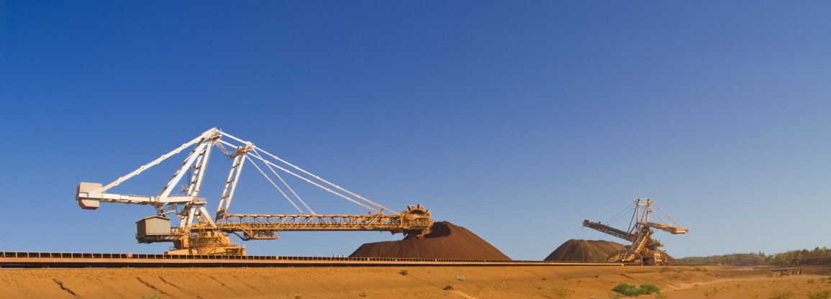
Lessons from China: Securing Gold Through Investment
India International Gold Convention 2014
September 12, 2014

Slide 2

EMC is the only Asia Based M&A Advisory focused Latin America Mining Transactions
M&A Advisory Services
We help Asian clients identify potential acquisition targets in Latin America which can allow them to expand their business
We structure deals in such a way that they satisfy the financing needs of Latin American companies as well as the investment needs and style of Asian Investors.
Once an acquisition is made EMC will help the buyer with the process of integration of the acquired company and the buyer company
Capital Raising
We help companies with assets in Latin America to raise capital from Asian investors to assist them in expanding their business and their Asian shareholder base
Buy Side Deal Origination
We provide a deal flow of Latin American deals for Asian Investors
Deals that come through our pipeline have been subject to preliminary due diligence. We look for exclusive off-the-market deals for our investors

Slide 3
Chinas procurement of gold is driven by state owned companies
China and India are different in that the drive for overseas natural resources procurement in China is been driven by government owned companies with strategic objectives rather than profits.
India is driven by private companies whose primary objective is to create returns for share holders.
China aggressively looking to become a major player international player for precious and base metals
The Chinese government main objective is to avoid disruptions in supply and to shelter against price volatility, they also want to prop their currency as they are slowly liberalizing the RMB.

Slide 4
Gold has significant strategic importance for China
Form of savings for citizens
Very significant for Chinese Government as they prepare to internationalize the RMB
They want to eventually liberalize the RMB and prop their currency with gold to a significant ration, far beyond that of western countries
China is very secretive about their imports of gold as the US thinks they artificially devalue the currency which creates a huge trade deficit for the US
The recent creation of the BRICS Bank and the Shanghai Cooperation Organization significant

Slide 5
China is becoming one of the most important mining investors in the world
China is becoming one of the most important mining investors in the world
Chinese´s main objective is to secure natural resources, and gold and copper are viewed by the government as the No. Strategic commodities, essential to the growth of the Chinese Economy
Government, the direct investment from China has been growing from US$1.8 billion dollars in 2004 to US$13.3billion dollars in 2009.
Total outbound investment has reached US$54.66 billion dollars in the past 10 years

Slide 6
How are Chinese Securing Natural Resources Overseas?
1
Traditionally Chinese Investors had made majority acquisitions at the asset level. However, In recent years there have been a growing number of Chinese and other Asian investors taking minority stakes in companies.
The level of sophistication of these investments reflects how Chinese companies are understanding better western capital markets and see the benefit of becoming share holders in companies which hold assets they might be interested in buying in the future or merely for financial gain purposes.
Growing
Equity Investments
2
Strategic & Financial
Investments

Slide 7
Investment Modalities
Equity or Asset Take Over
Convertible Debt
Gold Pre-payment
JV
Short Term Loan

Slide 8
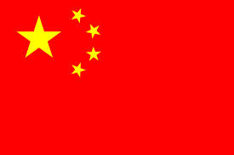
Case Study 1 – Shandong Gold Acquire Focus Minerals
FOCUS MINERALS Raises $227.5M THROUGH PLACEMENT TO SHANDONG GOLD
Investment by Shandong Gold to provide Focus with a robust balance sheet and the backing and expertise of one of China’s three largest gold producers
Placement proceeds to support Focus’ goal of becoming a +500,000oz gold producer
Placement price of 5 cents per share represents a premium of 28%
Shandong Gold will own 51% of Focus on a fully diluted basis
Shandong Gold International Mining (600547:Shanghai)
Buys 51% stake (AUD $227.5 M)
Focus Minerals
(ASX:FML)

Slide 9
Case Study 2 – Sun Investments Acquire Admiralty Resources
Sun Investments acquires initially a 10% stake
Through placements in subsequent rounds they rise their stake to 30% + Board Representation and Management Control.
The company originally owned a copper asset in Chile
After acquiring a controlling stake they beging to look for other assets to inject into the company
Sun Investments
Private Group China
Buys 30% Stake
Admiralty Resources
(ASX:ADY)

Slide 10

Case Study 3 – China Blue Chemical Invests in Western Potash.
China Blue Chemical acquire a 19% stake in Western Potash
Board respresentation and control of CFO Office
Accompanied by an MoU to supply Capex to develop projects
Accompanied by a preferential off-take agreement
Company will increase equity position over time
China Blue Chemical
(3983:Hong Kong)
- Buys 19% Stake
(C$ 32 M)
- Off-take agreement and MoU to supply project finance
Western Potash
(TSX:WPX)

Slide 11
Case Study 4 – Canarc Resources acquires Santa Fe Resources through Gold Bond
Features:
Underwriting USD22 Million Debt Facility:
Bond pays investor 8% interest per annum
Security against mining title
At the tend of the loan period investor gets principal by way of delivery of physical gold at a preferential price.

Slide 12
Sample Chinese, Hong Kong and Indian equity investments
China Blue Chemical
(3983:Hong Kong)
Sun Investments
Private Group China
Regent Pacific Group Ltd (575:Hong Kong)
Wuhan Iron & Steel
China SOE
(600005:Shanghai)
- Buys 19% Stake
(C$ 32 M)
- Off-take agreement and MoU to supply project finance
- Buys 40% Stake
(USD $40 M)
- Off-take agreement
Buys 30% Stake
Buys 9% Stake
Admiralty Resources
(ASX:ADY)
Century Iron Mines
(TSX:FER)
Condor Gold
(AIM:CNR)
Western Potash
(TSX:WPX)

Slide 13

Sample Chinese, Hong Kong and Indian equity investments
Winsway Coal
(1733:Hong Kong)
Shandong Gold
SOE China
GVK
Private India
Regent Pacific Group Ltd (575:Hong Kong)
Buys 60% Stake
(USD $600 M)
Buys 17% Stake
(USD $3 M)
Buys 79% Stake
(USD $1.26 Billion)
Buys 3.59%
(AUD $30 M)
Grande Cache Coal
TSX (now delisted)
Kalahari Resources
(TSX-V: KLA)
Hancock Coal
ASX (now delisted)
Bannerman Resources Limited
(ASX:BMN)

Slide 14
Sample Chinese, Hong Kong and Indian equity investments
Ansteel Group
China
Jilin Jien Nickel Industry Co.
(600432:Shanghai)
Chengdu Tianqi
China
Shandong Gold International Mining (600547:Shanghai)
52.16% of major Iron Ore project
(AUD $39 M)
Take over approved from 19.9% ownership
(C $847 M)
Buys 51% stake (AUD $227.5 M)
Buys 19.1% stake
Gindalbie Metals
(ASX:GBG)
Metallica Minerals
(ASX:MLM)
Talison Lithium Limited
(TSX:TLH)
Focus Minerals
(ASX:FML)

Slide 15
Sample Chinese, Hong Kong and Indian equity investments into TSX and ASX listed companies
Minmetals
(1208:Hong Kong)
Sinosteel Corporation
Minmetals
(1208:Hong Kong)
Yanzhou Coal Mining Company
(1171:Hong Kong)
Buys 82% stake (C $1.3 Billion)
Takeover (USD $905 M)
Buys 5% stake (AUD $12 M)
Takeover (AUD $3.5 Billion)
Midwest Corpoation
ASX (now delisted)
Anvil Mining
TSX (now delisted)
Havilah Resources
(TSX:HAV)
Felix Resources
ASX (now delisted)

Slide 16
What are the best jurisdictions to invest in world-wide?
2010 worldwide investment in exploration (USD Billion)
Mexico advanced two spots to become de 4th most attractive place in the world and 1st in Latin America in terms of investment in mining exploration, behind only Canada, Australia and United States.
According to the Metals Economics Group, Mexico attracted 6% of the worldwide investment, equaling $641 million USD.
$641 M

Slide 17
Mining Industry in Mexico
Mining Investment in Mexico (US million)
Mining Numbers
Annual Production Value | $20,148 million
Mining Investment | $7.647 million
Currency Generated | $22,526 million
Source: Camimex
Highest figure ever for mining investment in Mexico with $7,647 million in 2012.
The total for the 2007-2012 period ascended to $25,245 million.
4th highest currency generating sector in the country.
Source: Camimex
Currency Generation in Mexico (US million)
Mining Employment
2012 direct jobs | 332,000
2012 indirect jobs | 1,600,000
2,000,000 Mexican families live off the mining industry.
Source: Camimex
Source: Camimex

Slide 18
Mining Industry in Mexico
Annual production worth: $20,148 million USD.
GDP: 1.6%
Jobs:
  - Direct: 332,000
  - Indirect: 1,600,000
Mining investment 2012: $7,647 million USD (+36%)
Minerals within Top 10 worldwide production: 18
1st
Silver (19.8%)
2nd
Fluorite (19%)
5th
Lead (4.95%)
7th
Zinc (5.06%)
10th
Gold (3.27%)
10th
Copper (2.7%)
Source: Camimex

Slide 19
Gold
2004-2011 gold production (ton)
Gold Production by State (oz)
Sonora | 883,500 (31%)
Zacatecas | 541,500 (19%)
Chihuahua | 484,500 (17%)
Durango | 285,000 (10%)
Source: INEGI
Total production in oz was 2.85 million
Mexico´s gold production per mining unit (main units)
Source: INEGI
Unit | Company | State | Oz (000´s)
Los Filos | Goldcorp | Guerrero | 306.1
El Coronel | Minera Frisco | Zacatecas | 175
Peñasquito | Goldcorp | Zacatecas | 168.2
La Herradura | Fresnillo Plc | Sonora | 162.9
Mulatos | Alamos Gold | Sonora | 156
El Sauzal | Goldcorp | Chihuahua | 152
Largest Players:
Goldcorp Inc., Canada
Fresnillo Plc., Mexico
Minera Frisco, Mexico
Agnico Eagle Mines Ltd., Canada
Gammon Gold Inc., Canada
Source: INEGI

Slide 20
Total Gold Production is 2.8 Million Ounces annually

Slide 21
About EMC
Emerging Markets Capital is a Hong Kong based boutique M&A Advisory Firm, dedicated to connecting Asian Investors with quality investment opportunities in Latin America.
Our area of expertise is exclusively in natural resources. We focus on Mexico, Colombia and Brazil.
Contact
Email: infor@emarcap.com
21st Floor, Fairmont House
8 Cotton Tree Drive
Central
Hong Kong, SAR China
Phone number: (852) 61030227
Fax: (852) 25220882
www.emarcap.com

